Slide 1

We'll give everyone a few minutes to join and get settled.
Please remain muted unless you want to speak.
Notes:
Jackie

Slide 2
Creating Impactful and Innovative Team Science Workshops
Laura Hildreth, MS
Jackie Knapke, PhD
Jack Kues, PhD
Angela Mendell, MS
Stephanie Schuckman, MA
Notes:
Jackie

Slide 3
Technology Overview
  If you’re using a webcam, check your angle
  Mute yourself
  Know how to unmute yourself
  Chat to “Everyone”
  Answer a poll
Notes:
Jackie

Slide 4
Learning Outcomes
At the end of this workshop, you should be able to:
Understand the fundamentals of adult learning when teaching team science and the science of teams.
Describe and apply principles for developing cross-disciplinary team science workshops.
Develop actionable evaluation strategies.
Notes:
Jackie
We usually include a slide on learning outcomes because people in an academic environment expect them, but we usually provide a more informal overview of the kind of experience we're trying to provide so they know what to expect.

Slide 5
Workshop Overview
Five key principles:
  Developing and integrating “pre-work”
  Incorporating adult learning principles
  Balancing didactic and “hands-on” components
  Promoting participant self-reflection
  Actionable evaluation strategies
Notes:
Jackie
About this workshop: we're going to walk you through a model that we go through when we create our workshops. We've modified it over the years. Our workshops are designed to engage learners, help them reflect on their experiences and learn some info and skills that they can take back to their workplace. We warn them we expect them to engage and participate actively in activities and discussions. The same is true for you in this workshop. :)
Hand over to Angela

Slide 6
How often do you incorporate pre-work into your workshops?
Pre-work, what’s that?
Never
Seldom
Occasionally
Frequently
Always

Slide 7

What is pre-work
Collected prior to workshop
  Registration information
  Assessments
  Surveys
  Reading material
Notes:
Angela
Intro to concepts first?
Then hit on the process, rationale….
What it is and why we do it
List prework in a column and then what it does
go into the example slide where I'm going to have a table, I'm probably going to incorporate this. Why'd we do it? The benefits ended up table a little bit. So for the stuff that, that's just the rest of it. I have a logistics slide. How does it work? What the timing is, you know, like the actual how to piece and like that. Yeah. And then lessons learned pointers, things that we, you know, get in. This can be incorporated above if we want to do that.

Slide 8

Purposeful Pre-work
Learn about audience
  Who they are
  What their needs are
Time efficient
Notes:
Angela

Slide 9
Who’s here today?

Slide 10
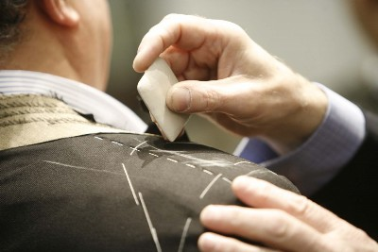
Purposeful Pre-work
Workshop customization
  Informs content
  Activity design

Slide 11
Example: Communication Styles Assessment
Logical
Analytical
Fact Based
Quantitative
Holistic
Intuitive
Integrating
Synthesizing
Organized
Sequential
Planned
Detailed
Interpersonal
Feeling-Based
Kinesthetic
Emotional
Highlights different styles
  4 colors
The Whole Brain Business Book
  By: Ned Herrmann

Slide 12
Example: Communication Styles Assessment
Style breakdown
Spend more time
Are attendees a team
Opposing styles
Group 1
Group 2

Slide 13

Pre-work in Action
Integrated into workshop
Report in aggregate
Engages attendee
Connects material

Slide 14
Pre-work versus Polls
Pre-work
Introduces attendees
Directs content
Polls
Dynamic
Moderate compliance
Further refinement
Higher compliance
Unique,
customized
workshop

Slide 15

Pre-work Post Workshop
Attendees get their results
Can use for evaluation
Improves future workshops

Slide 16

Logistics & Timing
Decisions, Decisions
Which platform should we use?
What pre-work would be best?
What’s our timeline?
Notes:
Add emails, timing, lead time, access,
REDCap, different platforms and why. Differences/functionality
Communication management

Slide 17
Pre-work
Information Gathering
Brevity
It’s a balance
Only a portion will complete
Avoid required readings
Notes:
Add emails, timing, lead time, access,
Communication management

Slide 18

Build it
Platform
Timeline
Design
Content
Notes:
Add emails, timing, lead time, access,
Communication management

Slide 19

Test it
Functionality
Wording, spelling, typos
Ask others

Slide 20

Send it
Give time to complete
Send reminders
Provide a deadline
Give time to analyze data

Slide 21
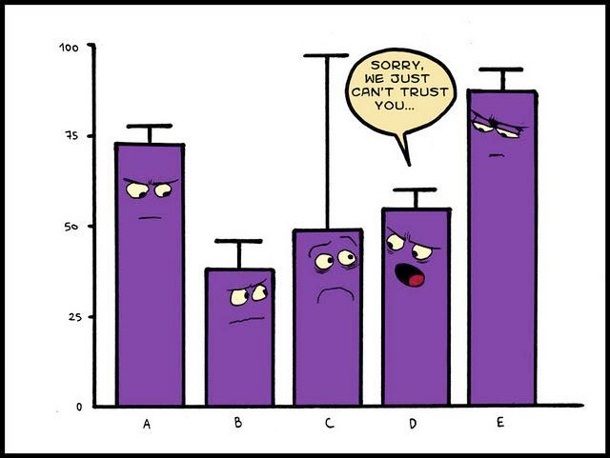
Incorporate it
Analyze pre-work
Consider content
Display data

Slide 22
Project Management
Build
Send
Analyze
Incorporate
Test
1-2
Weeks
1-2
Days
1-2
Weeks
1-5
Days
1-5
Days

Slide 23
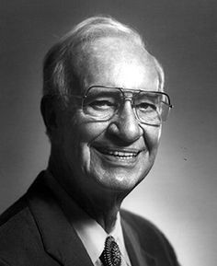
Principles of Adult Learning
 | Greek root | Meaning
Pedagogy | paid + agogus | children + leader of
Andragogy | andr + agogus | man (vs. boy) + leader of
Malcolm Knowles is best-known for developing this theory in the mid-late 20th century.
Notes:
Jackie

Slide 24

Andragogy Model:
6 Key Principles
Adults need to know why they should learn something
  How will it benefit them?
2. An adult’s self-concept is different
from a child’s
  Children’s self-concept: dependency
  Adults’ self-concept: self-direction
Notes:
Jackie

Slide 25
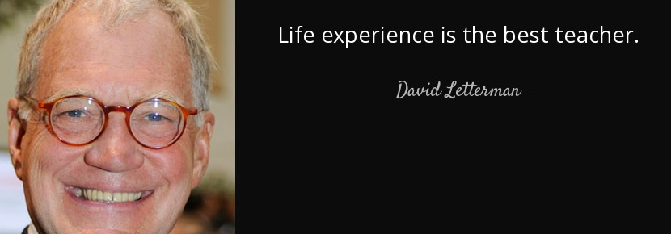
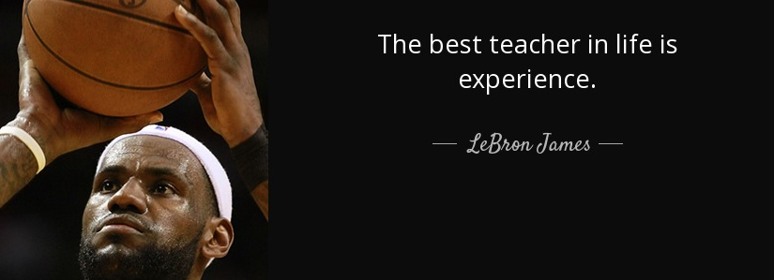
Andragogy Model:
6 Key Principles
3. Adult learners place high value on
their own and others’ experience
  Experience is its own form of expertise
4. Adults bring a different “readiness
to learn” than children
Notes:
Jackie

Slide 26
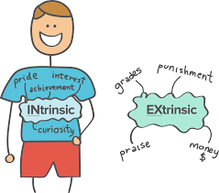
Andragogy Model:
6 Key Principles
5. Adults approach learning with a
problem-based orientation
6. Adults are more intrinsically
motivated to learn
Adult priorities: increased job
satisfaction, self-esteem, sense of
accomplishment, quality of life
Notes:
Jackie

Slide 27
Case Example:
Andragogy Principles and Team Science Training
Fall 2016:
  Our first series of 3 workshops: Creating & Assembling a Team, Effective Teams, Leading Effective Teams
  Participants were required to attend as a condition of an internal grant award
  We realized early in the first workshop, many were unhappy about being there, thought they already knew how to work effectively in teams
  Some (particularly senior faculty/PIs) felt insulted that they were forced to attend, felt it was a waste of time
Notes:
Jackie

Slide 28
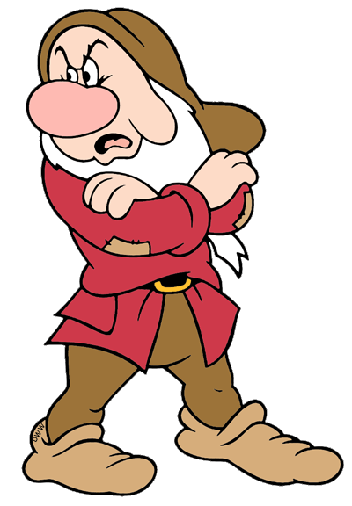

Case Example:
Andragogy Principles and Team Science Training
Adults “need to know” why they should learn something
Participants didn’t understand why they were required to be there, why they needed to learn what we were trying to teach them
An adult’s self-concept is different from a child’s
Violated their self-concept of “self-directed” learning
Notes:
Jackie

Slide 29

Case Example:
Andragogy Principles and Team Science Training
  We had to pivot in the last two workshops to incorporate adult learning principles
  Some benefits:
    Some were early in team formation
    Participants came in their real teams
    Organized around specific research topics
Notes:
Jackie

Slide 30

Case Example:
Andragogy Principles and Team Science Training
  3. Adult learners place high value on their own and others’ experience
  Allowed some of the more seasoned researchers to lead discussions or present solutions to team problems
      Example: Team Charters
Notes:
Jackie

Slide 31

Case Example:
Andragogy Principles and Team Science Training
  4. Adults bring a different “readiness
  to learn”
  Focused on topics that were useful to them in their immediate work lives
      Example: Develop a Team Communication Plan
Notes:
Jackie

Slide 32
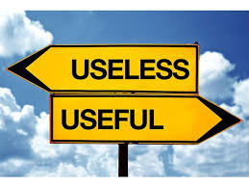
Case Example:
Andragogy Principles and Team Science Training
5. Adults approach learning with
a problem-based orientation
Developed activities that allowed participants to solve (or pre-solve) problems on their teams
    Example: 5 Dysfunctions
Notes:
Jackie

Slide 33
Case Example:
Andragogy Principles and Team Science Training
Logical
Analytical
Fact Based
Quantitative
Holistic
Intuitive
Integrating
Synthesizing
Organized
Sequential
Planned
Detailed
Interpersonal
Feeling-Based
Kinesthetic
Emotional
6. Adults are more intrinsically
motivated to learn
Introduced content that contributed immediately to their sense of accomplishment as an individual and/or a team
    Example: Communication Colors
Notes:
Jackie

Slide 34

Large Group Chat/Discussion
Think back to workshops you have attended or hosted.
Now that you know a bit more about andragogy, what are some specific ways you can incorporate it into your future workshops?
Type your ideas in the Chat.
Andragogy Principles:
Adults:
need to know why they should learn something
have a different self-concept from children
place high value on their own and others’ experiences
bring a different “readiness to learn”
approach learning with a problem-based orientation
are more intrinsically motivated to learn
Notes:
Jackie

Slide 35

Interactivity
What is an interactive workshop?
Engages people energetically in learning new information or techniques.
  Apply new information
  Analyze problems and figure out solutions
  Share experiences and ideas
How to Conduct an Interactive Workshop; Marva A. Barnett, Founding Director and Professor, Teaching Resource Center, University of Virginia Faculty, Department of French
Notes:
Laura
An interactive workshop engages people actively in learning new information or techniques.
It allows your attendees to
Apply the information you’re sharing with them
Analyze problems or challenges and figure out solutions
And it gives them the opportunity to Share their experiences and ideas

Slide 36
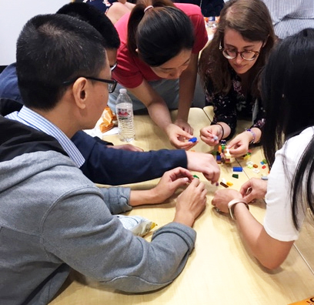
Interactivity
How do you prepare an interactive workshop?
  Know your audience
  Analyze your material / information
  Plan a balance of didactic and hands-on workshop components
    Present key information about Team Science
    Offer an opportunity to apply the material IRL
    Keep didactic sections under 15 minutes
Notes:
Laura
As we discussed in the section on Prework, it’s important to know your audience. Who are they, where are they from, what’s their area of expertise?
Once you know who they are, you can tailor the content to their needs, including didactic and hands-on components that are applicable to them.
The secret to success here, is to balance the two so that your audience takes away key information about team science, but also has the opportunity to experience that new information IN REAL LIFE - in the form of hands-on learning activities, as well as open discussion about that experience.
The takeaway here is that we try to talk for no more than 10-15 minutes before we ask participants to “do” something

Slide 37

Didactic sections are “informationally efficient”
- but they can be boring.
Notes:
Laura
During the didactic section of a workshop, you can impart a lot of information in a very efficient way – you just explain what you want them to know (and hope they’re listening).
But often, when it comes to Powerpoints, we always add photos, cartoons, videos, little pictures of people sleeping…anything we think will keep the audience awake, but it’s still, for the most part, a one-way conversation.
Too much talking could keep your participants from internalizing what you’re hoping they’ll learn from your workshop.

Slide 38
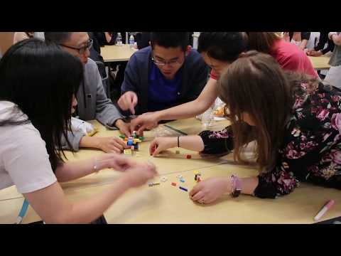
Interactivity
  Activities can help participants process the information in a meaningful way
  It’s a balance of practical aspects and learner engagement
    Be sure to budget enough time
    Stay in control of your audience
How To Team Your Dragon
Notes:
Laura
Interactivity is important because it increases the learning power of the experience,
So we aim for a balance of practical aspects and learner engagement
But Interactivity does tend to use up a lot of time on the clock.
It’s hard to judge how long it will take – for people to learn what you’re trying to teach them
(not to mention the logistical need to organize small groups, introduce an activity, and give them time to work together)
Remember to stay in control of the time, because if the discussion is going really well, you may not want to break up your groups of actively engaged participants.

Slide 39

Interactivity
Take workshop literally:
Engage participants in identifying problems and coming up with possible solutions
Stimulate their understanding by letting them employ new tools in small groups
Notes:
Laura
In a Team Science workshop, you might ask the audience to brainstorm the challenges related to communication, diversity, or trust.
Or you could present some possibilities and ask participants to supplement them with their own ideas
Or you could ask for personal stories about unsuccessful attempts to meet these challenges, and then, in large group discussion, construct a list of pitfalls to avoid.
After the audience is actively thinking about possible solutions, you introduce your techniques and tools. This section of the workshop works best if participants practice at least one of the techniques with each other in small groups.

Slide 40

Interactivity
Focus
on Results
ACTIVITY
Create an activity to stimulate understanding of team science techniques (communication, conflict management…) (5 min)
DISCUSSION
Presentations and discussion about the activities created by each group (5 min)
Embrace
Accountability
Achieve Commitment
Master Conflict
Build Trust
Notes:
Laura
I am now going to ask you to gather back into your small groups to co-create an activity that will
stimulate understanding of team science techniques that help meet the challenges of team dysfunction.
After you’ve thought up some possible ideas for activities, we’ll come back together so you can share your ideas with the larger group.

Slide 41
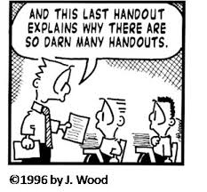
Interactivity
Prepare a handout
Note your main points
When should you distribute it?
  Before: good for notetaking during the workshop
  After: summary of main points might distract participants from focusing on the process of the workshop
Notes:
Laura
If your workshop involves interactivity, your audience might too busy having fun to take very many notes.
So, you might want to make sure they have the information provided in a handout to review later if they need it.
So - create a handout that outlines your main points and, in it, describe your tools and techniques well enough for someone to make sense of them later.
These notes will also be useful for someone watching your workshop on a video, sometime in the future.
You’ll also need to decide if you want to distribute your handout at the beginning of the workshop or at the end.
Each way offers a different advantage. Some participants find it useful to take notes on a handout, completing it as the workshop progresses.
But others, might focus too much on the notes, and lose focus on the process of the workshop.

Slide 42

Interactivity
Tell them what is planned
Announce the interactive nature of the workshop
Let them know that their experiences and expertise matter to you
Notes:
Laura
This is maybe something you would think that most people would expect – to participate in hands-on activities and group discussions during a workshop.
But it’s good practice just to Give them a head’s up…
And let your participants know early on - that their experiences and expertise matter to you - and that you plan to engage them in open discussion and idea exchange.
TOTAL TIME (without discussions) 5:29

Slide 43
Number of Workshops Developed in the Past Year

Slide 44
Mean Scores on Assessment Questions
Notes:
Jack

Slide 45
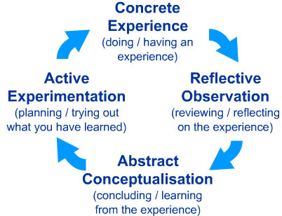
Kolb’s Cycle of Experiential Learning
Notes:
Jack

Slide 46
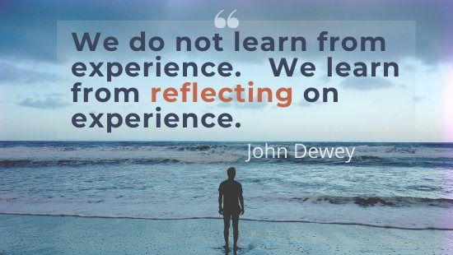
Notes:
Jack

Slide 47
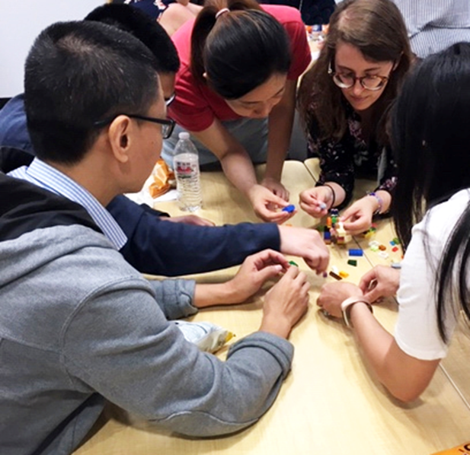
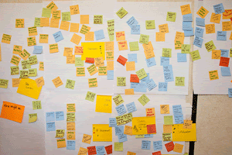
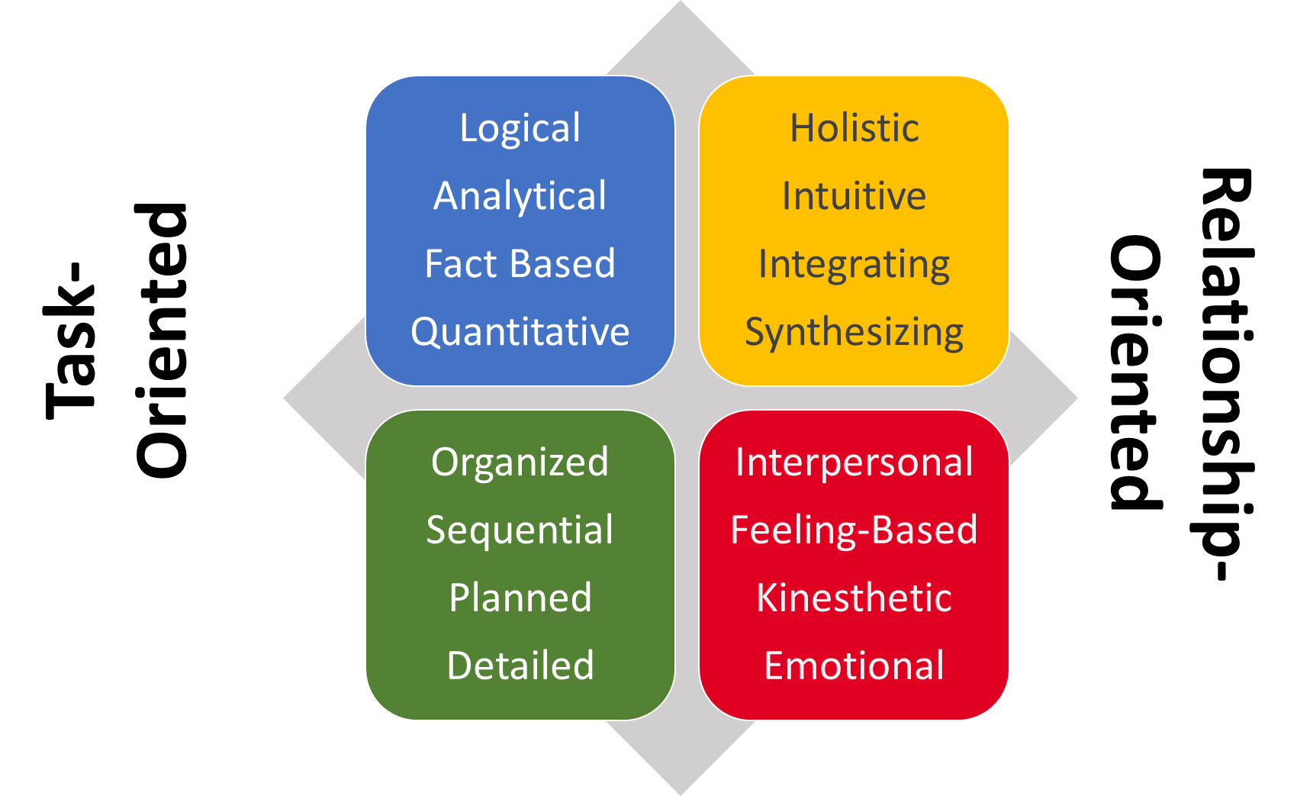
Hiding in plain sight
Reflective Observation
Concrete Experience
Abstract Conceptualization
Notes:
Jack

Slide 48
Facilitating Reflection: Some good catch phrases
“Think of an experience where your new knowledge would have helped you better understand what was happening.”
“How can you use your new skills to improve a situation you’re currently struggling with?”
“With your new knowledge, how can you avoid a common problem in the future?”
“How can you re-interpret some of your recent experiences?”
“If I knew then what I know now, I would have……..”
Notes:
Jack

Slide 49
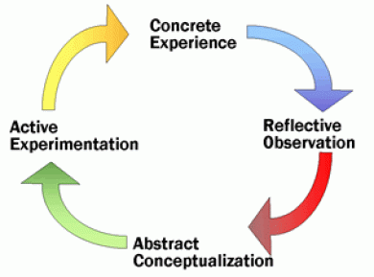
Notes:
Jack

Slide 50
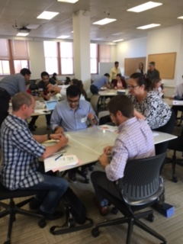

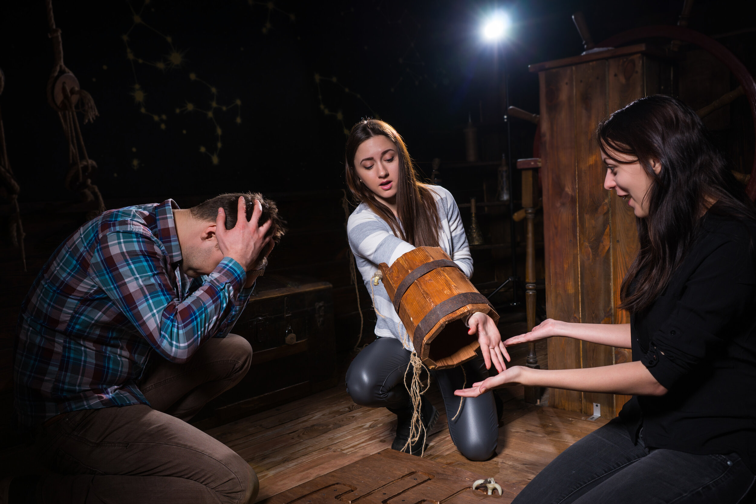
Try it out…….
Notes:
Jack

Slide 51
Reflection on Self-Reflection: Some things we’ve seen and heard
Grounding attendees in their own experiences
Attendees are not always willing to share their experiences
“Note-takers”- It’s all about learning something new
  We provide copies of slides and handouts and discourage too much note-taking
Overcoming “I can’t do this because……”
Helping people gain control of themselves and their surroundings
Notes:
Jack

Slide 52
Evaluation: We love it when they love us
Standard Evaluation Strategies
  Post-activity evaluations
  Long-term follow-ups
A Step Beyond
  Faculty de-briefs
  Observers
Notes:
Jack
Review attendee feedback and also debrief among the faculty who were there to critique what went well, what didn't.

Slide 53
Impact Metrics: A deeper dive
Consultations from workshop attendees
Requests for customized workshops
Notes:
Jack

Slide 54
Workshops and Consultations 2016-2019
Notes:
Jack

Slide 55
General and Customized Workshops 2016-2019
Notes:
Jack

Slide 56
A Quick Summary
Five key principles:
  Developing and integrating “pre-work”
  Incorporating adult learning principles
  Balancing didactic and “hands-on” components
  Promoting participant self-reflection
  Actionable evaluation strategies
Notes:
Jack – Here are the key things we just covered. Key take-aways. Leave these key points on the screen and then open up for Q&A, comments

Slide 57


Slide 58
Thank you!
Visit our website for more Team Science resources:
  https://www.cctst.org/programs/cis
Contact us with questions:
  laura.hildreth@uc.edu
  jackie.knapke@uc.edu
  jack.kues@uc.edu
  angela.mendell@uc.edu
  stephanie.schuckman@uc.edu

Slide 59
Selected References
Barnett, M.A. How to Conduct an Interactive Workshop. University of Virginia
Teaching Resource Center. https://faculty.virginia.edu/marva/Teaching%20Workshops/conduct_workshop.htm
Herrmann, N. & Herrmann-Nehdi, A. (2015). The Whole Brain Business Book, 2nd
ed. McGraw-Hill.
Kolb, D. A. (1984). Experiential learning: Experience as the source of learning and
development (Vol. 1). Englewood Cliffs, NJ: Prentice-Hall.
Knowles, M. S. (1984). Andragogy in Action: Applying Modern Principles of Adult
Learning. San Francisco, CA: Jossey-Bass.
Knowles, M. S., Holton III, E. F., & Swanson, R. A. (2011). The Adult Learner. Oxford,
UK: Elsevier.

