Slide 1
Welcome
THE ART & SCIENCE OF COLLABORATION
We will
Begin Shortly
Notes:
Hi everyone and welcome to THE ART & SCIENCE OF COLLABORATION

Slide 2
Check webcam angle
Locate mute/unmute
Locate chat
Locate polling
TECH
CHECK

Slide 3
This is a WebEx Recording
The video will show:
Slides
Video of person speaking

Slide 4
The Art and Science of Collaboration: Building Your Toolkit
September 8, 2020
Megan Lamkin, PhD
Jack Kues, PhD
Developed by the Center for Improvement Science (CIS)
Notes:
I’m Megan Lamkin, UC’s Program Director for Undergraduate Research and I’ll be facilitating the art and science of collaboration with my colleague Dr. Jack Kues, director of Uc’s Center for Improvement science, in College of Medicine. Jack would you like to say hello?
Jack: Hello, I’m Jack from the Center for Improvement Science, which is focused on enhancing the productivity of research teams through multidisciplinary networking, training, and consultation. I’ll look forward to talking more with you later.
Make a point of Team Science and Science of Team Science: STUDIES HAVE SHOWN....TOOLS (will mention on slides 6-7)

Slide 5
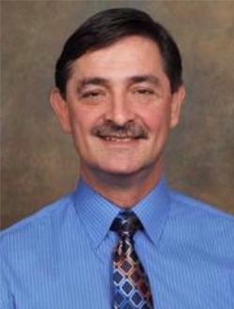
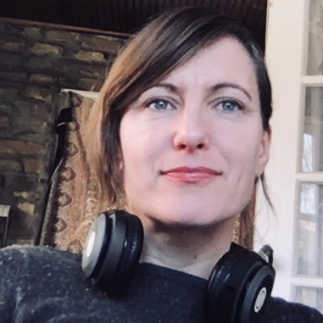
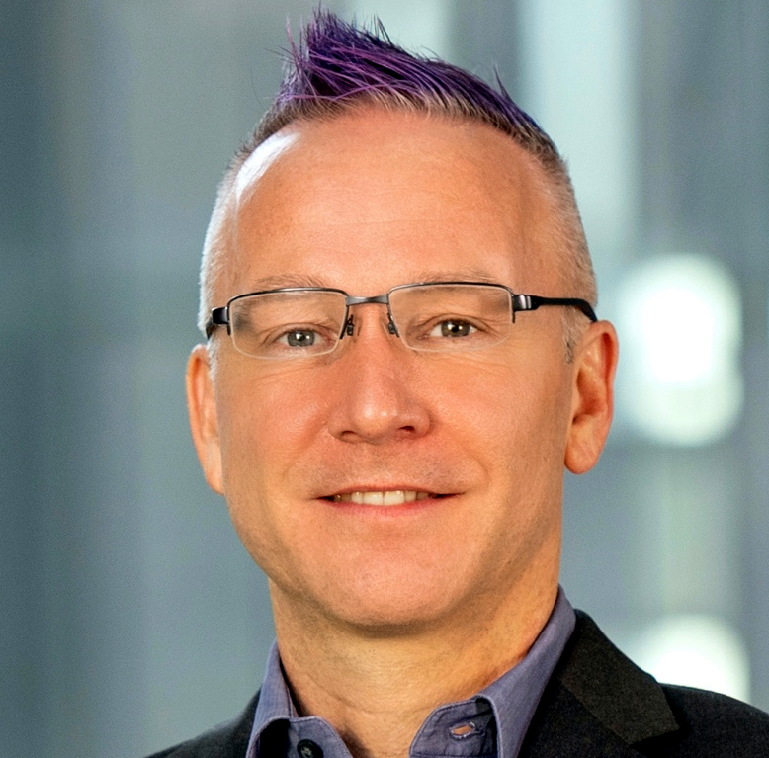
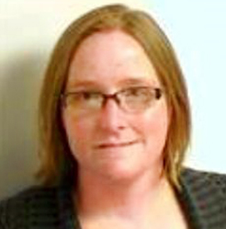
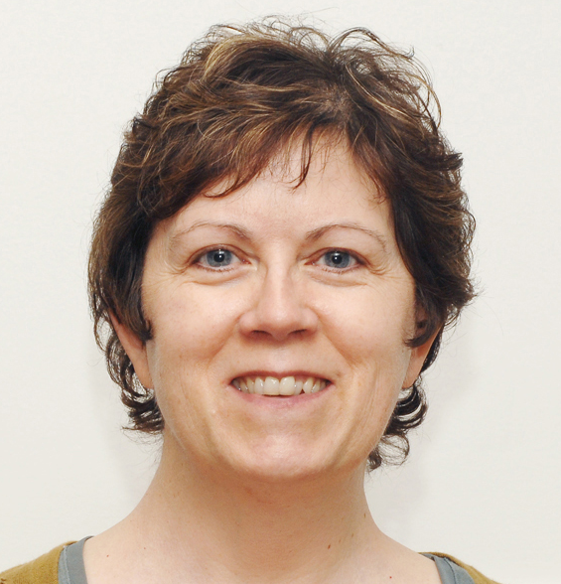
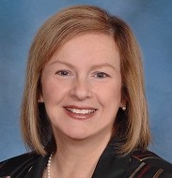
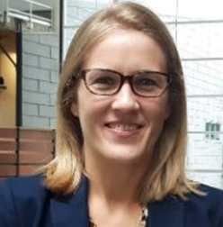
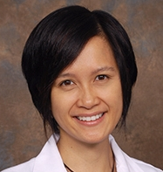
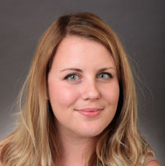
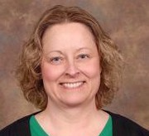
Our Team
Jack Kues, PhD
Associate Dean, Continuous Professional Development
Megan Lamkin, PhD
Assistant Professor, Undergraduate Research
Jason Blackard, PhD
Professor, Internal Medicine
Angela Mendell, MS
Program Manager, Center for Improvement Science
Laura Hildreth, MS
Program Director, Center for Improvement Science
Stephanie Schuckman, MA
Program Manager, Center for Improvement Science
Rebecca Lee, PhD, RN
Associate Professor, College of Nursing
Jackie Knapke, PhD
Associate Director, Continuous Professional Development
Jennifer Molano, MD
Associate Professor, Neurology and Rehab Medicine
Megan Johnstone, PhD
Postdoctoral Fellow, CCHMC
Elizabeth Kopras,
Sr. Research Associate, Internal Medicine
Soni Regan, PhD
Assistant Professor, Family Medicine
Notes:
We are part of a larger team, which was built as part of a college of medicine initiative and is now expanding to support research teams in all colleges.

Slide 6
The Art and Science of Collaboration: Building Your Toolkit
Notes:
We call this presentation the Art & Science of collaboration because while so much is known about effective teams, achieving productivity and joy in collaborative work can be challenging.

Slide 7
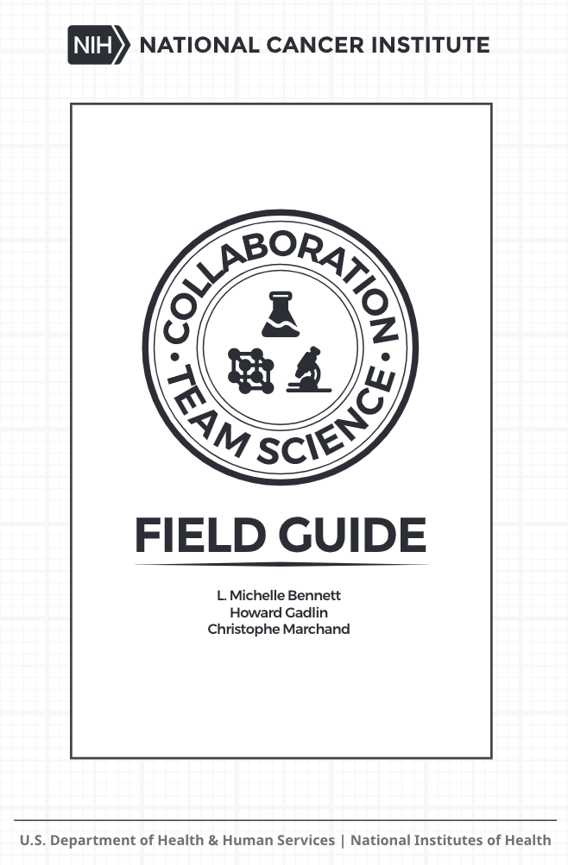
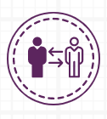
TRUST
VISION
SELF-AWARENESS
LEADERSHIP
MENTORING
Notes:
The trainings & guidance we offer are grounded in Team Science principles, which are essentially collaboration best practices for researchers. The principles were developed in the late 2000s-early 2010s when it became increasingly clear that interdisciplinary or transdisciplinary work was going to be increasingly needed to address complex 21st century problems – and many were struggling in collaborative roles. While the principles were developed to support teams in medical sciences, they are transferrable for collaborations across arts, humanities, social science and STEM disciplines. There are 10 principles and they basically say that highly effective teams have a strong foundation of trust; a shared vision; self-awareness or emotional intelligence; collaborative leadership; mentoring…

Slide 8
TEAM EVOLUTION & DYNAMICS
COMMUNICATION
RECOGNITION & SHARING SUCCESS
CONFLICT & DISAGREEMENT
LEVERAGING NETWORKS & SYSTEMS
Notes:
An understanding of team evolution & dynamics; effective communications; recognition and sharing success; conflict and disagreement; and knowledge to leverage networks and systems to transcend their organizational structure – in other words, achieving significant, far-reaching impact.

Slide 9
Megan
Reflect on whether collaboration is appropriate for your project
Identify several collaboration best practices
Determine training needs
BY THE END OF
THIS SESSION
you will be
able to…
Notes:
In this session, we hope to provide you perspective to reflect on whether collaboration is appropriate for your project; identify several collaboration best practices and begin to determin your training needs.

Slide 10
Which best describes your most recent collaboration:
We’re lucky nobody got hurt.
Inefficient and draining, but we made it.
Productive, but socially/intellectually draining.
Socially/intellectually satisfying, but not very productive
Socially/intellectually satisfying & productive.
Poll
Notes:
First I’d like to get sense of previous collaborative experience.
What has been your most common way to find collaborators?
Work with friends or people I know and like
Work with people who have the skills, knowledge, and credentials I need
I try to create a team with a lot of diversity and different views/skills
I usually am assigned collaborators and have little choice in the matter
I try to find people who will do the work
What have been your biggest challenges finding collaborators? (chat or open discussion)
What would be the most helpful tool you can think of for identifying good collaborators? (chat or open discussion)

Slide 11
Notes:
Yes collaboration involves a lot of moving parts, which means there are a lot of ways it can go wrong.

Slide 12
What are important things to consider before initiating or accepting an offer to collaborate?
Chat
Notes:
So given the consideration of your needs in a collaborative relationship, what are important things to consider before initiating or accepting an offer to collaborate?

Slide 13
Framing the WHY
Goals
Ability
Time
Enjoyment
Notes:
Yes, so addressing being thoughtful about the “WHY”
is the gateway to working alone or working with others.
Goals: What are you trying to accomplish (what is the nature of your project?)
Ability: Do you have the ability/resources to do it yourself or do you NEED others with special skills/knowledge?
Time: Sometimes it is FASTER to do it yourself (ie., no need for team discussions or debate, no need for training others, etc.)
Sometimes going it alone takes more time (ie., time-consuming tasks like gathering data or finding resources) Having more “hands” will allow you to move a project faster.
DO YOU HAVE A SHORT TIMELINE THAT IS IMPOSSIBLE TO MEET ALONE?
Enjoyment: Do you like to work in a team or do you prefer to work alone?

Slide 14
DECIDING THE WHO
Content Expertise
Project Management
Finance
Regulatory
Technology
Writing/Editing
What else to consider?
Notes:
What skills/resources do I need?
To fill in the scope of the work
To manage the work
Optimizing diversity
To be creative/innovative
To manage differences
How big of a team
Smaller teams are easier to manage
Larger teams can handle more complexity
Where do I find collaborators?
Working with your friends
Using your networks
What has been your most common way to find collaborators?
Work with friends or people I know and like
Work with people who have the skills, knowledge, and credentials I need
I try to create a team with a lot of diversity and different views/skills
I usually am assigned collaborators and have little choice in the matter
I try to find people who will do the work
What have been your biggest challenges finding collaborators? (chat or open discussion)
What would be the most helpful tool you can think of for identifying good collaborators? (chat or open discussion)

Slide 15
Optimizing Disciplinary Diversity
Notes:
This is a reminder that the more diverse you team– whether that’s diversity by discipline or lived experience – the greater potential the team has for trouble-shooting and problem-solving – but often teams with amazing potential do not achieve that potential because they are poorly managed. And with that, I’m going to hand it over to Jack who is going to walk you through some of the tips and tools for effective team management and collaboration.

Slide 16
Jack
Understanding Key Team Roles
Balancing the Functions of a Team
Building Collaborative Processes
Recognizing how Teams Form and Develop
HOW TO
BUILD & SUSTAIN
YOUR TEAM
Notes:
JACK
Faculty getting started typically have 3 big questions: how do I find students; how do I get funding; and what other forms of support are available for me and my students

Slide 17
In your experience, what is the most common reason teams fail:
Poor leadership
One or more disruptive personalities
Unclear vision or goals
General lack of enthusiasm
Lack of resources
Poll

Slide 18
Leadership and Management
Role of Leader
Role of Manager
Copes with Change
Aligns people
Motivates and Inspires
Focuses on people
Asks why
Plans long term
Copes with Complexity
Organizes people
Administrates and Controls
Focuses on systems and structures
Asks what
Plans short term
Notes:
JACK
Give this a new header (leadership isn't a tool?
Transition from Why to How
HOW WE ADDRESS LEADERSHIP IS CRITICAL
These are processes that all teams must navigate
Your Human Resource tools towards a successful collaboration
Maybe we recreate the graphic to reflect this info? Also – this is an example of where we say we are teaching people how to apply tools but we are really talking theory.

Slide 19
Functions of a Team
Task Functions
Initiating
Information seeking
Information giving
Opinion seeking
Clarifying
Elaborating
Coordinating
Developing procedures
Summarizing
Maintenance (Team) Functions
Encouraging
Expressing feelings
Having fun
Compromising
Facilitating communication
Interpreting
Listening
Following
Declaring success
Notes:
Team are constantly trying to engage in two missions: 1) Completing the task/mission of the team, and 2) Developing themselves into a more highly functioning team

Slide 20
Building Collaborative Process
Visioning Meeting
Team Assessment
Team Charter
Regular Check-Ins
Notes:
JACK
When you are thinking about collaboration, what OTHER questions do you ask yourself? (In chat)

Slide 21
What kinds of things generally cause you to really enjoy working on a team?
What kinds of things generally cause you to not like working on a team?
Chat
Notes:
Discussion questions: When you find yourself on a team (or in a collaboration) that you do not like, what do you do?
What kinds of things generally cause you to not like working on a team
What kinds of things generally cause you to really enjoy working on a team
If you had a choice between being a leader or a manager, which would you prefer? (Poll)
Leader
Manager
Either
Neither
In your experience collaborating and working in teams, which of the following describes your experience with balancing team functions? (Poll)
Much more task focused
Slightly more task focused
A good balance between task and maintenance
Slightly more maintenance focused
Much more maintenance focused

Slide 22
Share Ideas
Share Ideas
Agree on Goals
Visioning Meeting
TOOLS
Notes:
JACK Framework we provide to develop a Vision or Goal
Creating a Shared Vision (and here's what I mean by "Vision")
What are we doing? We want to identify a goal
Bring everyone together to share a goal, vision, direction
Starting with something in common
Tools:
Visioning Meeting to Create a Vision – best practices?
CHANGE THE WORDS TO: Share, Negotiate, Agree; develop a Statement
Sharing, engagement, negotiation, wiifm,
All part of how you would conduct a visioning meeting (framework)

Slide 23
Team Readiness assessment
Roles and responsibilities
Communication Styles assessment
Team
Assessment
TOOLS
Notes:
JACK
https://www.ncfp.org/wp-content/uploads/2018/11/Pretty-Good-Tool_collaboration-readiness-pretty-good-tools-for-collaboration-strategy-and-partnership.pdf
https://www.inscits.org/collaboration-readiness
https://dalspace.library.dal.ca/bitstream/handle/10222/72149/Murdoch-Jennifer-PhD-IDPhD-July-2016.pdf?sequence=1&isAllowed=y

Slide 24
Appreciate Diverse Communication Styles
Logical
Analytical
Fact Based
Quantitative
Holistic
Intuitive
Integrating
Synthesizing
Organized
Sequential
Planned
Detailed
Interpersonal
Feeling-Based
Kinesthetic
Emotional
Relationship-Oriented
Task-Oriented
Notes:
JACK
What color are you?
When working in teams what color is the person(s) that has been most difficult to work with?
Change Diverse to Different

Slide 25
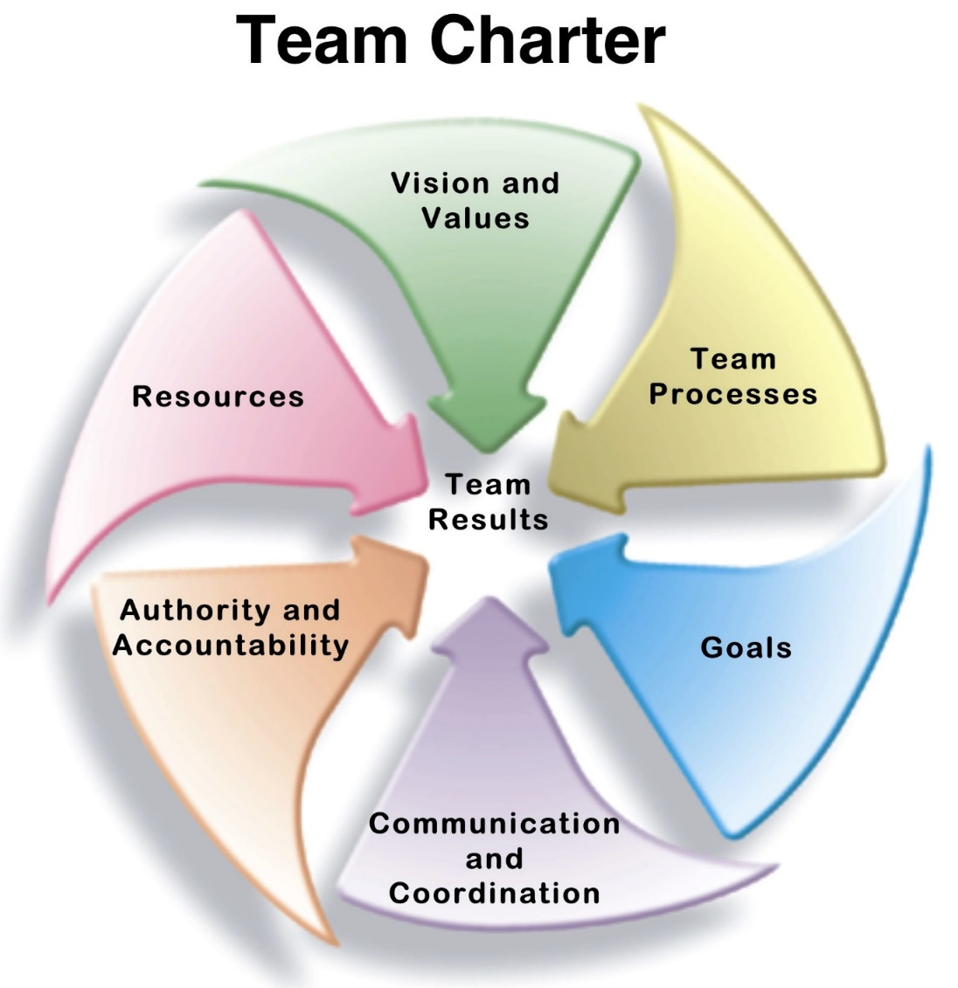
Team
Charter
TOOLS
Notes:
JACK
Avoiding problems down the road (Risk assessment)
Add links to resources for Team Charter Tools

Slide 26
Team Process Checking and Productivity
Collaboration software
Tuckman's Model
Regular
Check-Ins
Team Maintenance
5 Dysfunctions Framework
Conflict Mitigation Framework
CliftonStrengths Assessment
TOOLS
Notes:
JACK
Team Maintenance (relationships) v Tasks (project management)
Process check-in
See if what you're doing is productive but also meeting the goals

Slide 27
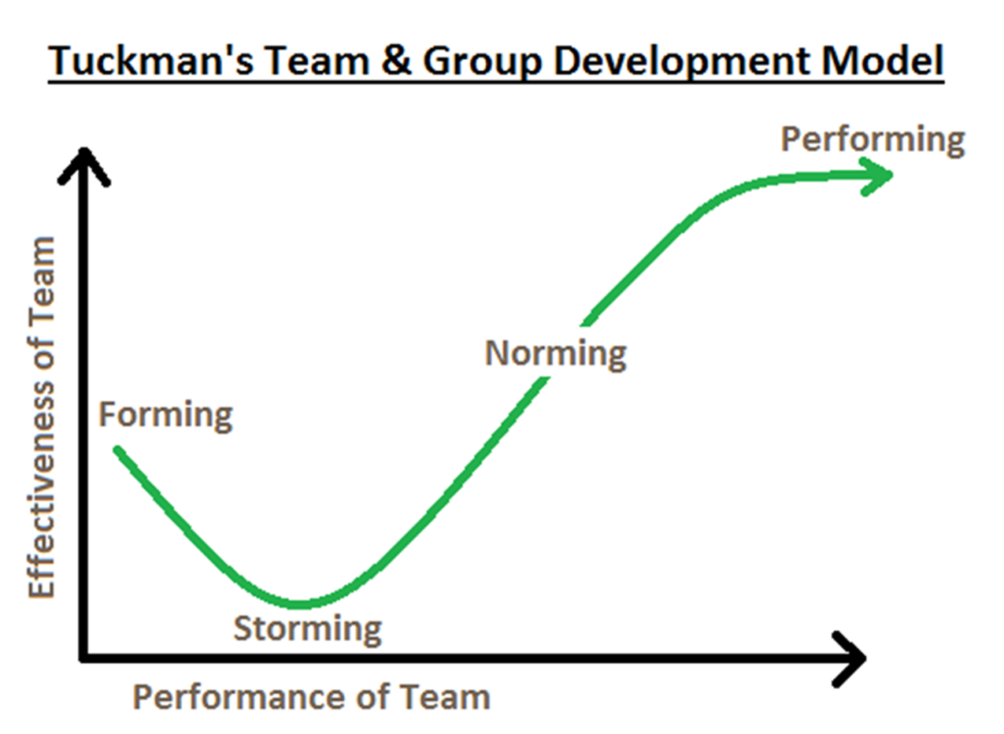
Team Function and Dysfunction
Notes:
JACK
Here's SCIENCE!
How many times did you think you were going to fail (early on) and then things took off.
Plot where your team is on the chart, and where you're going next

Slide 28
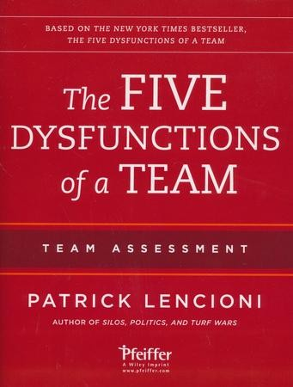
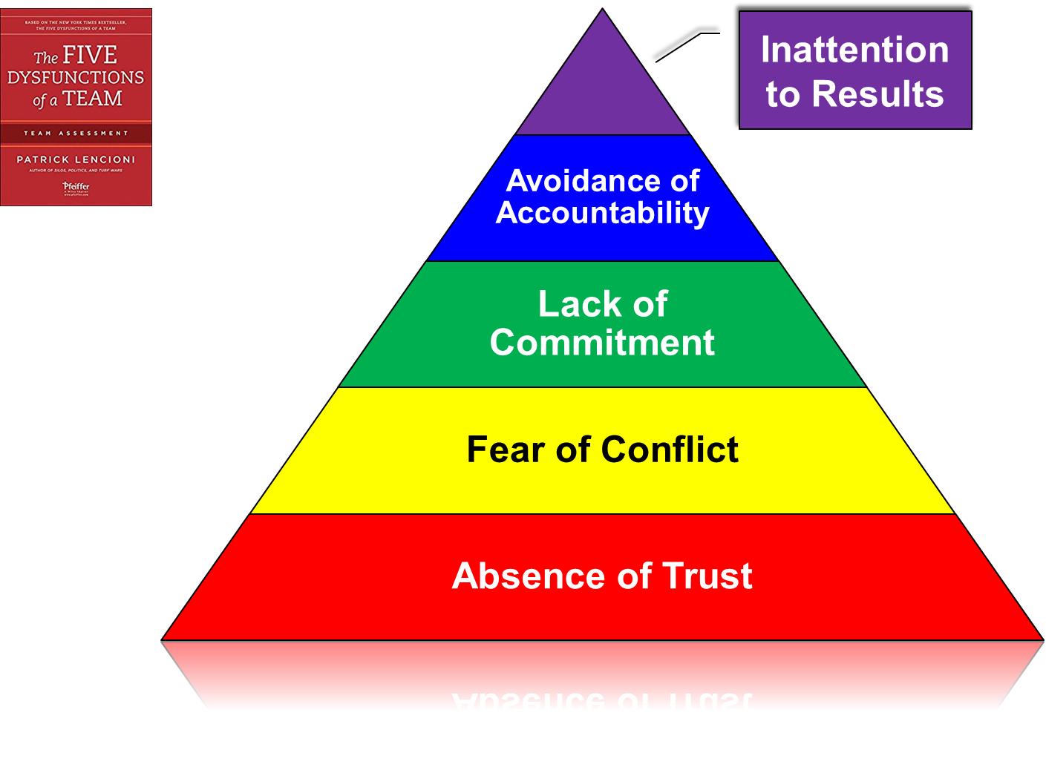
Team Function and Dysfunction
Notes:
JACK
Set up our workshop on Trust/Conflict and work in leadership issues like status, etc

Slide 29
BY NOW,
you should be
able to…
Reflect on whether collaboration is appropriate for your project
Identify several collaboration best practices
Determine training needs
Notes:
JACK
Best practices extracted from scientific examination and art of how to practice collaboration

Slide 30
Thank you!
Visit our website for more Team Science resources:
https://www.cctst.org/programs/cis
Contact us with questions:
jack.kues@uc.edu
megan.lamkin@uc.edu
jason.blackard@uc.edu
Notes:
JACK

Slide 31
Fall 2020 Team Science Series
Communication: The Cornerstone of Successful Teams – Sept 17 (2-3 pm)
Explore different communication styles and how they interact.
Team Foundations: Building with Trust – Oct 22 (2-3 pm)
Examine how building a foundation of trust creates an environment in which conflict can become a force for positive change, and how a leader contributes to building an effective team.
Leveraging Team Differences to Tackle Complex Problems – Nov 5 (2-3 pm)
Discover the principles of building functional teams.
Notes:
JACK
REGISTRATION available on Faculty Development OneStop
Laura will post these registration links in the Chat during the workshop:
Communication: The Cornerstone of Successful Teams #184857
Team Foundations: Building with Trust #185426
Leveraging Team Differences to Tackle Complex Problems #185754

Slide 32
More Team Science Resources
CCTST CIS Website: cctst.org/programs/CIS
Team Charters: cctst.org/programs/cis/resources/team-science-tools
National Cancer Institute (NCI) Team Science Toolkit: ​
https://www.teamsciencetoolkit.cancer.gov/public/Home.aspx ​
Northwestern University Clinical & Translational Sciences Institute offers 4 learning modules on Team Science at http://www.teamscience.net
The Science of Team Science​
Team Science Research Process in Behavioral Science​
Team Science Research Process in Basic Medical Science​
Team Science Research Process in Clinical Medical Science ​
Notes:
JACK

