Slide 1
Kidney Disease: Changing Landscapes and New Horizons
Charuhas V. Thakar, MD
Professor of Medicine
Director, Division of Nephrology, Kidney C.A.R.E Program
University of Cincinnati
Chief, Renal Section, Cincinnati VA Medical Center

Slide 2
December 29th, 1940

Slide 3
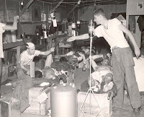
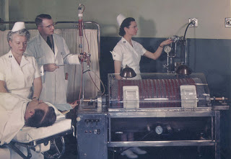
MASH: 1950 - 1953
Evacuation Helicopter
MASH
Kolff Dialyzer

Slide 4
Chronic Dialysis
1963 – VA Hospitals announced its intentions to open 30 dialysis centers across the country
1965 – Public Health Service started the Kidney Disease Control Program (KDCP) and awarded 12 grants to start 12 dialysis centers across the country

Slide 5
House Ways and Means Committee - 1971
Shep Glazer, NY; William Litchfield, Houston, TX; Roland Fortier, CT; Peter Lundin, Medical Student, CA; June Crowley, and Abram Holz, NY
Glazer made an official statement for NAPH, and then spoke about his personal situation:
I am 43 years old, married for 20 years, with two children ages 14 and 10. I was a salesman until a couple of months ago until it became necessary for me to supplement my income to pay for the dialysis supplies. I tried to sell a non-competitive line, was found out, and was fired. Gentlemen, what should I do? End it all and die? Sell my house for which I worked so hard, and go on welfare? Should I go into the hospital under my hospitalization policy, then I cannot work? Please tell me. If your kidneys failed tomorrow, wouldn't you want the opportunity to live? Wouldn't you want to see your children grow up? (U.S. Congress, House, Committee on Ways and Means, 1971b)

Slide 6
Lets Do The Numbers
660,000 - ESRD Patients
486,000 on Dialysis
194,000 Transplant
1% - ESRD as Proportion of Medicare Beneficiaries
10% - Proportion of Medicare budget ($ 688 Billion in 2017) consumed

Slide 7
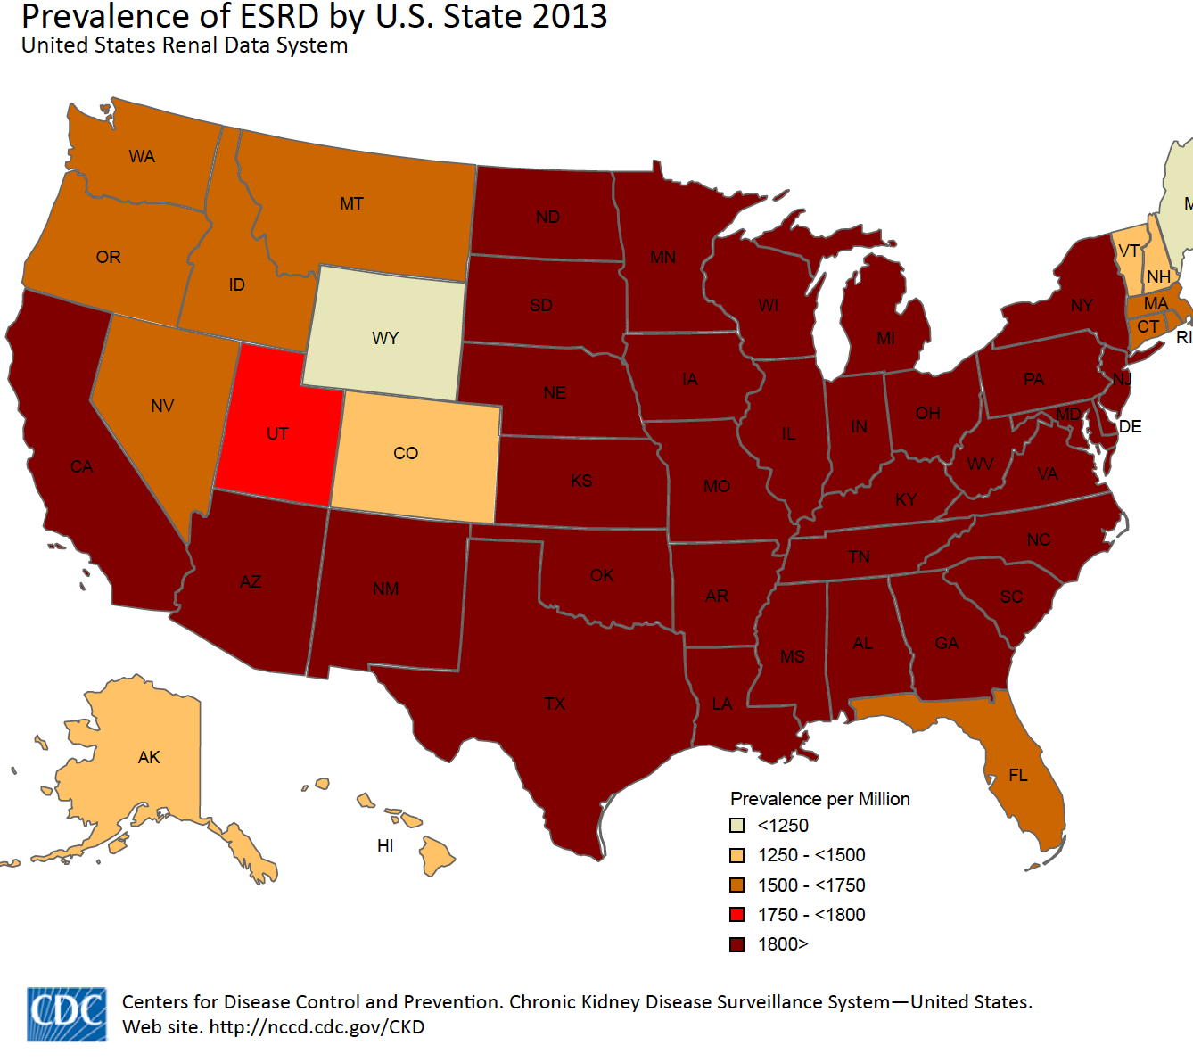

Slide 8
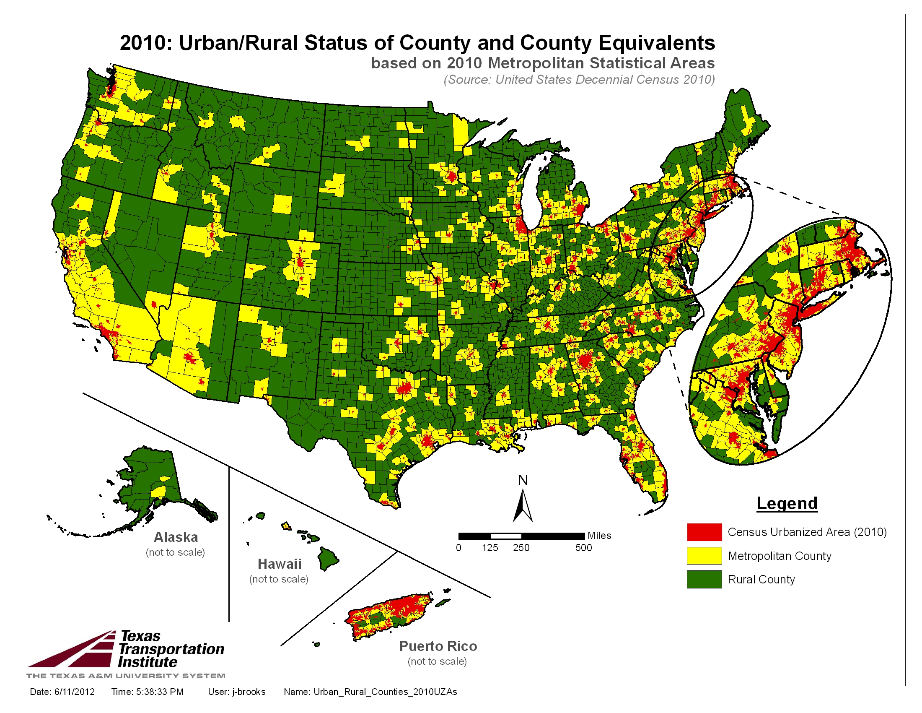
Urban vs Rural
counties map
84% of Geographic Area = Rural

Slide 9
Dialysis in Rural America
Prevalence of dialysis use is similar across rural and urban areas (3.9 /1000 residents)
As opposed to 23% of Urban Counties, 77% of remote rural counties lack an in-county dialysis facility.
On average, rural ESRD residents lived 33.3 miles away from a dialysis facility

Slide 10
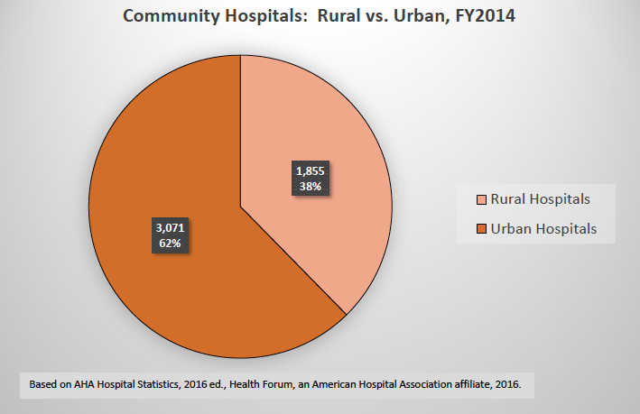
Rural Hospitals
Population in Rural America:
57 Million (19.3%)
Rural Hospitals support jobs:
2 Million
Annual ER visits:
21.5 Million
Acute dialysis availability:
1-in-3 hospitals

Slide 11
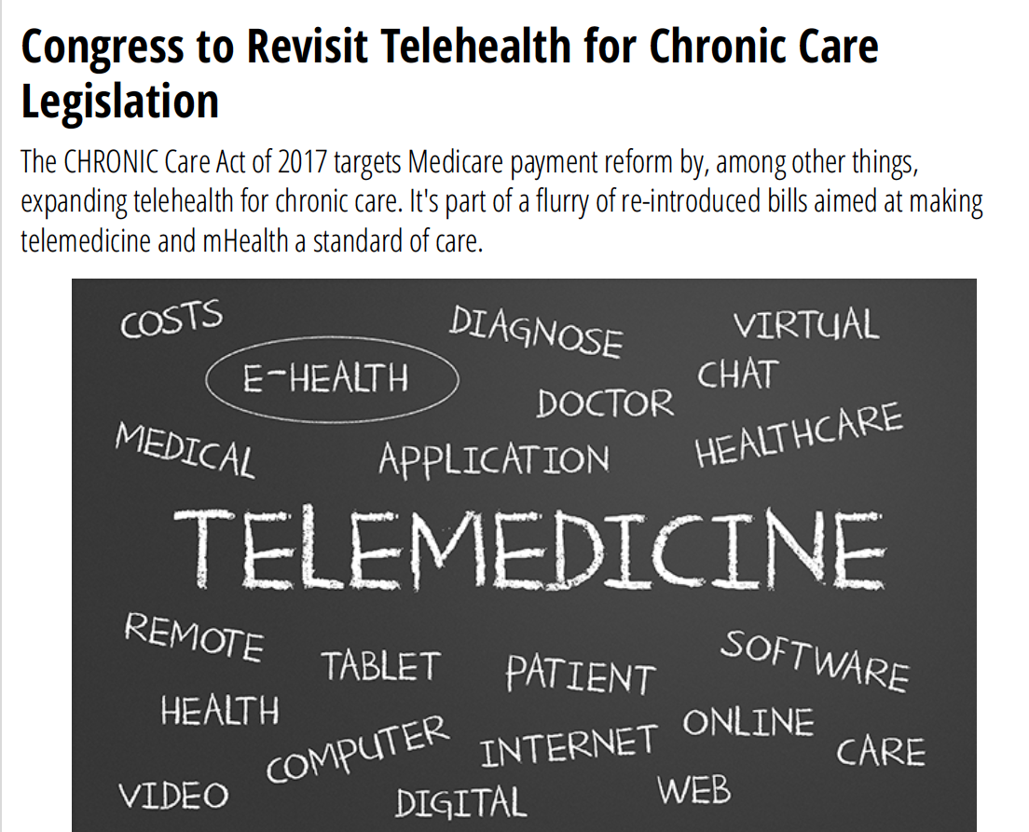
…...Back to the Ways and Means Committee

Slide 12
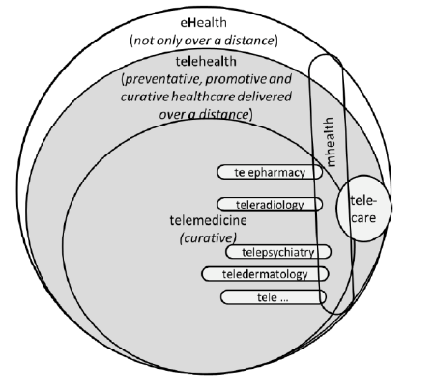
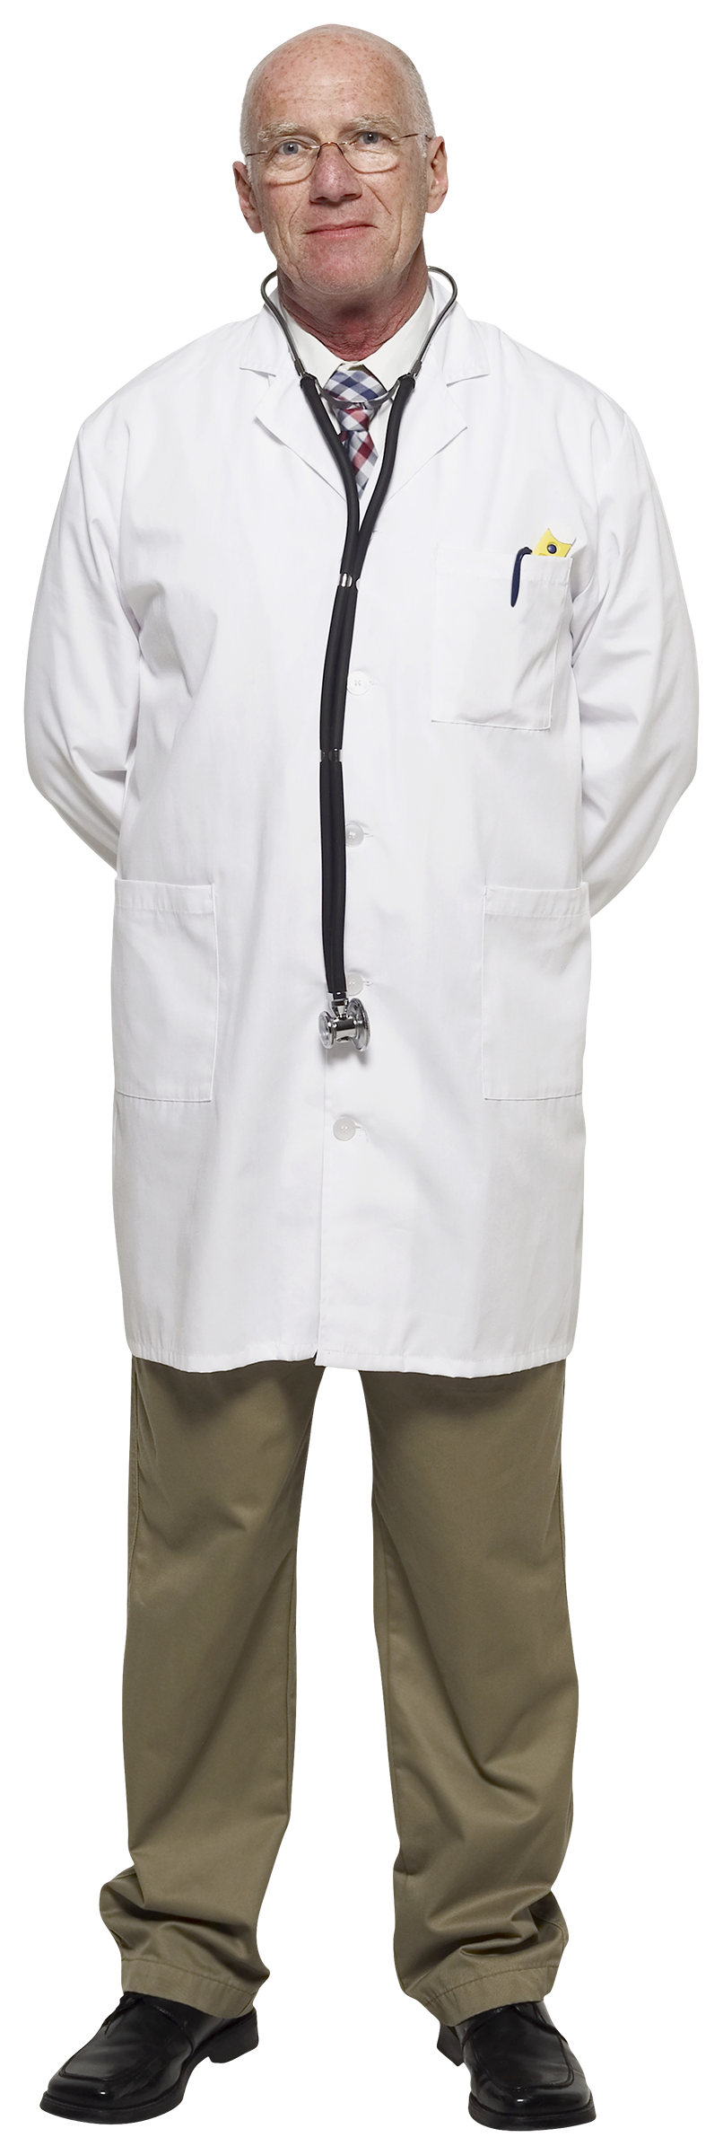
Terminology
Tele-Nephrology

Slide 13
Tele-health Pilot Meadowview Hospital
Acute Care Hospital
Dialysis Provider
Nephrology Services
Stake holders
Administration
Providers
Nursing
IT
Pharmacy
EMR
Dialysis related
Space/Regulatory/
Quality/Safety

Slide 14
Clinical Pathway: Tele-Nephrology
✔
ER Assesses Renal/Dialysis patient
Hospitalist Admits to Floor/ICU
Tele-Renal Team determines course of Treatment/follow up visit
MD : Renal Contact
MD : Tele-Renal Discussion to Assess Need for Dialysis
Follow up
Tele-Renal encounter made available in ER
Dialysis Nurse Notified
- Dialysis Nurse Evaluates Patient
- Confirms Orders
- Dialysis Nurse : Renal MD Discussion
- Floor Nurse Prep for Tele-encounter
Tele-Encounter:
Patient/Dialysis RN/Bedside RN/MD
✔

Slide 15
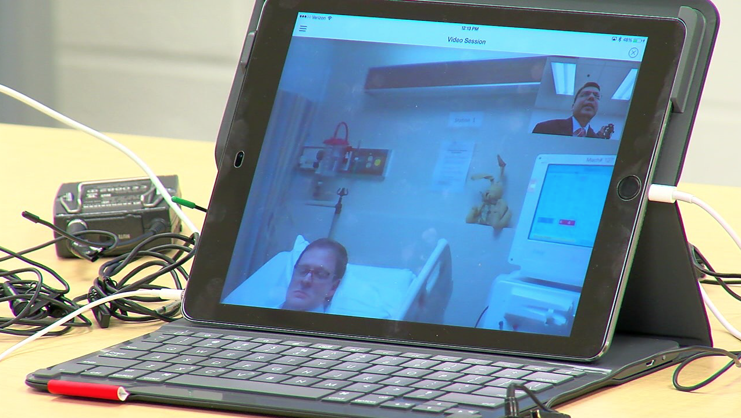
Tele-Nephrology
Patient and nurse in dialysis room
Lucky Bunny Rabbit
Patient and Nurses View
MD view of patient/Machine

Slide 16
Cincinnati Experience
Patient | Bed-days | Tele-visits | Dialysis Treatments | % in ICU
49 | 182 | 75 | 81 | 10%

Slide 17
Driving…...
Nephrology Division
Monthly Mileage: 6,400 Miles
2,920 Miles

Slide 18
Home Dialysis
Educate patients
Manage/Change prescriptions
“Parental Control”
Monitor reports – adherence
Travel

Slide 19
Colorado River Rafting

Slide 20
SCAN-ECHO
Specialty Care Access Network - Extension for Community Healthcare Outcomes
Specialty Care
PCP Team1
PCP Team2
PCP Team3

Slide 21
Data Recipient
Provider
Self

Slide 22
Canon 70D; 100-400 mm Canon L; f-5.6; 20 frames/second

