Slide 1
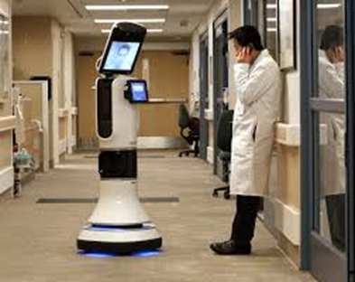
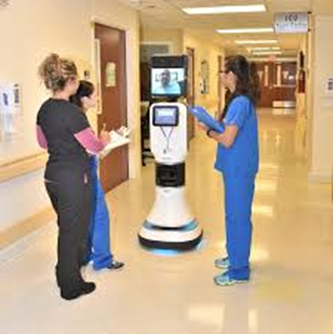
Improving Myself through TeleHealth
Devon Lehman MSN, RN, CCRN-E
lehmand2@xavier.edu

Slide 2
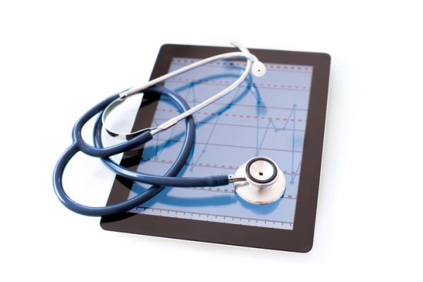
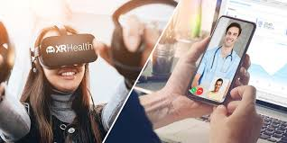
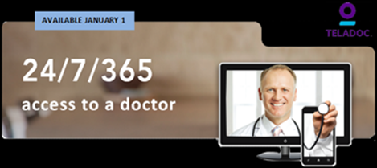
Objectives
Review the foundational aspects of TeleHealth
Identify and understand ways for population health improvement through telehealth
Review how TeleHealth can extend Healthcare Provider's Career

Slide 3
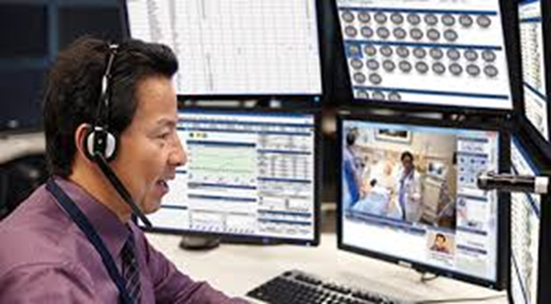
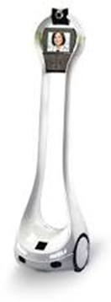
About Me....
PTSD
Devon Lehman Jr. MSN, RN, CCRN-E
20 years Registered Nurse
15 years Critical Care
Retired US Army- Major
Fulltime employee at the VA TeleICU
Adjunct Xavier School of Nursing
These are my Ideas.. I do not endorse any of the products in this presentation

Slide 4
TeleHealth- to Nursing Students
Following slides are a few of what I teach New and upcoming Students to be prepared for TeleHealth
Normally abut 1 hour presentation, Scenarios/Case Study, Q&A
Scenarios-
Code Stroke
Code Blue
Nurse to Nurse consult
Nurse to Provider SBAR-Q

Slide 5
Telehealth
2011 State of the Union Address
“Within the next five years, we will make it possible for business to deploy the next generation of high-speed wireless coverage to 98% of all Americans. This isn't just about a faster internet and fewer dropped calls. It's about connecting every part of America to the digital age. It's about a rural community in Iowa or Alabama where farmers and small business owners will be able to sell their products all over the world. It's about a firefighter who can download the design of a burning building onto a handheld device; a student who can take classes with a digital textbook; or a patient who can have face-to-face video chats with her doctor.”
https://youtu.be/7xOixuZ-lco

Slide 6
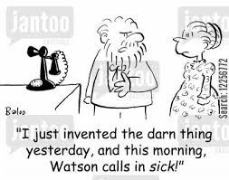
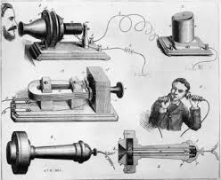
First Call for Medical Assistance
10 March 1876-
Alexander Graham Bell, "Mr. Watson, come here, I want you.“
Bell had just upset the wet battery powering the transmitter thus spilling sulphuric acid on his clothes.

Slide 7
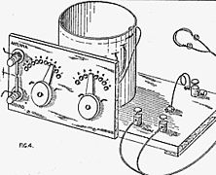
Foreshadowing Telemedicine
“The Radio Doctor - Maybe!”
April 1924, Radio News
1900 - Reginald Fessenden made a weak transmission of voice over airwaves
1927- The first experimental television transmission did not occur until
(Institute of Medicine, 1996)

Slide 8
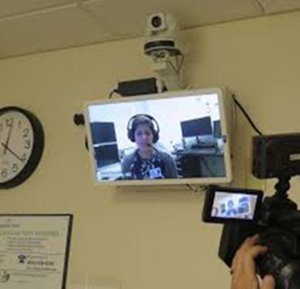
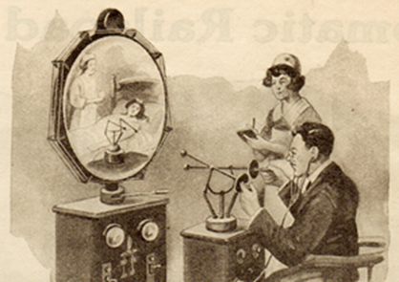
Telehealth vs. Telemedicine

Slide 9
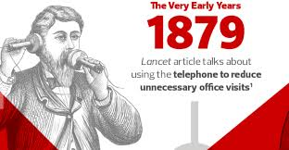
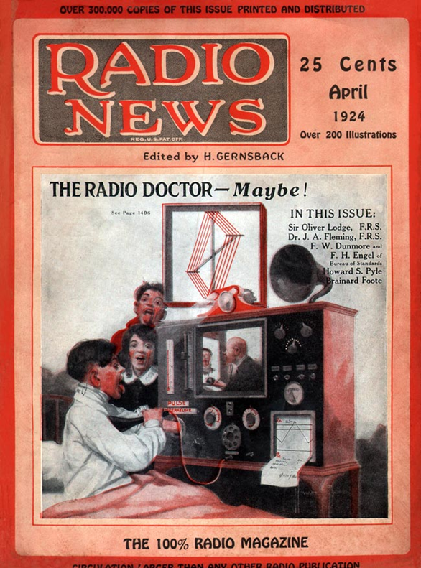
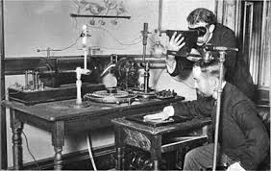
Telehealth- History (CDW Healthcare, n.d.)
1927
EARLY YEARS -1879 Lancet article talks about the use of the telephone to reduce unnecessary office visits
1924 – Radio News article foreshadowing the “Radio Doctor”
1948 - First radiologic images sent via telephone across 24 miles in Eastern Pennsylvania
1959 - Canadian radiologists report diagnostic consultations based on fluoroscopy images transmitted by coaxial cable
Late 1950’s/Early 60’s - Closed-circuit TV link established between Nebraska Psychiatric Institute and Norfolk State Hospital for Consultations
1961 - Radiotelemetry for patient monitoring
1973 - NASA links Indian Health Service reservations with mobile support units (STARPAHC)
1990’s - Rise of the internet supports the way for improved telehealth
2014 - President Obama signs National Defense Act, expands telemedicine

Slide 10
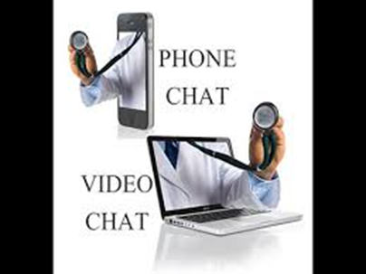
Telehealth - Access
Bring Healthcare to the Patient
Primary Care
TeleStroke/Neurology
Cardiology
Intensivist (inpatient/ICU)
Pediatrics
Optometry
Dermatology
Urology
Gastrointestinal
Psychology/Psychiatry
TeleRetinal
Obstetrics
Pain Management
Infectious Disease
Rheumatology
Sports Medicine
Oncology
Neurology

Slide 11
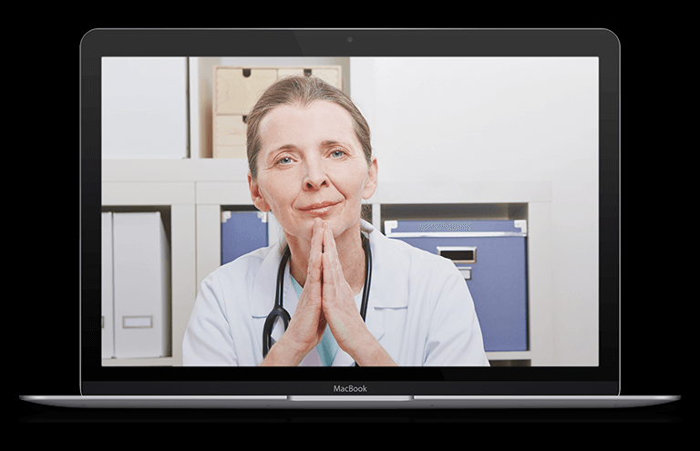
Telehealth- Primary Care
Multiple appoints for Medication management
Chronic Condition Management
Wellness Exam
Follow-up
Diabetes
Hypertension
Coronary artery disease
Cardiac arrhythmia
End stage renal disease
Hepatitis
Asthma / COPD
Obesity
Oncologic co-morbidities
Neurodegenerative diseases
Colonoscopy / sigmoidoscopy results
Mammogram results
Cholesterol levels
STD testing
CBC results
Blood glucose levels
Liver function testing
Pap smear results
Blood electrolytes

Slide 12
Telehealth - Pros/Cons
Pros
Aging In Place
Population health/Health promotion
Increases accessibility to specialists/consults
More convenient, accessible care for patients
Saves on healthcare costs
Extends access to consults from specialists
Improves response time (faster access to specialists/highly trained staff)
Complement to traditional in-person medical care
Increases patient engagement
Provides better quality patient care

Slide 13
Telehealth - Pros/Cons
Cons
Requires technical training and equipment
May reduce in-person interactions with doctors
Many providers/Insurance Companies charge a “convenience fee”
Navigating the changing policy and reimbursement landscape can be tricky

Slide 14
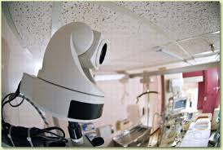
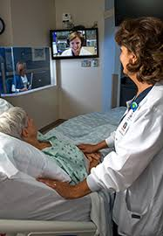
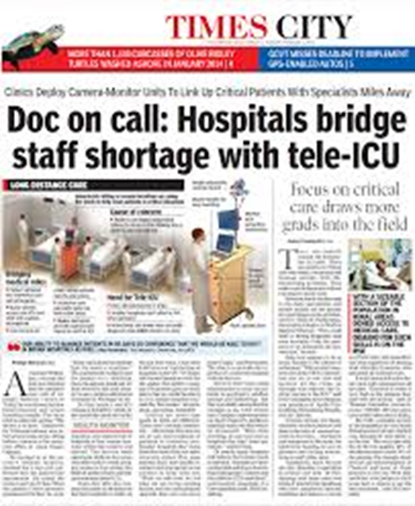
Telehealth – ICU

Slide 15
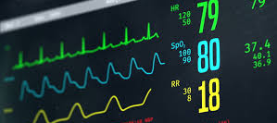
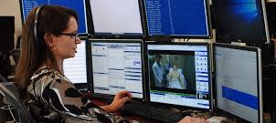
TeleICU- VA
eLerts
Phone Call/Signout
Alarms- Algorithms/Parameters
Orders - Verify

Slide 16
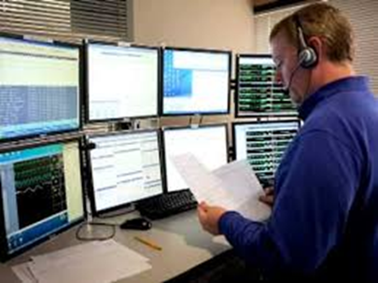
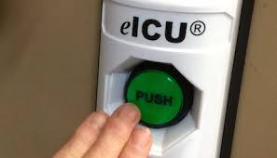
Telehealth – ICU cont'd
Bidirectional Audio/ Visual Content Sharing
Immediate Intensivist coverage
Highly experienced critical care nurse involvement
Mortality rate reduction of 13.6% to 11.8% (Sadaka, et al., 2013)
LOS 13.3 to 9.8 days
https://youtu.be/gUfxgwJfq3M

Slide 17
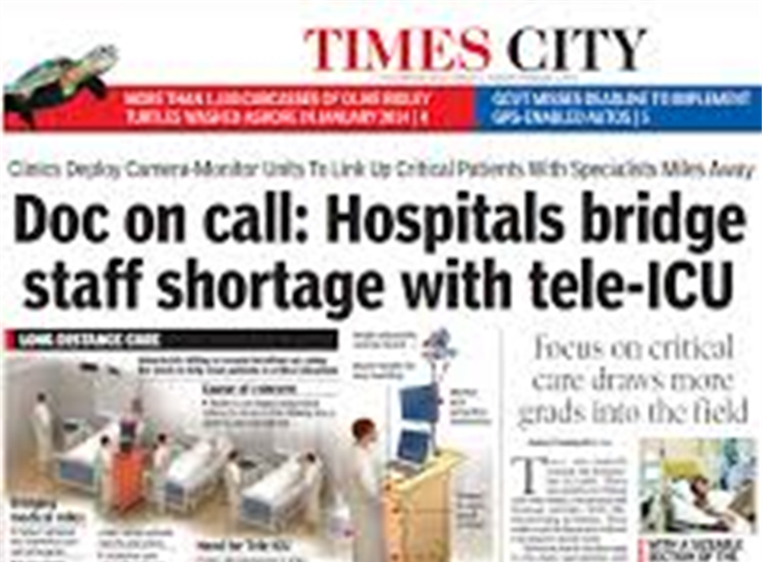
TeleICU- What can we do
Vitals/Labs- Second set of eyes
2nd Verifications – Blood; Timeout; High Risk Medications
Run an Emergency/Code
Watch other patients during Event
Verify Orders/Procedure
Check on Patient without use of PPE
Share information – Do not Silo information
Read Images - Provider
Stat Orders - Provider

Slide 18
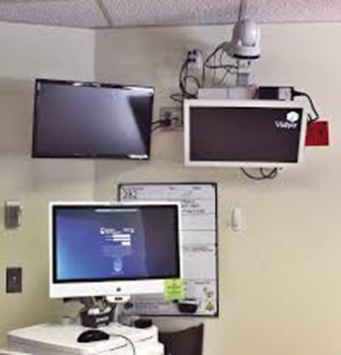
TeleICU- What can we Not do
Tele-Sitter
Restraints
Some medications/narcotics
Reduce Staffing
Hands on Patient
Assessment
Grief
Smell

Slide 19
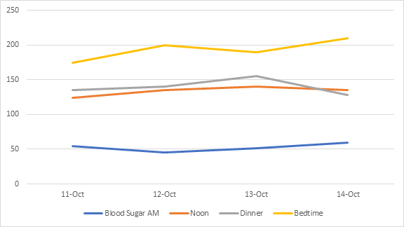
Telehealth - Trends/Alarms
Blood Sugar

Slide 20
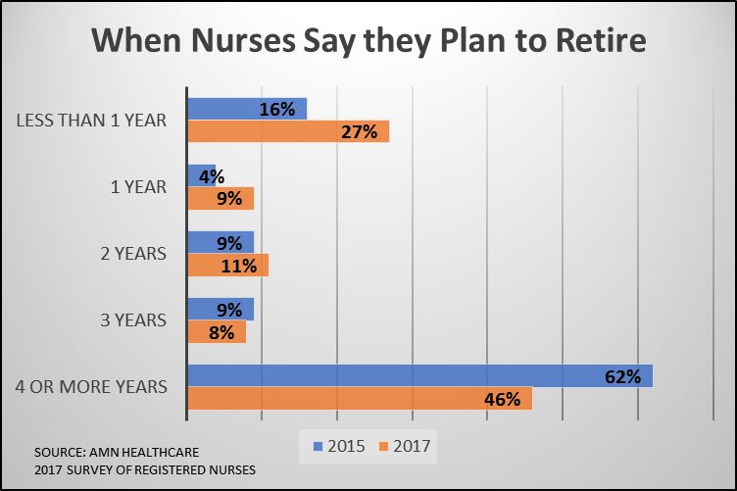
Telehealth- Statistics
The 2017 survey also showed that 73% of Baby-Boomer nurses who are planning to retire say they will do so in three years or less.
How can Telehealth support this turnover???
New Graduate
Keep Staff from Early Retirement
https://www.amnhealthcare.com/latest-healthcare-news/nurse-retirement-wave-hits/

Slide 21
TeleICU - Transporting Patients
In one study, Natafgi, et al. (Oct 2009-Feb 2014) identified 1,175 avoided transfers out of 9,048 encounters in 85 rural hospitals across seven states.
Cost savings of $3,823 per avoided transfer ($4,492,025) while accounting for tele-emergency costs.
Home Visits vs. Doctor’s Office
Specialists (Neurology/Dermatology/Cardiac etc.) - Office vs Telehealth
Transportation from home/facilities-
Weather
Insurance (ambulance, auto, medical)
Cost (ambulance, EMTs, RNs, supplies)
Time/Distance (Who is driving them?/ Who is accepting them)
Building/Office Space (utilities, space, diseases, property insurance)
Safety
$4.5 million savings over 4.5 years!!!!!

Slide 22
Telehealth - Future
Telehealth apps (office visits from your phone)
Primary/Follow-up
Specialty
Therapy
Health promotion
Worldwide access to specialists/providers
Immediate access
Cost savings

Slide 23
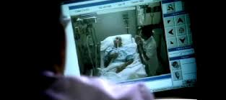
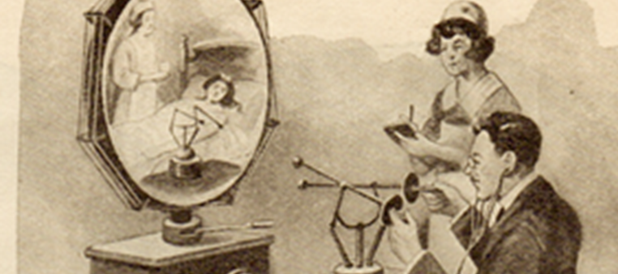
References
CDW Healthcare. (n.d.). The history of telemedicine. Healthcare CommunIT. Retrieved from http://www.cdwcommunit.com/news/top- news/the-history-of-telemedicine/
Bladin, C. F., & Cadilhac, D. A. (2014, April 24). Effect of telestroke on emergent stroke care and stroke outcomes. Stroke, 1876-1880. doi: https://doi.org/10.1161/STROKEAHA.114.003825
Institute of Medicine. (1996). Telemedicine: A guide to assessing telecommunications for healthcare. Washington, D. C.: National Academics Press. doi:10.17226/52.96US)
Natafgi, N, Shane D, Ullrich F, MacKinney AC, Bell A, Ward M. (2017, March 7). Using tele-emergency to avoid patient transfers in rural emergency departments: An assessment of costs and benefits. Journal of Telemedicine and Telecare. doi.org/10.1177/1357633X17696585
Sadaka, F., Palagiri, A., Trottier, S., Deibert, W., Gudmestad, D., Sommer, S. E., & Veremakis, C. (2013). Telemedicine intervention improves ICU outcomes. Critical Care Research and Practice, 2013, 1-5. doi.org/10.1155/2013/456389

