Slide 1


Cincinnati Biorepository to Enhance the Acute Resuscitation of Cardiac Arrest Patients
(Cincy BEARCATS)
Justin Benoit, MD, MS, FAEMS
November 20th, 2023

Slide 2



ACLS – State of the Science
CARDIAC ARREST
PLAN A
PLAN B
<20%
>80%
ARE YOU SURE IT’S NOT SHOCKABLE?
REMEMBER:
CARDIAC ARREST HAS MANY CAUSES
11-20-2023

Slide 3
ACLS – State of the Science
Oncology
“THE CANCER”
BENIGN
MALIGNANT
PLAN A
PLAN B = “The Chemo”
ARE YOU SURE IT’S NOT BENIGN?
REMEMBER:
“THE CANCER” HAS MANY CAUSES
11-20-2023

Slide 4
ACLS – “Future” State of the Science
CARDIAC ARREST
PLAN A
PLAN B
PLAN C
PLAN D
PLAN E
20%
20%
20%
20%
20%
11-20-2023

Slide 5
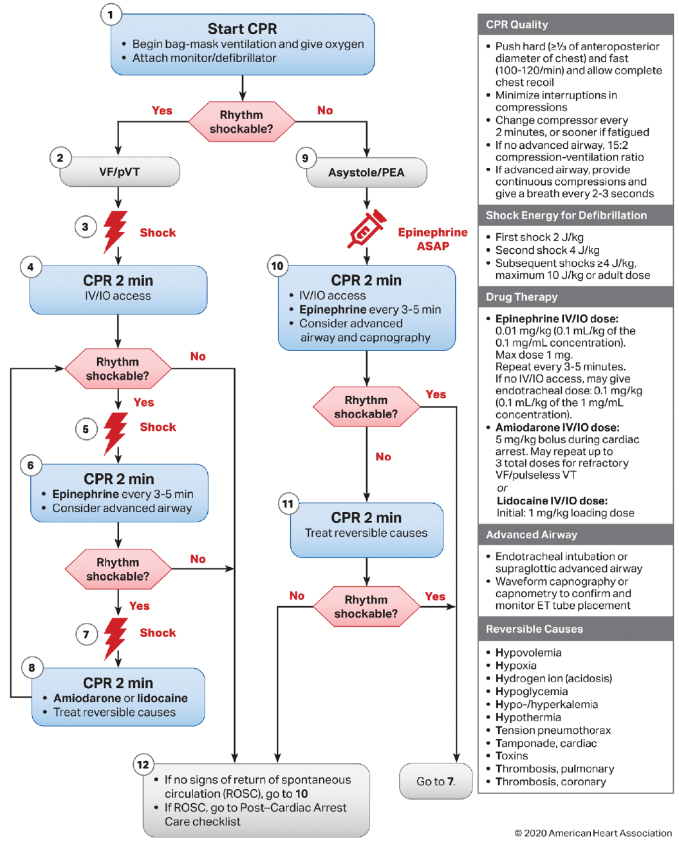
A Fundamental Lack of Information
Current knowledge only explains 50% of survival rates
Reasons why one patient survives, and another does not, remain unknown.
11-20-2023

Slide 6


A Fundamental Lack of Information
Mystery
Puzzle
Too Much Information
Not Enough Information
Lack of patient selection = “Negative” clinical trials
11-20-2023

Slide 7
Lack of Patient Selection = “Negative” Trials
11-20-2023

Slide 8
Lack of Patient Selection = “Negative” Trials
11-20-2023

Slide 9
Lack of Patient Selection = “Negative” Trials
11-20-2023

Slide 10
Lack of Patient Selection = “Negative” Trials
11-20-2023

Slide 11
Lack of Patient Selection = “Negative” Trials
11-20-2023

Slide 12
Lack of Patient Selection = “Negative” Trials
11-20-2023

Slide 13
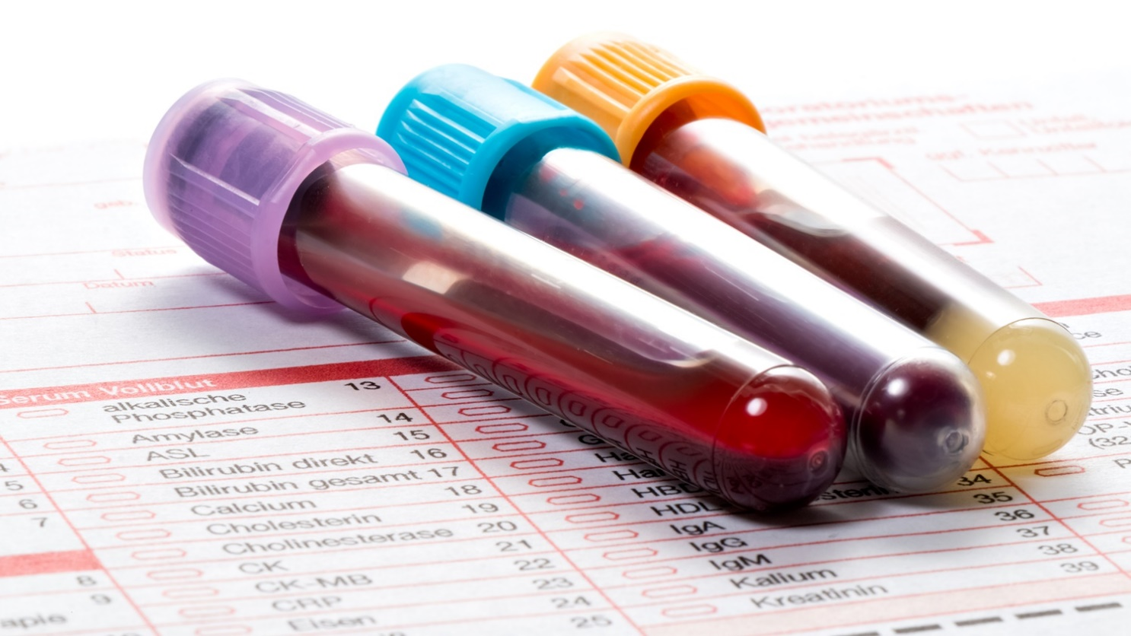
Blood-Based Biomarkers
Blood-based biomarkers play a central role in the diagnosis and treatment of essentially all critically ill patients …
… except cardiac arrest?
11-20-2023

Slide 14
Blood-Based Biomarkers
Wait, I get a ton of blood tests on cardiac arrest patients!
Post-ROSC ≠ Intra-Arrest
Okay, but what about the H’s and T’s?
Good place to start, but no standardization
Well, we don’t have time to do fancy tests!
A COVID test takes 2 minutes … at home
Yeah, but this has all been studied, right?
Actually … No
11-20-2023

Slide 15
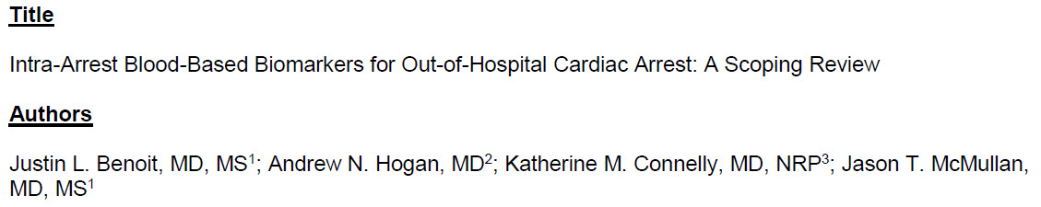
Blood-Based Biomarkers
11,834 records
118 studies
105 blood-based biomarkers
45 years of resuscitation science
Studies per biomarker = 2 (IQR 1-4)
Complete Reporting = 8/118 (7%)
Pediatric Patients = 3/118 (3%)
11-20-2023

Slide 16
Cincy BEARCATS
We propose to create the Cincinnati Biorepository to Enhance the Acute Resuscitation of Cardiac Arrest Patients (Cincy BEARCATS), which will contain serial intra-arrest blood samples from out-of-hospital cardiac arrest patients, linked to demographic, resuscitation, and outcome data, in order to improve survival from out-of-hospital cardiac arrest.
11-20-2023

Slide 17
Cincy BEARCATS
The rationale is that a better understanding of intra-arrest pathophysiology would enable stratification of out-of-hospital cardiac arrest patients into clinically relevant subgroups that are currently unknown. The discovery of distinct pathophysiological pathways in cardiac arrest subgroups may have therapeutic implications, leading to the development of personalized treatment strategies and future clinical trials. These subgroups may also have prognostic implications that could improve value-based medicine.
11-20-2023

Slide 18
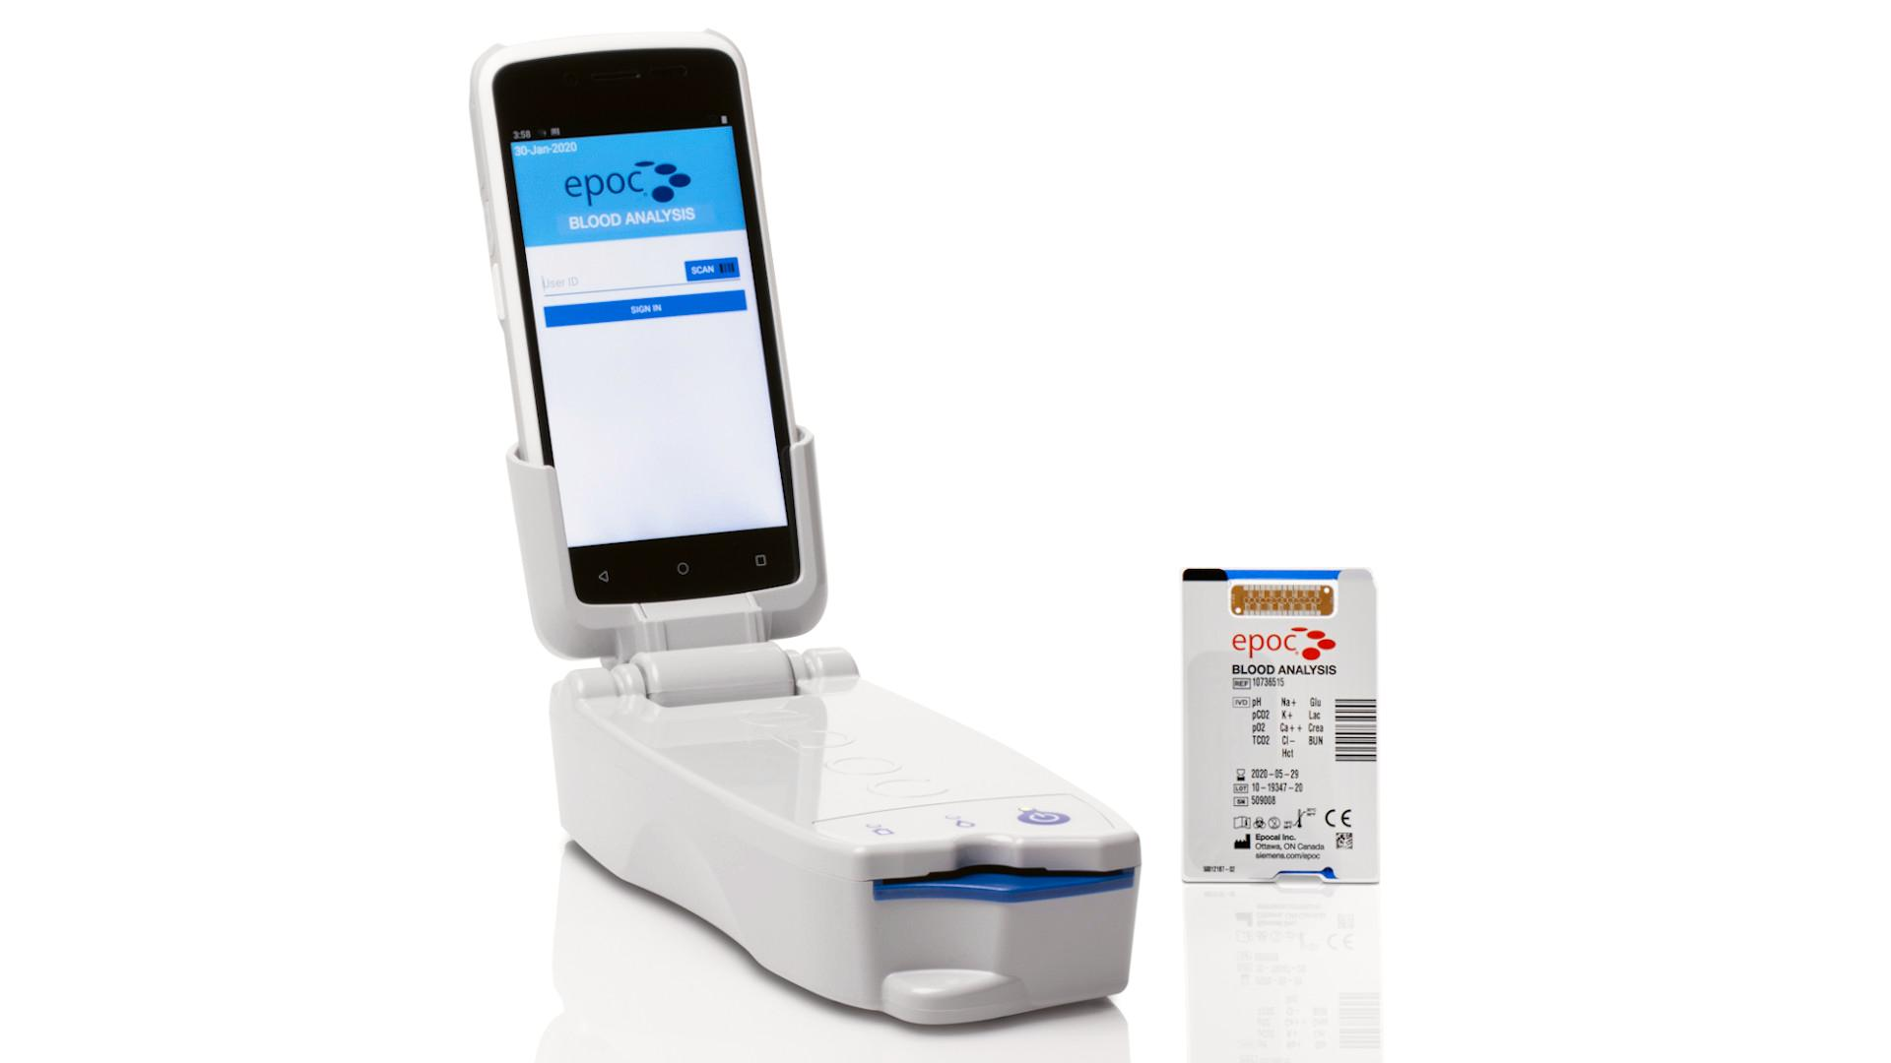
Cincy BEARCATS
Cardiac
Arrest
1-Jan-2040
Cardiac
Arrest
11-20-2023

Slide 19
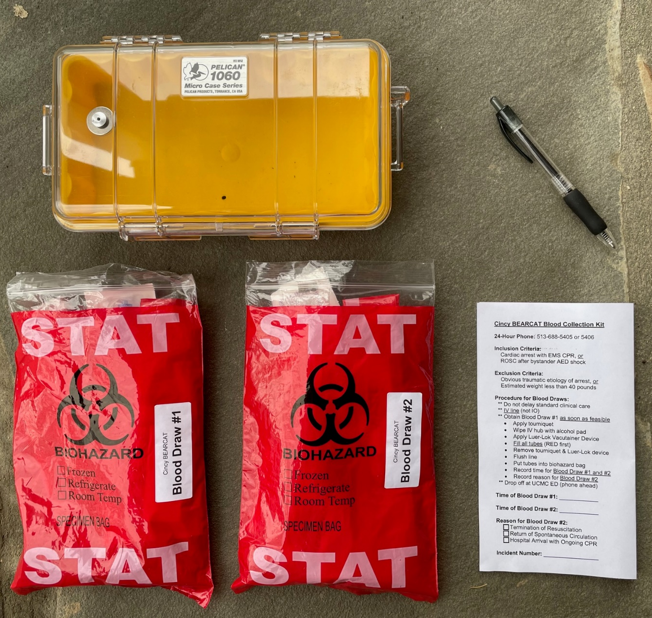
Cincy BEARCATS
11-20-2023

Slide 20
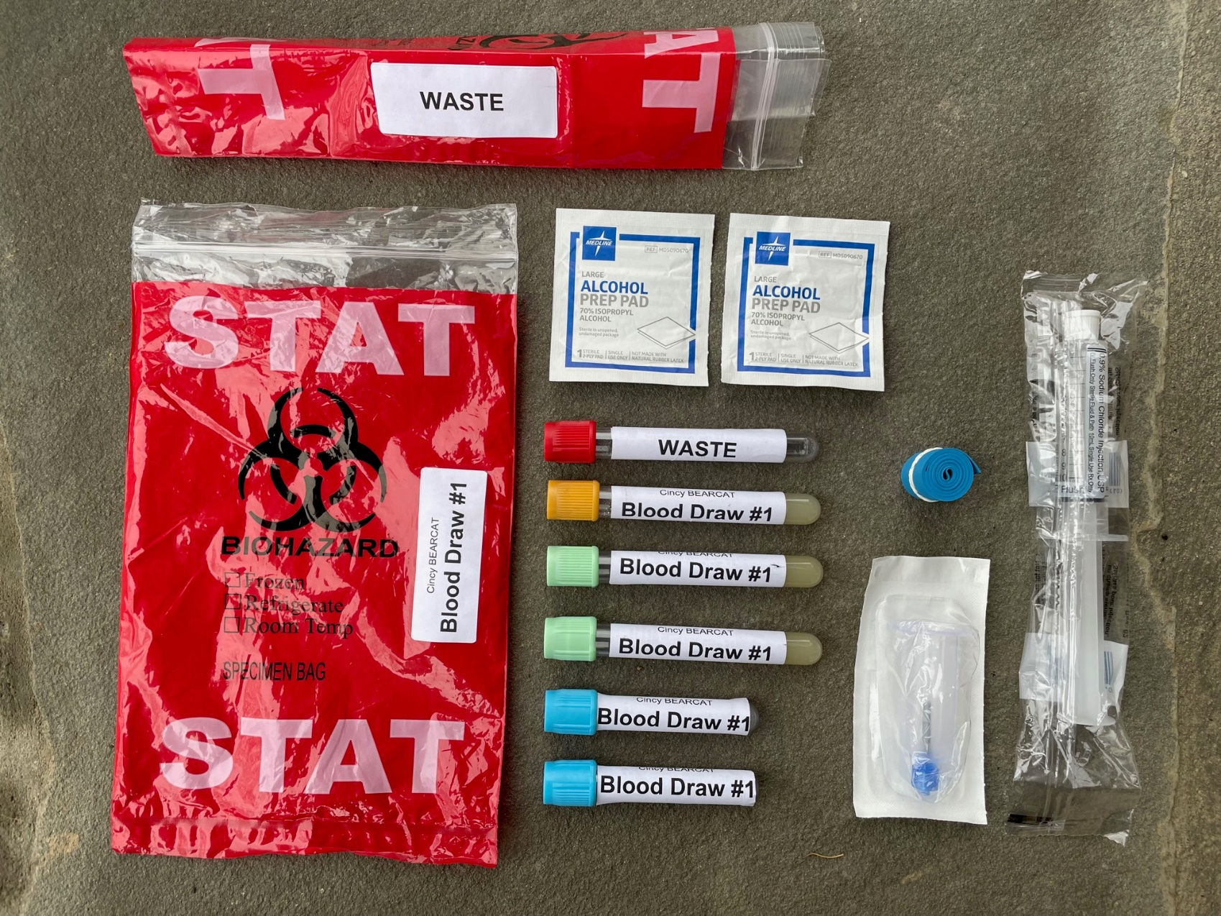
Cincy BEARCATS
11-20-2023

Slide 21
Cincy BEARCATS
Inclusion Criteria
  Out-of-hospital cardiac arrest patient where resuscitation is attempted by a 9-1-1 EMS responder via CPR and/or defibrillation, OR
  Patient who achieves ROSC after defibrillation by a bystander AED
Exclusion Criteria
  Clear and obvious traumatic etiology of arrest
  No resuscitative efforts performed
  Neonates (<30 days)
  Bystander suspected cardiac arrest where ROSC occurs without defibrillation or EMS CPR
11-20-2023

Slide 22
Cincy BEARCATS
Follow standard cardiac arrest treatment protocols
Neither on-scene resuscitation nor any specific duration of resuscitation is required
Patient does not need to go to UCMC ED
11-20-2023

Slide 23
Cincy BEARCATS
Blood Draw #1
  IV established per standard-of-care
  First blood draw as soon as feasible
  Serum, lithium heparin, and citrate tubes
  Cannot use IO for study
Blood Draw #2
  (A) Termination of Resuscitation (immediate after)
  (B) Return of Spontaneous Circulation (pulse and BP)
  (C) Hospital Arrival with Ongoing CPR (just before)
50 mL blood collected (or 3 cc/kg if under 40 lbs)
11-20-2023

Slide 24
Cincy BEARCATS
Record time of Blood Draw #1 and #2
  Same clock used to record interventions
Record reason for Blood Draw #2
Blood Drop-off
  ALS Supervisor or any responding unit
  Call 513-688-5405 or 513-688-5406
  UCMC ED ambulance bay
  Replacement yellow research box provided
UCMC ED processes and freezes blood immediately
Clinical data from CARES (national cardiac arrest registry)
11-20-2023

Slide 25



Pilot Study
Funding from Cincinnati CCTST (NIH CTSA Grant)
Two Cincinnati Fire stations (32 & 34)
11-20-2023

Slide 26
Pilot Study
Patients with blood draw attempt
n=27
Unsuccessful blood draw
n=8
Blood sample obtained
n=19
Blood sample lost
n=1
Patients enrolled
n=18
11-20-2023

Slide 27
Pilot Study
Gender
  11 Male
  6 Female
  1 Unknown
Race
  12 African American
  5 White
  1 Unknown
Samples frozen within 2 hours of 9-1-1 call
  ~1 hour to get blood from EMS
  ~1 hour to spin, aliquot, and freeze
Lab testing in progress
11-20-2023

Slide 28
Pilot Study
Calcium
Na/K/Ca
Bicarbonate
Lactate
Malondialdehyde
Biological Antioxidant Potential
Diacron-Reactive Oxygen Metabolites
Ischemia Modified Albumin
D-dimer
Antithrombin
PT/PTT
SC5b-9
Renin
Aldosterone
Interleukin-6
Cell-Free DNA
Potential Therapy
Bicarb, THAM
Antioxidants
Thrombolytics, ECPR, Heparin
Eculizumab
Vasopressin, Angiotensin II
Steroids, Tocilizumab
11-20-2023

Slide 29
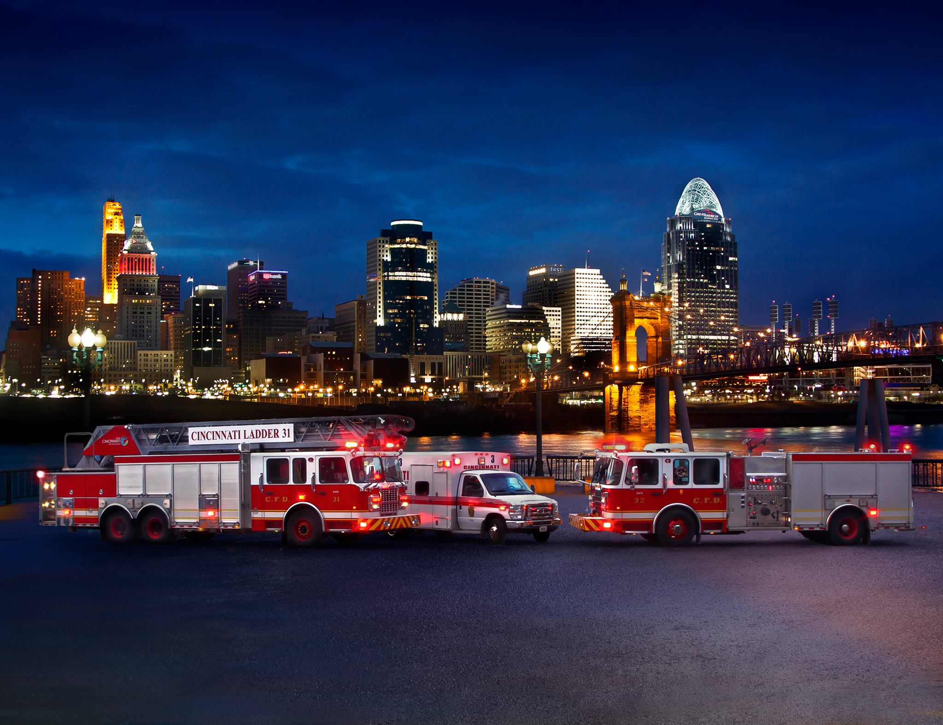
Questions?
11-20-2023

Slide 30
Early serum markers predict trauma patient outcomes
Michael D. Goodman, MD
University of Cincinnati
Department of Surgery

Slide 31
Background
Trauma is the leading cause of death for Americans up to age 45
Two thirds of all patients who die following injury do NOT die from hemorrhage¹
Injured patients who survive past first 24 hours may succumb to later complications such as Multiorgan System Failure (MOSF), sepsis, respiratory failure or complications from traumatic brain injury (TBI)
Studies have demonstrated that those with early elevation of inflammatory markers may be at higher risk for mortality and post-injury complications³⁻⁹

Slide 32
Background
The Pragmatic Randomized Optimal Platelet and Plasma Ratios (PROPPR) trial demonstrated improved mortality in patients receiving 1:1:1 resuscitation²
  9.7% of patients experienced mortality between 24-hours and 30 days after traumatic injury
  Deaths due to MOSF, sepsis, respiratory failure, and TBI complications
Retrospective secondary analysis of PROPPR serum found seven key inflammatory markers to be early predictors of 30-day mortality³
  Eotaxin, IL-1ra, IL-6, IL-8, IL-10, IP-10, MCP-1
  Syndecan and lactate added as well

Slide 33
Background
With increasing strain on health care resources, early cytokine levels may help with prognostication in severely injured trauma patients
Are these serum marker changes predictive for all critically injured patients, not just those in hemorrhagic shock
Sept 2021 – Aug 2022 enrolled 465 patients by convenience sampling of remnant serum at 6, 24, and 72 hour samples available
  217 patients excluded due to lacking one or more desired timepoints (mortality 3.7% 7/217)
Divided patients by transfusion status (none, some (1-4 units), massive (5+))

Slide 34
(5/25)
(13/78)
9.6%
(13/135)
16.7%
20.0%

Slide 36
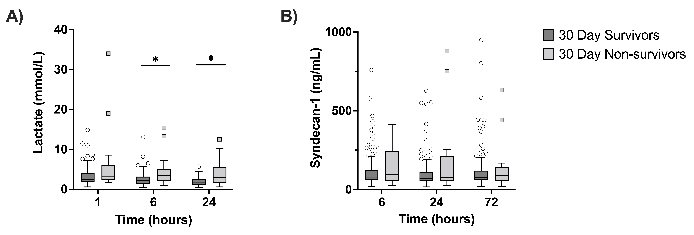
Lactate but not syndecan-1 levels correlated with early cytokine elevation in non-survivors

Slide 37
6-hour Timepoint
All Patients | Massive Transfusion | Submassive Transfusion | No Transfusion
IL-1ra |  | IL-8 | IL-1ra
IL-8 |  | Lactate | IL-10
IL-10
MCP-1
Lactate

Slide 38
Transition to next study
Early elevation of IL-1ra, IL-8, IL-10, MCP-1, and lactate at 6-hours post-traumatic injury may be useful predictors of 30-day mortality
Although significant differences between survivors and non-survivors at 6-hours, not strong enough to calculate a reliable cut off value
46% of patients were excluded for not having all 6, 24, 72 hour samples
Focus on the 6 hour, or ICU admission timepoint
Combined with Orthopedics interest in:
  IL-6 association with fracture fixation outcomes
  Demonstrated thrombophilia outcomes in pelvic fracture patients

Slide 39





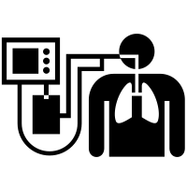
Resuscitation in real time
Whole blood
Hemostatic adjuncts
ICU admission
Viscoelastic testing
Viscoelastic testing
Viscoelastic testing
POC labs
Balanced
resuscitation
Serum biomarker testing
Permissive hypotension
Limited crystalloid
Time from injury

Slide 40
AIMS
Evaluate the key early inflammatory markers at 4-6 hours after injury to predict 30-day morbidities and mortality
Evaluate the utility of early serum IL-6 levels to predict poor outcomes in fracture fixation
Evaluate early genetic markers of inherited thrombophilia in trauma patients
CURRENT STATUS
Collecting initial serum samples from all trauma patients admitted to SICU or NSICU
Will collect for 8-9 months
Then run all serum analyses at once Spring 2024

Slide 41
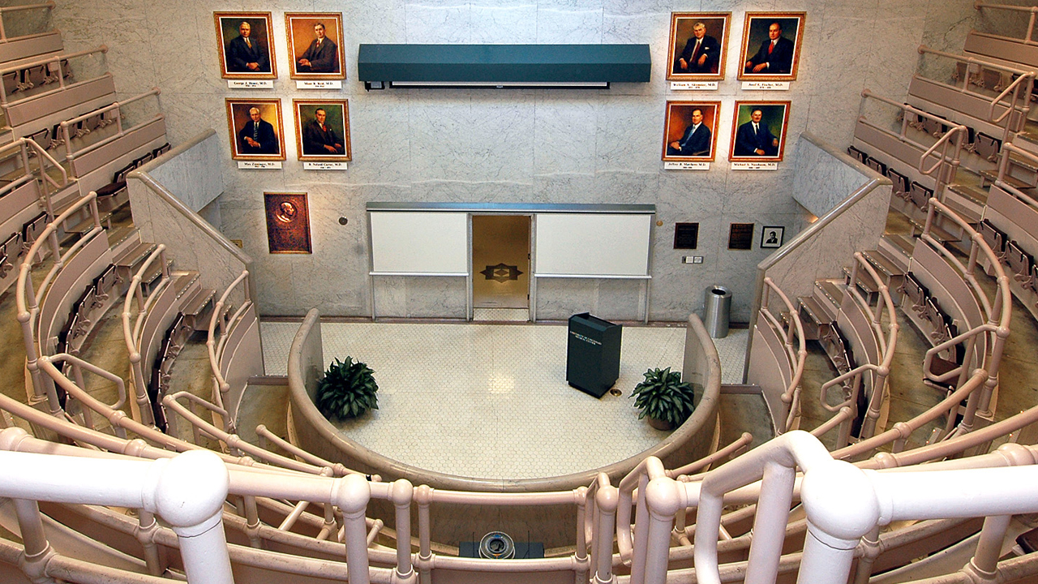

THANK YOU!

Slide 42

Minimal Risk Studies in High Risk Clinical Settings
IRB Perspective
David Ficker, MD
IRB Chair 2, 4

Slide 43
Clinical trial example
Video versus direct laryngoscopy for tracheal intubation of critically ill adults. N Engl J Med 2023;389:418-29
  BACKGROUND Whether video laryngoscopy as compared with direct laryngoscopy increases the likelihood of successful tracheal intubation on the first attempt among critically ill adults is uncertain
  METHODS In a multicenter, randomized trial conducted at 17 emergency departments and intensive care units (ICUs), we randomly assigned critically ill adults undergoing tracheal intubation to the video-laryngoscope group or the direct-laryngoscope group.
    primary outcome was successful intubation on the first attempt.
    secondary outcome was the occurrence of severe complications during intubation; severe complications were defined as severe hypoxemia, severe hypotension, new or increased vasopressor use, cardiac arrest, or death.

Slide 44
sIRB review – no more than minimal risk
Critically ill patients undergoing tracheal intubation in the ED or ICU are at significant risk for morbidity and mortality from their underlying illness. Most patients undergoing tracheal intubation in routine clinical care are intubated using either a video laryngoscope or a direct laryngoscope on the first attempt. Any benefits or risks of these two approaches are experienced by patients undergoing tracheal intubation in clinical care, outside the context of research.
As a requirement for enrollment in the DEVICE trial, the patient’s treating clinician must believe that either a video laryngoscope or a direct laryngoscope would be a safe and reasonable approach for the patient (otherwise the patient is excluded).
Therefore, making the decision between the two approaches randomly (by study group assignment) rather than by a clinician who thinks either approach is safe and reasonable for the patient is expected to pose no more than minimal additional risk.

Slide 45
sIRB waiver of informed consent
Obtaining informed consent for participation in the study would be impracticable.
  The majority of patients undergoing emergency tracheal intubation lack decisional capacity due to their underlying critical illness and surrogate decision makers are frequently absent.
  Further, emergency tracheal intubation is a time-sensitive procedure with only minutes between the decision to perform intubation and the completion of the procedure.
    Meaningful informed consent could not be executed in this brief window and attempting to obtain informed consent would lead to potentially deleterious and unethical delays in intubation which would increase the risk of hypoxemia, hypotension, and periprocedural cardiac arrest.
Because the study involves minimal incremental risk, the study would not adversely affect the welfare or privacy rights of the participant, and obtaining informed consent would be impracticable, a waiver of informed consent was requested from and approved by the single institutional review board at Vanderbilt

Slide 46
Discussion of intubation study
Video versus direct laryngoscopy for tracheal intubation of critically ill adults

Slide 47
UC HRP-001 - SOP - Definitions
3.23 Minimal Risk:
The probability and magnitude of harm or discomfort anticipated in the research that are not greater in and of themselves than those ordinarily encountered in daily life or during the performance of routine physical or psychological examinations or tests

Slide 48
If an IRB determines an activity is minimal risk
  The research might be eligible for review through expedited review if the research is minimal risk and the research fits into one of the categories
Not all minimal risk studies are eligible for expedited review

Slide 49
Definition of minimal risk is subject to interpretation
Whose daily life should be the standard?
  Risk faced by an average person in the general population?
  Risk faced by a member of the particular study population?
What are routine examinations?
  UC IRB – MRI scans without contrast are routine.
Harm and discomfort are not well defined
UC SOPs:
  The phrase “ordinarily encountered in daily life or during the performance of routine physical or physiological examinations or tests” should not be interpreted to include the inherent risks certain categories of subjects face in their everyday life. For example, the risks imposed in research involving human subjects focused on a special population should not be evaluated against the inherent risks encountered in their environment (e.g., emergency responder, pilot, soldier in a combat zone) or having a medical condition (e.g., frequent medical tests or constant pain).

Slide 50
Special circumstances
3.23.1 For research involving prisoners Minimal Risk is the probability and magnitude of physical or psychological harm that is normally encountered in the daily lives, or in the routine medical, dental, or psychological examination of healthy persons.
3.23.2 When following Department of Defense regulations, the definition of minimal risk based on the phrase “ordinarily encountered in daily life or during the performance of routine physical or physiological examination or tests” shall not be interpreted to include the inherent risks certain categories of human participants face in their everyday life.
  Example, the risks imposed in research involving human participants focused on a special population should not be evaluated against the inherent risks encountered in their work environment (e.g., emergency responder, pilot, soldier in a combat zone) or having a medical condition (e.g., frequent medical tests or constant pain).

Slide 51
Comparative effectiveness research (CER)
Studies that compare two or more existing or standard of care treatments or interventions
Randomize participants to one of the standard treatments and compare outcomes
Some IRBs consider CER studies as always minimal risk
  Subjects will not incur any additional risk over and above then the standard treatments
Others may consider “incremental risks”
  The risk added by study participation, above what is involved with standard of care treatment
Others consider all the risks involved as research risks (even the risk of standard of care treatments)

Slide 52
Intubation study
Comparative effectiveness study
Both arms are standard of care options
sIRB determined that subjects will not incur any additional risk over and above then the standard treatments
What would you consider this study? Minimal risk or more than minimal risk

Slide 53
StrokeNet study - CREST-2
Compare maximal medical therapy vs. carotid stenting vs. carotid endarterectomy in asymptomatic carotid stenosis
  All are standard of care treatments
UC cIRB determined this was more than minimal risk
  Protocol - risks of revascularization, the risks of not revascularizing, and the risks of medical therapy
  Differing risks among the treatment arms

Slide 54
Cardiac arrest biorepository study (UC)
Collect blood from out of hospital cardiac arrest patients in the field
  Collect after vascular access obtained by EMS
  Second collection of blood after 30 mins of resuscitation
  50 ml blood total (or 3 ml/kg)
  Identify potential biomarkers
Investigators requested waiver of informed consent
  IRB – Research could not practically carried out without the waiver, as there is little time and no opportunities to conduct the informed consent while treating someone for cardiac arrest out in the field. The board also noted the complexity of obtaining future consent with the high rate of mortality. In addition, the data obtained through the biorepository will not result in clinically actionable results, nor would it adversely affect the rights and welfare of the participants.

Slide 55
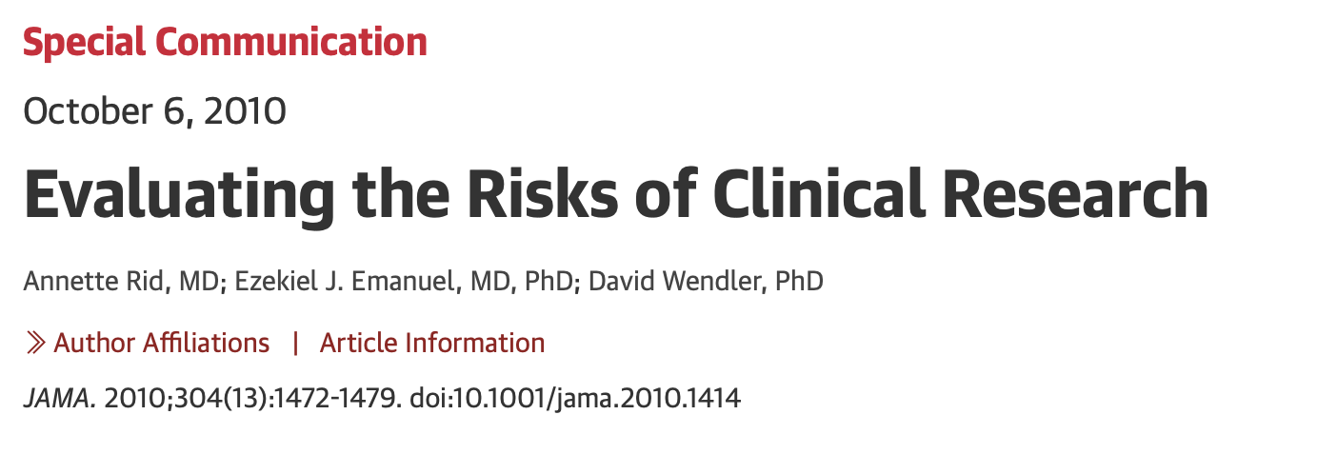
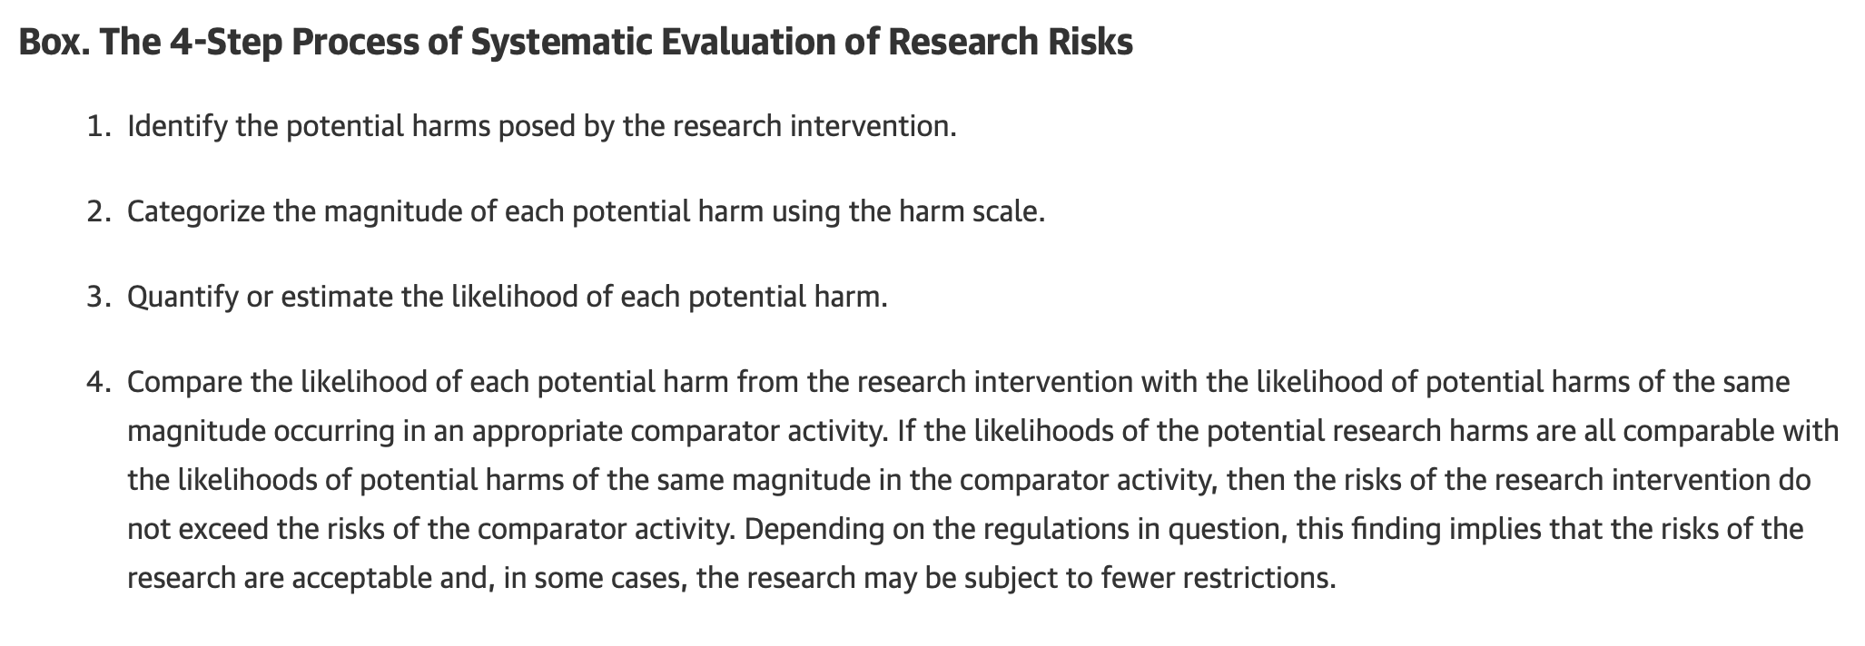

Slide 56
