Slide 1
Virtual Reality Simulation and Social Determinants of Health: A High-Tech Strategy to Improve Health Outcomes
Research Week 2019
Saundra L. Regan, PhD
Assistant Professor
Associate Director
Research Division
Department of Family & Community Medicine
saundra.regan@uc.edu

Slide 2
Acknowledgement
The Medicaid Equity Simulation Project is funded by the Ohio Department of Medicaid and administered by the Ohio Colleges of Medicine Government Resource Center. The views expressed in this presentation are solely those of the authors and do not represent the views of the state of Ohio or federal Medicaid programs.

Slide 3
Social Determinants of Health (SDH)
“…conditions in the environments in which people are born, live, learn, work, play, worship, and age that affect a wide range of health, functioning, and quality of life outcomes and risks.”
Healthy People 2020

Slide 4
Social Determinants of Health
Economic stability
Demographics
Social and community context
Health and health care
Neighborhood and built environment
Notes:
Employment
Housing instability
Food insecurity
Poverty
Early childhood education and development
High school graduation
Higher Education
Language and literacy
Race and Ethnicity
Language
Gender
Civic participation
Social cohesion
Incarceration
Discrimination
Reduced life expectancy
Higher incidence of cardiovascular disease, diabetes, infectious diseases
More disability
Access to foods that support healthy eating habits
Crime and violence
Environmental conditions
Quality of housing

Slide 5
Discrimination
“When stigma leads to social exclusion or discrimination (’experienced stigma’), it results in unequal access to resources that all people need to function well: educational opportunities, employment, a supportive community, including friends and family, and access to quality health care.”
CDC (2012)

Slide 6
Training on SDH
Didactic
Standardized patients
Clinical rotations
Community visits

Slide 7
Medicaid Equity Simulation Project
Grant from Ohio Department of Medicaid given to each Academic Health Center
Create a product to assist in educating providers about the SDoH
Targeted to Ohio Medicaid providers
Reduce implicit bias
Increase cultural competence
Recognize and address health disparities

Slide 8
Medicaid Equity Simulation Project
Virtual Reality: Educating Medicaid Providers on Health Disparities
College of Nursing (Susan Brammer, Lead Principal Investigator, Gordon Gillespie, Co-PI)
College of Medicine (Saundra Regan, COM Principal Investigator)
UC Center for Simulations & Virtual Environments Research (UCSIM) (Chris Collins, Senior IT Manager)

Slide 9
Development of Simulations
The scripts for the two virtual reality (VR) simulations were written by a communications expert and Medicaid Primary Care Providers
Reviewed by “experts” physician and advanced practice nurse providers who work with Medicaid patients, as well as standardized patients who have worked with students about SDoH, and virtual reality experts
Tested through phases by the experts on an iterative basis

Slide 11
Simulation One
No-Show
Depicted from the patient perspective.
Character is a middle-aged woman who is primarily Spanish-speaking.
She has several chronic diseases-CHF, HTN, Diabetes.
She has experienced several instances of being unable to make her primary care appointments due to lack of transportation.
She is headed to her appointment leaving her apartment and the elevator is out. She must climb down several flights of stairs and is not standing outside her building when her Medicaid transport bus arrives and they leave, she attempts to make it to the bus stop as the bus is pulling away.
Walking back to her apartment she collapses from shortness of breath.

Slide 12
Simulation One
She is taken to the ED and is evaluated for exacerbation of CHF.
The discharge nurse reads through her discharge instructions which include dietary changes and a new medication. The nurse asks if she understands everything and has any questions.
The character nods and signs but doesn’t understand very well since everything is in English.
When she gets home she calls the clinic for a new appointment and is informed that she has been discharged as a patient for 3 successive no-shows.

Slide 13
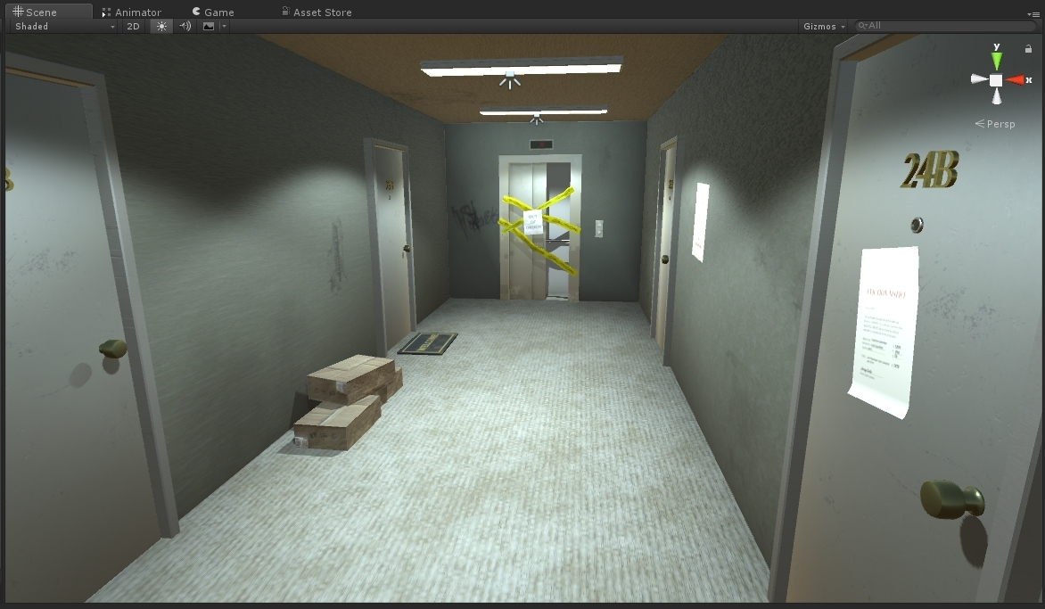
MEDICAID EQUITY SIMULATION PROJECT
SCENE MODELING
Notes:
This is to show them an example of a scene

Slide 14
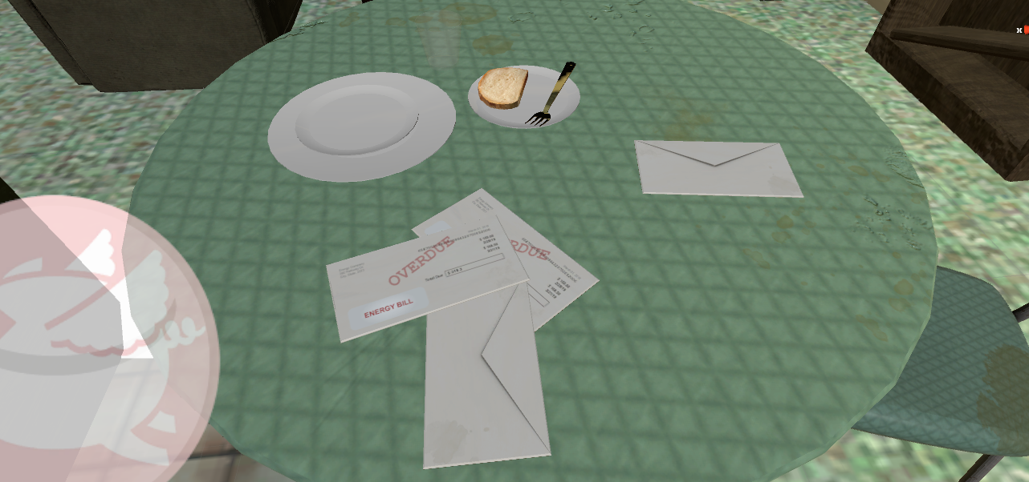

Slide 15
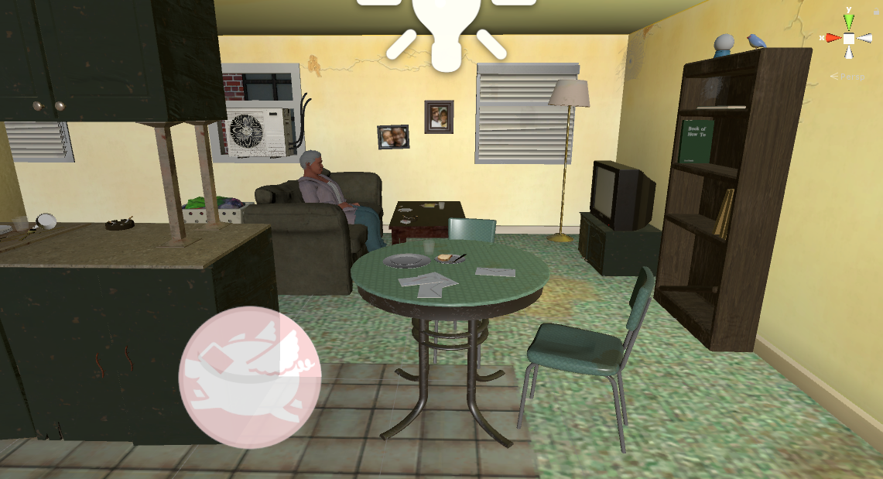
MEDICAID EQUITY SIMULATION PROJECT
CHARACTER AND SCENE MODELING

Slide 16
Simulation Two
Schizophrenia
Depicted from the patient perspective
Character is a young man living with his mother in an apartment.
He has schizophrenia and has not been taking his medication because he doesn’t like taking pills.
He is 45 minutes late to his appointment with the psychiatrist at the FQHC as he doesn’t have a car and has to take several buses to get there.
The provider is rushed and isn’t sure she can see him because he is so late and she has other patients waiting. She asks him some basic questions and writes his prescription. She asks him if would like to have case management.
He is suspicious about everyone knowing his business.

Slide 17
Simulation Two
He heads out and misses his bus and walks home. The neighborhood shows signs of poverty and crime.
He gets home to find overdue bills on his doorstep. There is nothing in the refrigerator.
His mother is angry and yells at him complaining of his inability to find or keep a job.

Slide 18
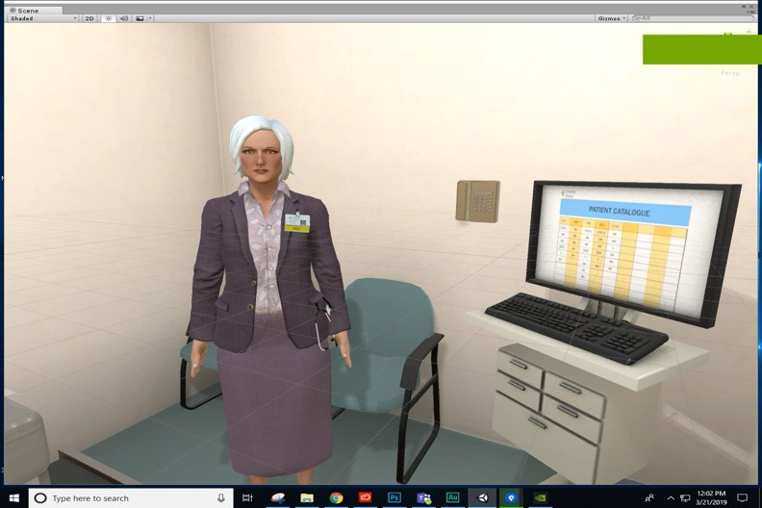
MEDICAID EQUITY SIMULATION PROJECT
CHARACTER MODELS

Slide 19
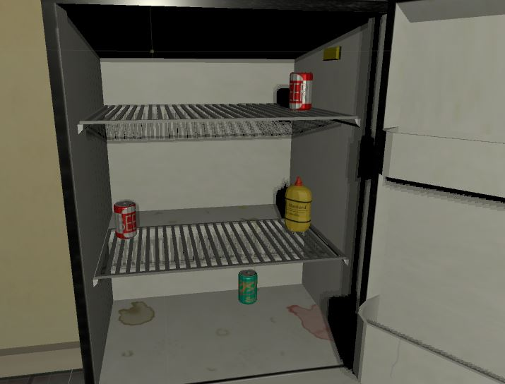
MEDICAID EQUITY SIMULATION PROJECT
SCENE MODELING
Notes:
Example of character

Slide 20
Evaluation
Evaluation will center on:
the use of the technology in educating providers about SDoH
how close the VR simulations are to the reality of the patients they see in daily situations
the patients in the simulation experience many types and forms of SDoH
how could facilitate better training of learners and providers
improvements that can be made to the simulations

Slide 21
Evaluation Timeline
February 2019 | Practitioner and Standardized Patient Participant Assessment for Content Validity
February/March 2019 | Initial Expert Panel Critique
March 2019 | Initial Expert Panel Assessment for Usability and Utilization/ Pilot Simulation 2 at All-Ohio Psychiatry Annual Meeting
April 2019 | Final Expert Panel Evaluation
April 2019 | Pilot Testing
April/May/June 2019 | Evaluation of Learning Experience by Provider Participants of the Virtual Reality Simulations
May/June 2019 | One Month Follow-up Evaluation
June 2019 | Data Analysis / Evaluation
July 2019 | Final Report
Notes:
I’ll say what changes are in evaluation timeline

Slide 22
Notes:
I am showing what we Chris and Joni have to schlep around and the reason we got new equipment, but what this has done to our timeline.

Slide 23
Notes:
New equipment

Slide 24
Medical Providers and Learners Please evaluate our Virtual Reality Simulation developed so far.
305 Procter Hall
College of nursing
Until 1 pm today
Notes:
I’ll say that personal connections are how we have gotten our sites. If it looks like we’ll have time, I’ll show the video we made about using the equipment.

Slide 25
Thank you !

