Slide 1
All Children Thrive Learning Network - Cincinnati
_{April} ₂₀₁₉

Slide 2
WHO WE ARE
All Children Thrive Learning Network
CCHMC Community Health Initiative
Robert Kahn, MD MPH
Professor of Pediatrics
Executive Lead, Community Health
Robert.kahn@cchmc.org
Anita Brentley, PhD
Community Engagement Consultant
Anita.brentley@cchmc.org
~30 at or affiliated with Children’s
~300 more gather biannually as part of the broader network

Slide 3
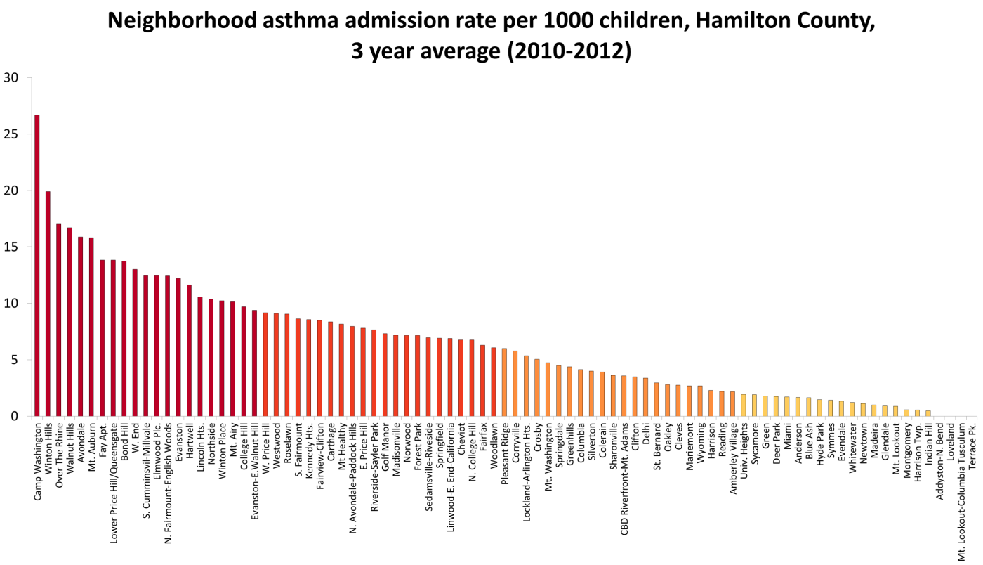
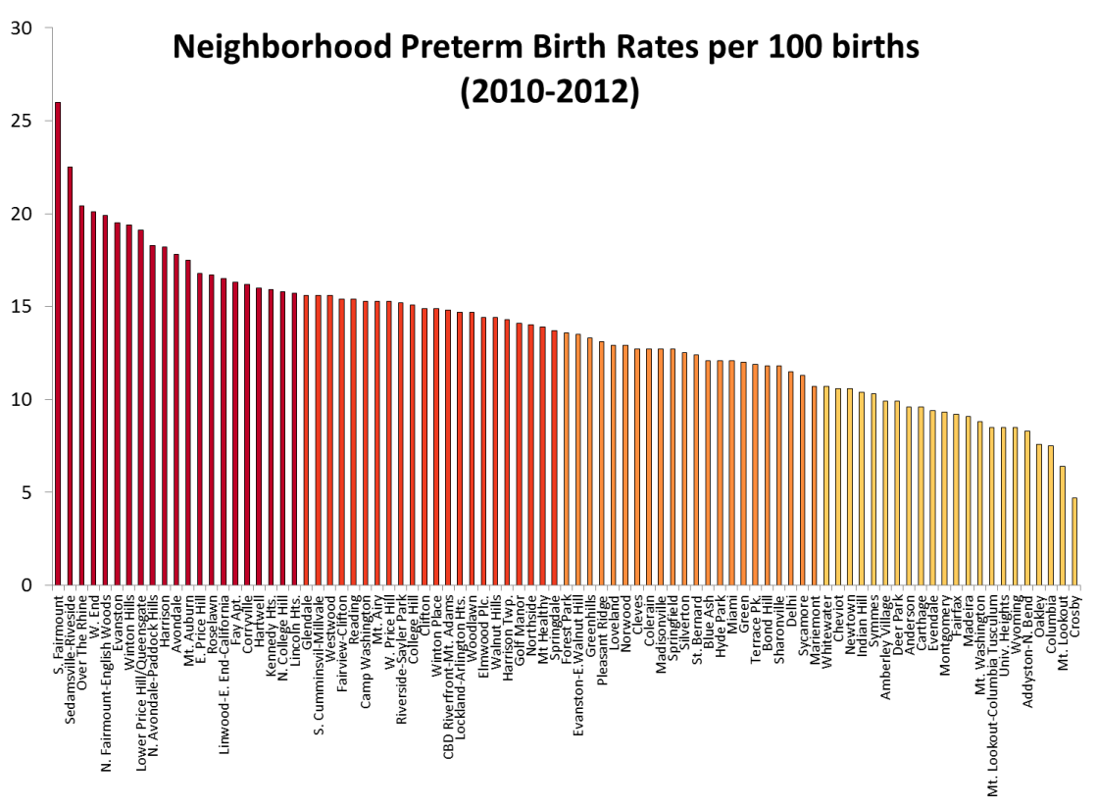
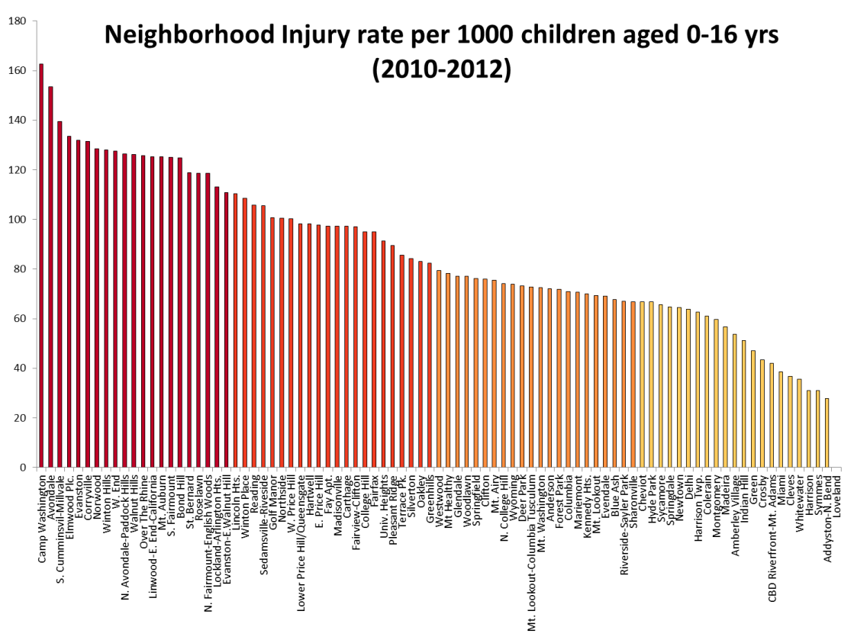
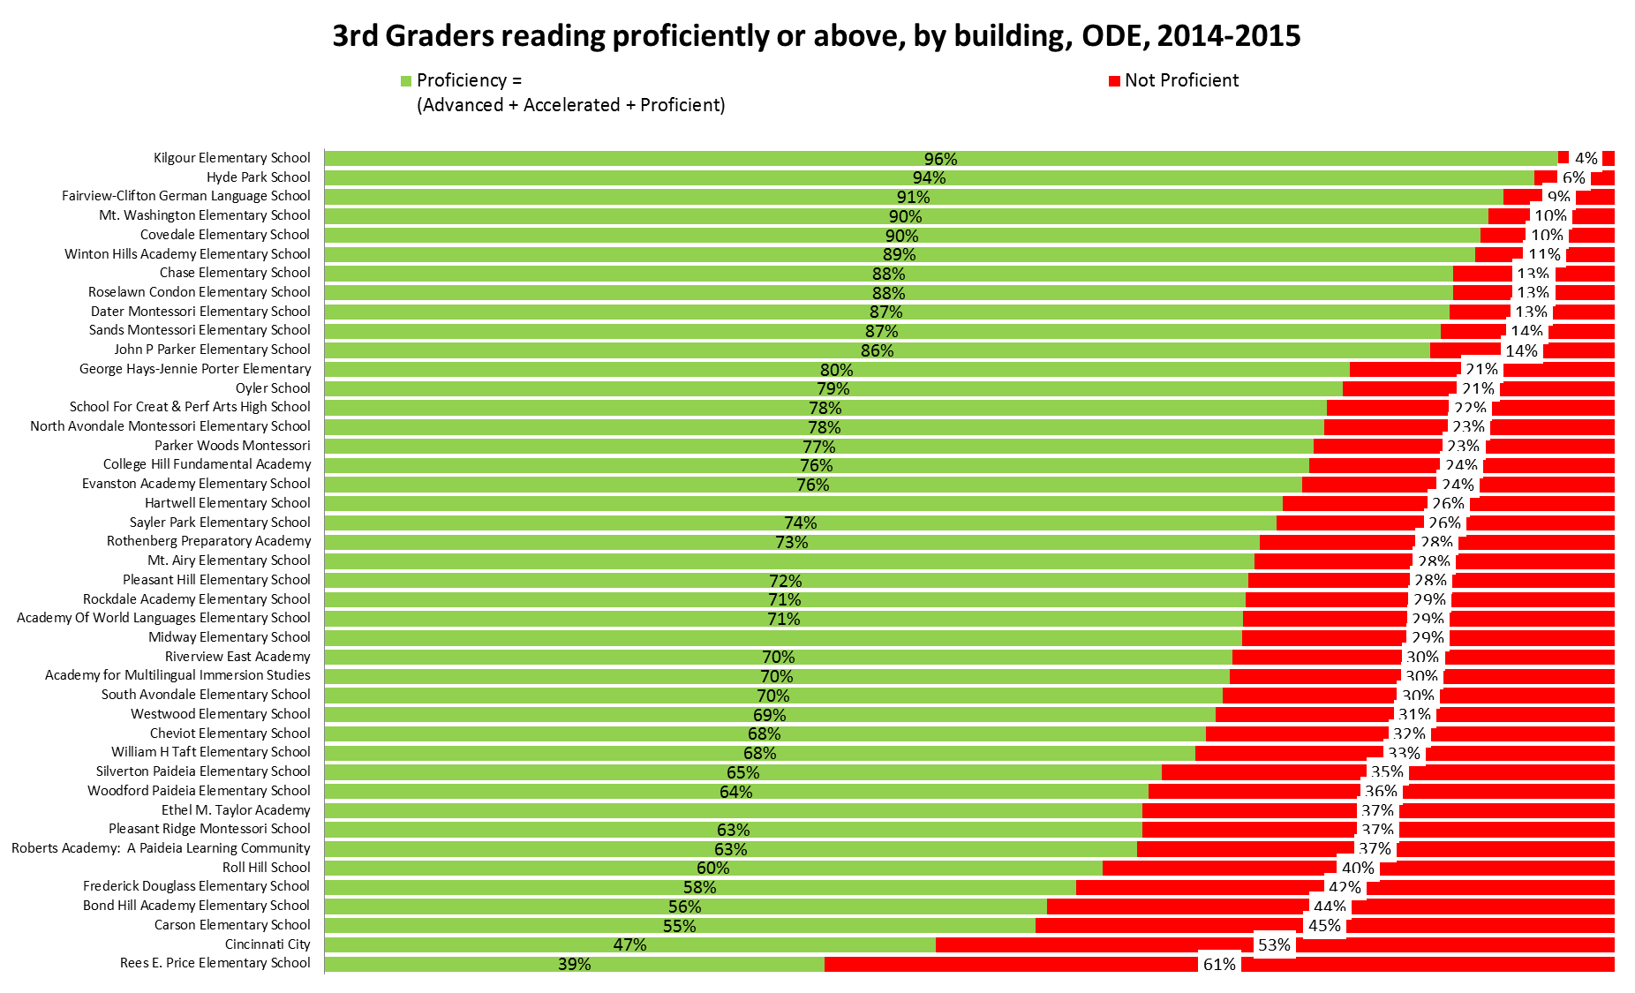
Avondale
Avondale
Price Hill
Price Hill
Avondale
Price Hill
Avondale
Price Hill
Notes:
Asthma – focus on cytokines… housing, pharmacy, schools..
School outcomes
Precision public health with get us to the role of root causes… here are similar neighborhood gradients in childhood injury, preterm birth, and mental health admissions.. Similar ordering of neighborhoods.. Suggesting some commonality among them, some shared root causes. PPH offers an opportunity to speed up insight into these fundamental issues.. But a study of molecular mechanisms will see these a individual conditions, silos… miss those foundational relationships
Enhanced by other data streams – EMS, Vital stats, crime exposure

Slide 5
WHAT WE DO
What are our primary activities/functions?
Describe accomplishments, resources, and projects

Slide 6
All Children Thrive Learning Network
Help Cincinnati’s 66,000 kids be the healthiest in the nation through strong partnerships
Morbidity and Mortality
Reduce annual infant deaths in Hamilton County
Reduce disparity in hospital bed days focusing on 2 high risk neighborhoods
Thriving
Ensure 5 year olds have a ‘healthy mind and body’*
Increase percent of children reading proficiently or above by 3rd grade in Cincinnati Public Schools
*Bundle measure: immunization, BMI, dental, behavior, vision, emergent literacy, speech, hearing

Slide 7
All Children Thrive Learning Network
Infant Mortality
Bed Day Disparity
Thriving at 5
3rd Grade Reading
Outcomes
Improvement Teams
Infant Mortality (Cradle Cincinnati)
Inpatient Bed Days Equity Team
Community Connected Primary Care
3rd Grade Reading
Community Quality Improvement Capability
Cores
Design Thinking, Community Activation
Data Management and Analytics
In Home Supports

Slide 8
Avondale

Slide 10
Notes:
Population Real life lab – FOR EVERY PROTOTYPE

Slide 11
Community activation
Level of Activation | Definition | Examples
Awareness | passive receipt of information | number of people who receive flyers, brochures or handouts; number connected via social media, email, website
Participation | use of existing tools or events | number of people attending community outreach events, learning sessions, network meetings, courses, number of people adopting changes
Contribution | improving existing tools, knowledge or resources | presenting at events, number of people involved in quality improvement at sites, number of people posting to sites, number of people serving on committees
Ownership | creating new resources / tools or leading initiatives | testing new ideas, co-leaders of work streams, parent leaders of activation projects

Slide 12
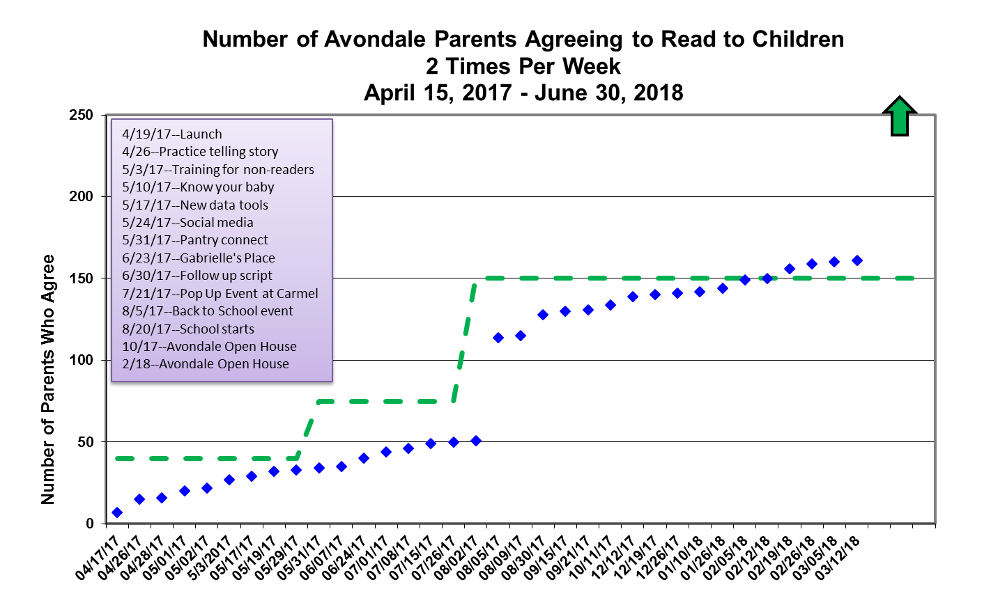
Caring Families: Reading Commitment

Slide 13
Community QI Capability
Model for Improvement
SMART
Specific
Measurable
Action Oriented
Realistic
Timely
What are we trying to
accomplish? AIM
How will we know that a change
is an improvement? MEASURES
What change can we make that
will result in improvement? IDEAS
Act
(Adopt, Adapt or
Abandon)
Plan
Study
Do
Langley et al. 1996

Slide 14
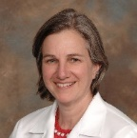
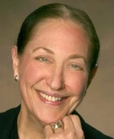
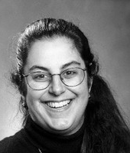
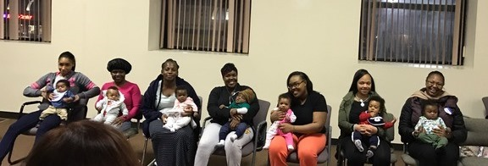
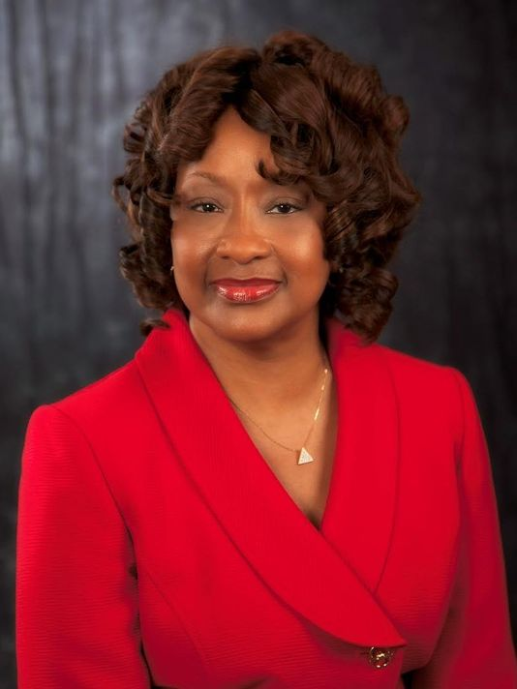
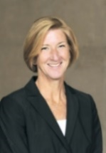
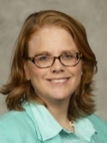
Building a Multi-Sector Learning Network
Obstetrics
Home visiting
Faith community
United Way
Pediatrics
Quality Preschool
City Council
Public schools
Public health
Benefits, child
welfare
Employment, financial . literacy
Legal aid:
housing, DV, benefits

Slide 15
HOW WE CAN BE A PARTNER TO OTHERS?
Population health
Multi-sector partnerships
Data analytics –disparities, improvement
Quality improvement
Design thinking and co-production with families

Slide 16
PARTNERS THAT WOULD BE USEFUL TO US?
2-3 generation approaches
Adult mental health – stress and depression
Job training and opportunities
Evaluation expertise

