Slide 1
Rapid Adaptive Control of Epidemic (RACE Network): Accelerating community-wide learning and response to the COVID pandemic
Michael Seid, PhD
Susan Cronin, PhD

Slide 2
0.5 x 0.5 = 0.25
McGlynn EA, et al. N Engl J Med 2003; 348:2635–45.
Mangione-Smith R, et al.. N Engl J Med. 2007;357:1515–1523
Brown & Bussell Mayo Clin Proc. 2011;86(4):304-314

Slide 3
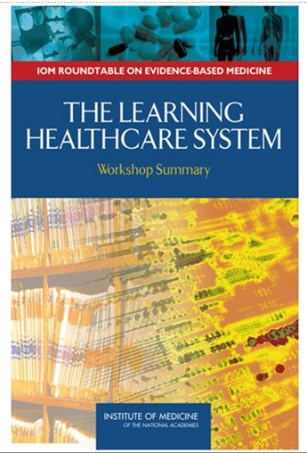
Learning Health System
(U.S. Institute of Medicine)
  One system for learning and doing (not separate systems for research and clinical care)
  Data is generated at the point of care, is aggregated to become knowledge, which is applied to clinical care, rapidly

Slide 4

Pediatric Inflammatory Bowel Disease
  Crohn’s disease and Ulcerative Colitis
109 Care Centers
950 Pediatric GIs
30,000 patients

Slide 5
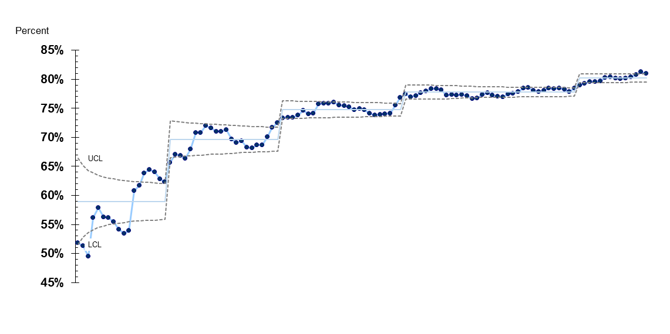
Clinical remission
82%
Apr
2007
Oct
2008
Aug
2010
Aug
2012
Jun
2015
Jul
2016
Centers with >75% of patients registered

Slide 6
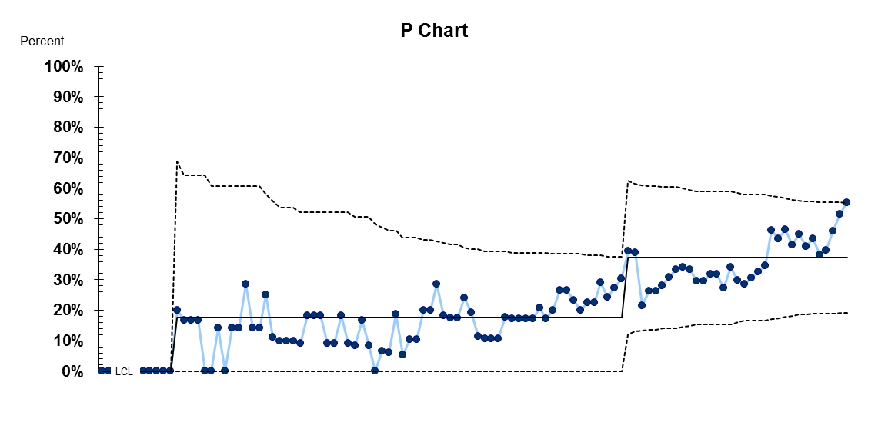
Centers with >80% clinical remission rate
55%
Jul
2007
May
2008
Nov
2013
Jul
2016
Centers registering patients >12 months

Slide 7

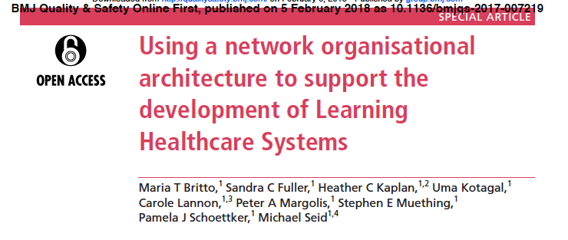


Replication in Other Networks
Solutions for Patient Safety Network
>100 hospitals
50% reduction in serious safety events
Ohio Perinatal Quality Collaborative
All 108 hospitals in Ohio
75% reduction in elective pre-term delivery
National Pediatric Cardiology Quality
Improvement Collaborative
57 hospitals; 90% of patients
40% reduction in inter-stage mortality

Slide 8


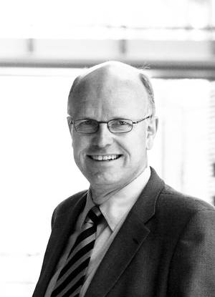

Martin Nowak
Evolutionary Biology
Dept of Mathematics
Harvard University
Elinor Ostrom 1933-2012
Economist
Nobel Laureate 2009
David Sloan Wilson
Distinguished Professor
Biological Sciences
and Anthropology
Binghamton University
Oystein Fjeldstad
Norwegian Business School
Chair, Dept of Strategy
Yochai Benkler
Harvard Law
Berkman Center

Slide 9
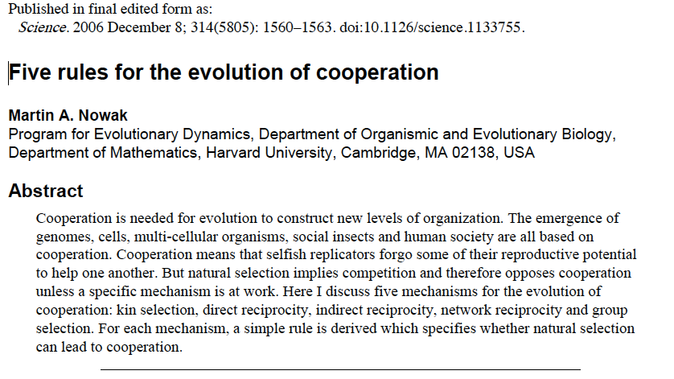
Kin Selection: Cooperate with genetic relatives
Direct Reciprocity: I help you, you help me
Indirect Reciprocity: I help you, somebody helps me
Network Selection: Neighbors help each other
Group Selection: Groups of cooperators (tribes) out-compete other groups

Slide 10
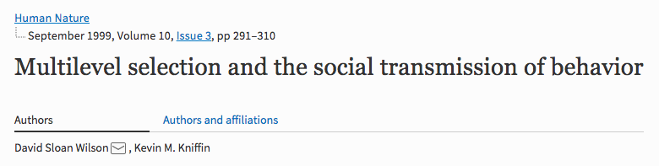
Multi-level selection
Cultural evolution
Multi-level selection
  "Selfishness beats altruism within groups. Altruistic groups beat selfish groups. Everything else is commentary”
Cultural Evolution
  Evolutionary forces also work on culture and behavior

Slide 11
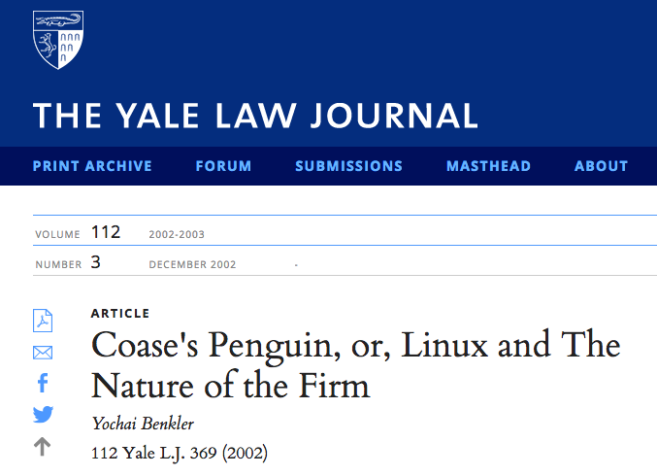

Commons-Based Peer Production
Distribution of the means of production of information, knowledge, and know-how
Non-market production
With the right system, everyone can be part of the solution

Slide 12
Design Principles for Stable Management of
Common Pool Resources
Clearly defined
Equitable resources and benefits
Access to decision-making
Monitoring
Graduated sanctions
Cheap and easy conflict resolution
Self-determination
Nested governance

Slide 13
The Architecture of Collaboration
Actor Oriented Architecture
  Actors who have a shared purpose and the capabilities and values to self-organize
  Renewable and expandable commons where the actors accumulate and share resources
  Protocols, processes, and infrastructure that enable peer-to-peer collaboration

Slide 14
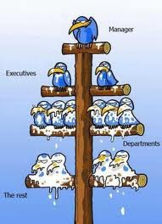
Architecture

Slide 15
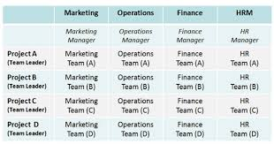
Architecture

Slide 16
Architecture

Slide 17
Actors with the will and ability to self-organize
All teach, all learn
Steal shamelessly, share seamlessly
You can make a difference
‘Words to describe us’
Common Purpose
Generosity and Contribution
Mastery
Continuous Improvement
Learning
Trust
Friendship
Solidarity
Respect

Slide 18
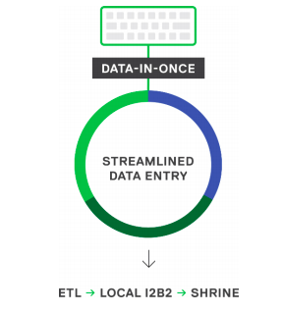
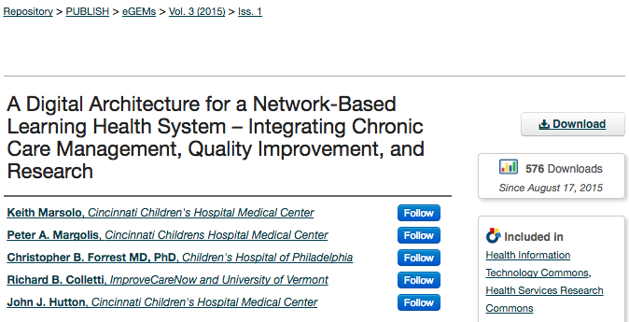
A commons to create and share resources
“Data in once”
  Research data collected as part of clinical care
Clinical Tools
  Pre-visit planning tool for efficient clinic visits
  Population management tool to identify patients needing more care
AHRQ R01HS020024

Slide 19
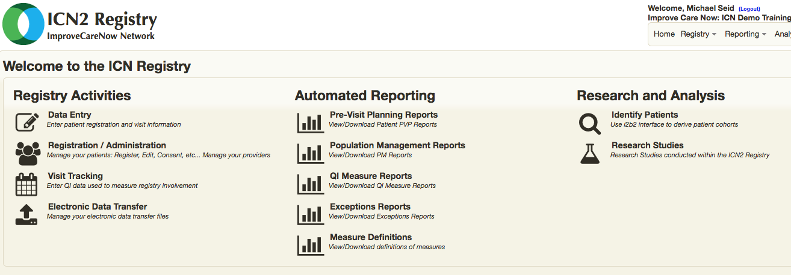
…A Commons
Notes:
Once you have the data flowing in, you can satisfy the second requirement and provide real-time guidance like pre-visit planning and population management. Built on Keith and John’s registry architecture, this screenshot is from ImproveCareNow’s enhanced registry (CLICK) showing the automated reporting available to clinicians, improvers, and researchers.

Slide 20
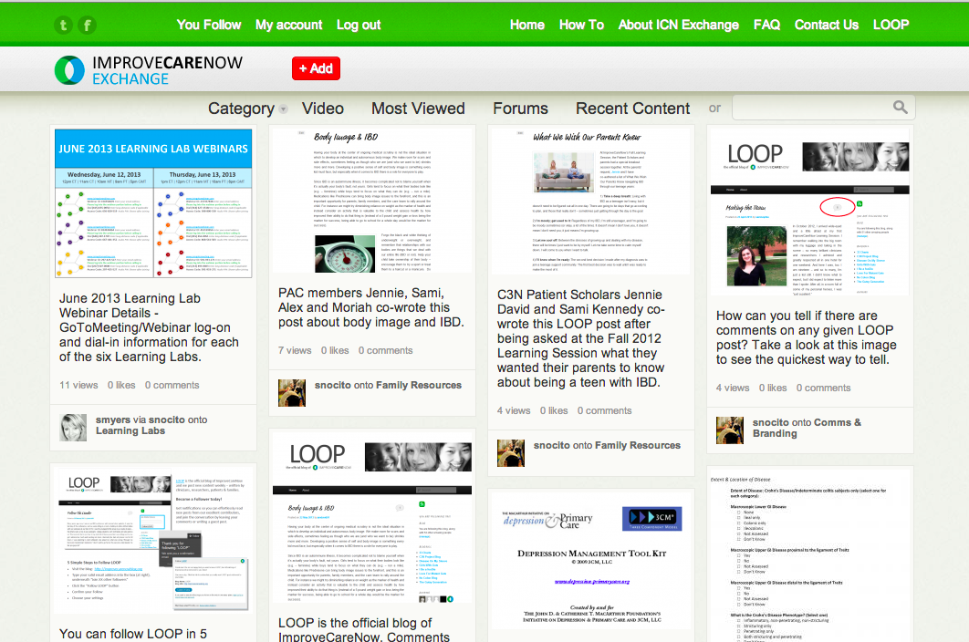
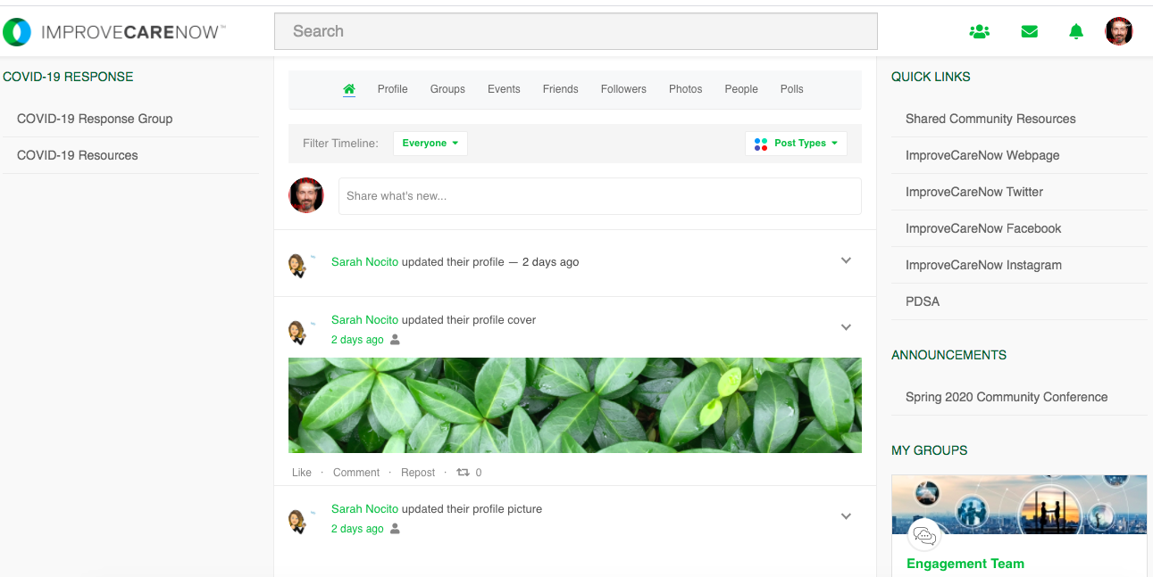
A commons..
Online
  Quality Improvement Reports
  Exchange – sharing how-to knowledge
  Hive SCIP
Offline
  Monthly phone calls
  Learning Labs (smaller groups)
  Biannual Learning Sessions

Slide 21

Working with – ‘co-production’
Health care is not something given from an expert to a customer, it is shared work – requires producing together
We don’t work for families as customers
We work with families as partners

Slide 22
Facilitating multi-actor collaboration

Slide 23
Examples: contributions last 2 months
Pre-visit planning video (Levine)
Group visit model (CHKD)
Parents on research committee helping develop research policies and process (Las Vegas)
Master reliance agreement template (IRB chairs at BCH, CCHMC and CHOP)
Speak out video (Alex Joffriet - CCHMC)
Ostomy toolkit (PAC)
Design for a clinical trial (ICN)

Slide 24
CCTST Optional Module: LHS
Goal: accelerate research, translation, and implementation of new knowledge into improved outcomes
Specific Aims
  Engage stakeholders in co-designing and collaboratively testing interventions to facilitate emergence of LHSs that improve outcomes by integrating clinical/translational research with health care practice
  Align and integrate functions across the CCTST for training and methodologic support to apply the network architecture that facilitates LHS formation

Slide 25
Original Plan
Develop, test, and refine interventions that facilitate the formation of a LHS within a major clinical sub-system of the AHC, specifically UC Health’s Gardner Neuroscience Institute and CCHMC’s Mind, Brain, and Behavior Initiative
…and then COVID-19 arrived.

Slide 26
New Plan
Let no pandemic “go to waste”!
COVID-19 provides a unique opportunity to build an LHS and contribute to the broader regional mission
Ultimately arrive at the same place through rapid prototype: a replicable, tested approach to facilitating the creation of LHSs within the AHC
Prototype—An approximation of product, service, component of a system, or system among one or more dimensions of interest

Slide 27
The Big Picture
Multi Agency Coordination
(Coalition)
Hospital Steering Committee
Work Groups
Public Health Steering Committee
Task Force
Congregate Care Steering Committee
Work Groups
Co-Chairs:
Evie Alessandrini & Steve Davis
The “RACE” Team:
Peter Margolis
Rob Kahn
Andy Beck
David Hartley
Michael Seid
Susan Cronin
Myra Saeed

Slide 28
The “RACE” Team
Goal: enable Rapid, Adaptive Control of the Epidemic
Mandate:
  Understand real time spread of disease using data from disease surveillance, diagnostic testing, and reporting systems to ensure that up-to-date information on local spread is available to inform strategy-setting and daily tactical decision-making to MAC sub-committees
  Use surveillance data to inform and update model-based forecasts
  Develop measurement and collaborative learning system to achieve and keep Reff<1.0 through integrated public health, health system, and community interventions
LHS
Module

Slide 29
LHS Update: Month 1
Developed an aim and theory focused on improving outcomes
Developed (and continue to refine) a logic model/work plan based on literature and theory of LHS frameworks
Created a virtual knowledge sharing infrastructure via Hive Networks
Identified and started collaborating with motivated partners
  Primary Care
  Pulmonary Medicine
Iterated. Iterated. Iterated. Iterated…

Slide 30
Secondary Drivers
Global Aim
Primary Drivers
Hospital-Based Care
Suppress transmission sufficient to reduce disease burden and return to economic productivity
Effective COVID Health Care Services
Ambulatory Care
Congregate Care (SNF, Shelters, Prisons)
SMART Aim
Community-Based Care
By July 2020:
Reduce mortality to seasonal levels
Achieve and maintain Reff < 1.0
Reduction in Reff similar across all populations
Increase economic productivity to normal levels and reduce unemployment
Maintain workforce >95%
Prepared, Protected Community and Workforce
Public Health Driven Prevention of Spread
Detection, Tracing, Containment
Population Awareness & Behavior Change
Leadership, Coordination, Communication
Effective Planning, Coordination, and Delivery of COVID Response
Population
Supply Chain for Goods and Services
Zone 3 Region
Policy, Regulation, Rights, Ethics
Real time Measurement and Learning System
Notes:
Contact allowance
Risk assessment, surveillance, measurement
Responsive delivery -
Situational awareness: Situational awareness or situation awareness (SA) is the perception of environmental elements and events with respect to time or space, the comprehension of their meaning, and the projection of their future status.[1]
Network learning system: structure and process for a LN to – collaborative culture, sharing of resources – what does it take to stand it up as a Network
where do models fit in to predict and support decision making
Under learning system - collaborative social network sharing platform, prioritized questions aligned with operational and strategic goals
ongoing evidence synthesis to inform decision making
focused planned experiments to accelerate learning
formalized learning structure (5 core components updated regularly)
Planned experimentation
Modeling –
formalized learning structure (5 core components updated regularly)
# of shots on goal
# of teams focused on priority questions

Slide 31
Opportunities
Leverage CCTST expertise to support emerging COVID workgroups where learning needs to take place (e.g., evidence, analytics, research)
  Hospital, Ambulatory, Neighborhood, Congregate Care, Public Health
Collaborate with teams addressing “burning questions” related to research/clinical restart
  Ex: telehealth
  Ex: community engagement around “crisis standards of care”
  Ex: testing/tracing strategies
NIH/NCATS COVID funding opportunities?

