Slide 1
Virtual Meeting on Social Determinants of Health Research, Education, & Practice in the College of Nursing
Rebecca Lee, PhD, RN, PHCNS-BC, CTN-A Associate Professor, University of Cincinnati College of Nursing

Slide 2
UC College of Nursing
Mission Develop nurse leaders who are empowered to generate, explore and apply nursing knowledge for evolving health care environments
Vision Through the creative leveraging of technology and inclusive excellence, we will lead the transformation of health care in partnership informed by the people we serve
Values ICARE: Integrity, Collaboration, Accountability, Respect and Excellence
Notes:
In the College of Nursing, our goal is to prepare nurse leaders who are empowered to generate, explore, and apply nursing knowledge for evolving health care environments.
One key strategy for preparing today’s nurses is use of the social determinants of health framework

Slide 3
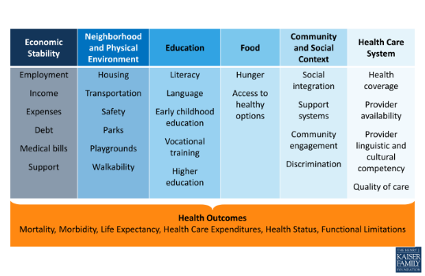
Social Determinants of Health
Notes:
While all of these factors are important, my own focus has been on built environment and homelessness. As faculty in the CON share this framework with our students, and apply it to our own research and practice, it is important to note that an intervention directed at any one area will result in improved health outcomes!

Slide 4
Homelessness
Over 3.5 million individuals are homeless at some point during an average year
800,000 American men, women, and children experience homelessness each night
2015 statistics from The Partnership Center showed 11,807 people experiencing homelessness in Greater Cincinnati
Health disparities are exacerbated among homeless individuals as a result of competing demands
Poor health contributes to becoming homeless, and is a major barrier to successful transition from homelessness
Notes:
A very brief background on homelessness

Slide 5
Previous & Current Research
A program of homelessness research
Ethnographic study of Appalachian mothers caring for their children in an urban homeless shelter (Lee, PI)
Ethnographic study of Appalachian families transitioning from homelessness into housing (Lee, PI)
Grounded theory study of the process by which homeless veterans manage chronic disease (Weber, PI; Lee, Co-I)
Grounded theory study of the process of health promotion among adults transitioning from homelessness (Lee, PI; Brehm, Co-I)
Notes:
Discuss briefly each study

Slide 6
Overview of Findings
Notes:
Note – all of these findings can be mapped to the previously viewed diagram depicting the SDH

Slide 7
UC Transdisciplinary Research Leadership Fellowship
UC Research development program
6 diverse scholars brought together to identify and tackle a “wicked problem” of our society using a transdisciplinary approach
Zvi Biener – Philosophy
Karlynn BrintzenhofeSzoc – Social Work
Josh Gross – Biology
Rebecca Lee - Nursing
Maobing Tu – Environmental Engineering
Xinhao Wang – Urban Planning
Topic: Loneliness in older adults
Notes:
In order to tackle the wicked problems of our society, we must prepare researchers to work together in partnership – and provide them with useful frameworks such as the SDH

Slide 8
Education
Health Issues of Vulnerable & Marginalized Populations: online learning course offered at both undergraduate and graduate levels to all UC students through the CoN
Currently, Nursing and Social Work students at both undergraduate and graduate levels participate
Course developed in 2008 based on SDH framework
Course guides students toward delivery of more culturally competent care to members of our society who are vulnerable & marginalized

Slide 9
Community Partnerships for Practice
St. Vincent de Paul in the West End of Cincinnati
Holistically meets the needs of neighbors by addressing crucial SDH elements
Charitable pharmacy, choice food pantry, homelessness prevention program
UC Open School Interprofessional clinic
Students & faculty from the colleges of nursing, medicine, pharmacy, allied health, and UCBA dental hygiene program come together to staff a health clinic each Saturday morning

Slide 10
Discussion
Additional Nurse Researchers: CON Website:
https://nursing.uc.edu/research/researchers.html
How can we be a partner to others?
Who are partners that would be useful to us?
Further discussion

