Slide 1
Live Well Collaborative
Session on Aging
Center for Clinical & Translational Science & Training, The Collaboration Network
January 17, 2019
© Live Well Collaborative

Slide 2
Who we are:
Our Purpose:
Founded in 2007 by the University of Cincinnati and Procter & Gamble, the Live Well Collaborative is a 501c6 nonprofit that transforms people’s experiences by delivering breakthrough innovations across the lifespan.
To specialize in USER CENTERED RESEARCH for the development of products and services for living well across the lifespan, with an expertise in the 50+ marketplace.
© Live Well Collaborative
Notes:
Building upon the success of the MENLO sessions, a University of Cincinnati DAAP (College of Design, Architecture, Art, and Planning) Masters of Design team took a deep dive in understanding the imaging process at UC Health Radiology. This deep dive acted as a framework for the Summer 2018 project conducted between UC Health Radiology, GE Healthcare, and the Live Well Collaborative. This supported UC Health’s dedication to improving lives through Empathy, Expertise, and Innovation in Radiology and the Vision of UC Health Radiology to be a nationally recognized center of imaging excellence known for best in class Patient Experience, a Nationwide Referral Base, and Innovative Research & Teaching. This project is a collective effort between UC Health Radiology, The Live Well Collaborative, and GE Healthcare, to help UC Health Radiology achieve their objectives.

Slide 3
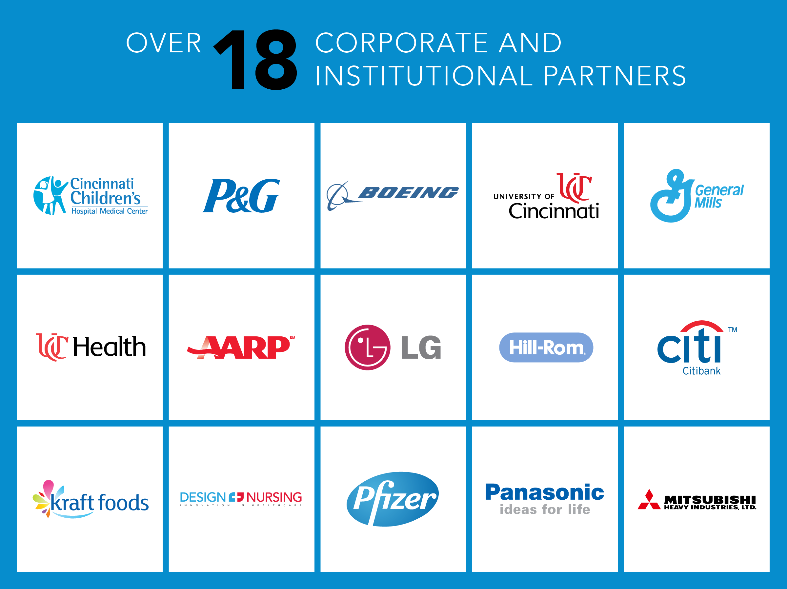

© Live Well Collaborative
+
+
Notes:
Building upon the success of the MENLO sessions, a University of Cincinnati DAAP (College of Design, Architecture, Art, and Planning) Masters of Design team took a deep dive in understanding the imaging process at UC Health Radiology. This deep dive acted as a framework for the Summer 2018 project conducted between UC Health Radiology, GE Healthcare, and the Live Well Collaborative. This supported UC Health’s dedication to improving lives through Empathy, Expertise, and Innovation in Radiology and the Vision of UC Health Radiology to be a nationally recognized center of imaging excellence known for best in class Patient Experience, a Nationwide Referral Base, and Innovative Research & Teaching. This project is a collective effort between UC Health Radiology, The Live Well Collaborative, and GE Healthcare, to help UC Health Radiology achieve their objectives.

Slide 4
© Live Well Collaborative
+
+
Notes:
Building upon the success of the MENLO sessions, a University of Cincinnati DAAP (College of Design, Architecture, Art, and Planning) Masters of Design team took a deep dive in understanding the imaging process at UC Health Radiology. This deep dive acted as a framework for the Summer 2018 project conducted between UC Health Radiology, GE Healthcare, and the Live Well Collaborative. This supported UC Health’s dedication to improving lives through Empathy, Expertise, and Innovation in Radiology and the Vision of UC Health Radiology to be a nationally recognized center of imaging excellence known for best in class Patient Experience, a Nationwide Referral Base, and Innovative Research & Teaching. This project is a collective effort between UC Health Radiology, The Live Well Collaborative, and GE Healthcare, to help UC Health Radiology achieve their objectives.

Slide 5
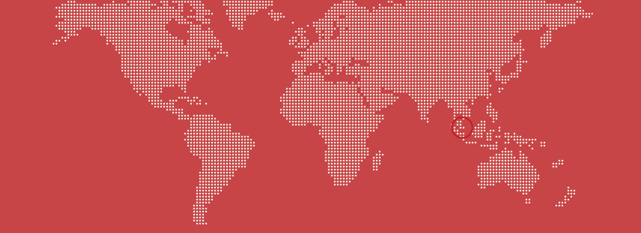
Global Presence
Legally and financially separate, Live Well Singapore was founded in 2010 through a partnership between P&G and Singapore Polytechnic. Live Well Collaborative and Live Well Singapore share a process model and methodologies, as well as global partners including P&G, Boeing, Hill-Rom, and Mondelez.
© Live Well Collaborative

Slide 6
© Live Well Collaborative
+
+
Notes:
Building upon the success of the MENLO sessions, a University of Cincinnati DAAP (College of Design, Architecture, Art, and Planning) Masters of Design team took a deep dive in understanding the imaging process at UC Health Radiology. This deep dive acted as a framework for the Summer 2018 project conducted between UC Health Radiology, GE Healthcare, and the Live Well Collaborative. This supported UC Health’s dedication to improving lives through Empathy, Expertise, and Innovation in Radiology and the Vision of UC Health Radiology to be a nationally recognized center of imaging excellence known for best in class Patient Experience, a Nationwide Referral Base, and Innovative Research & Teaching. This project is a collective effort between UC Health Radiology, The Live Well Collaborative, and GE Healthcare, to help UC Health Radiology achieve their objectives.

Slide 7
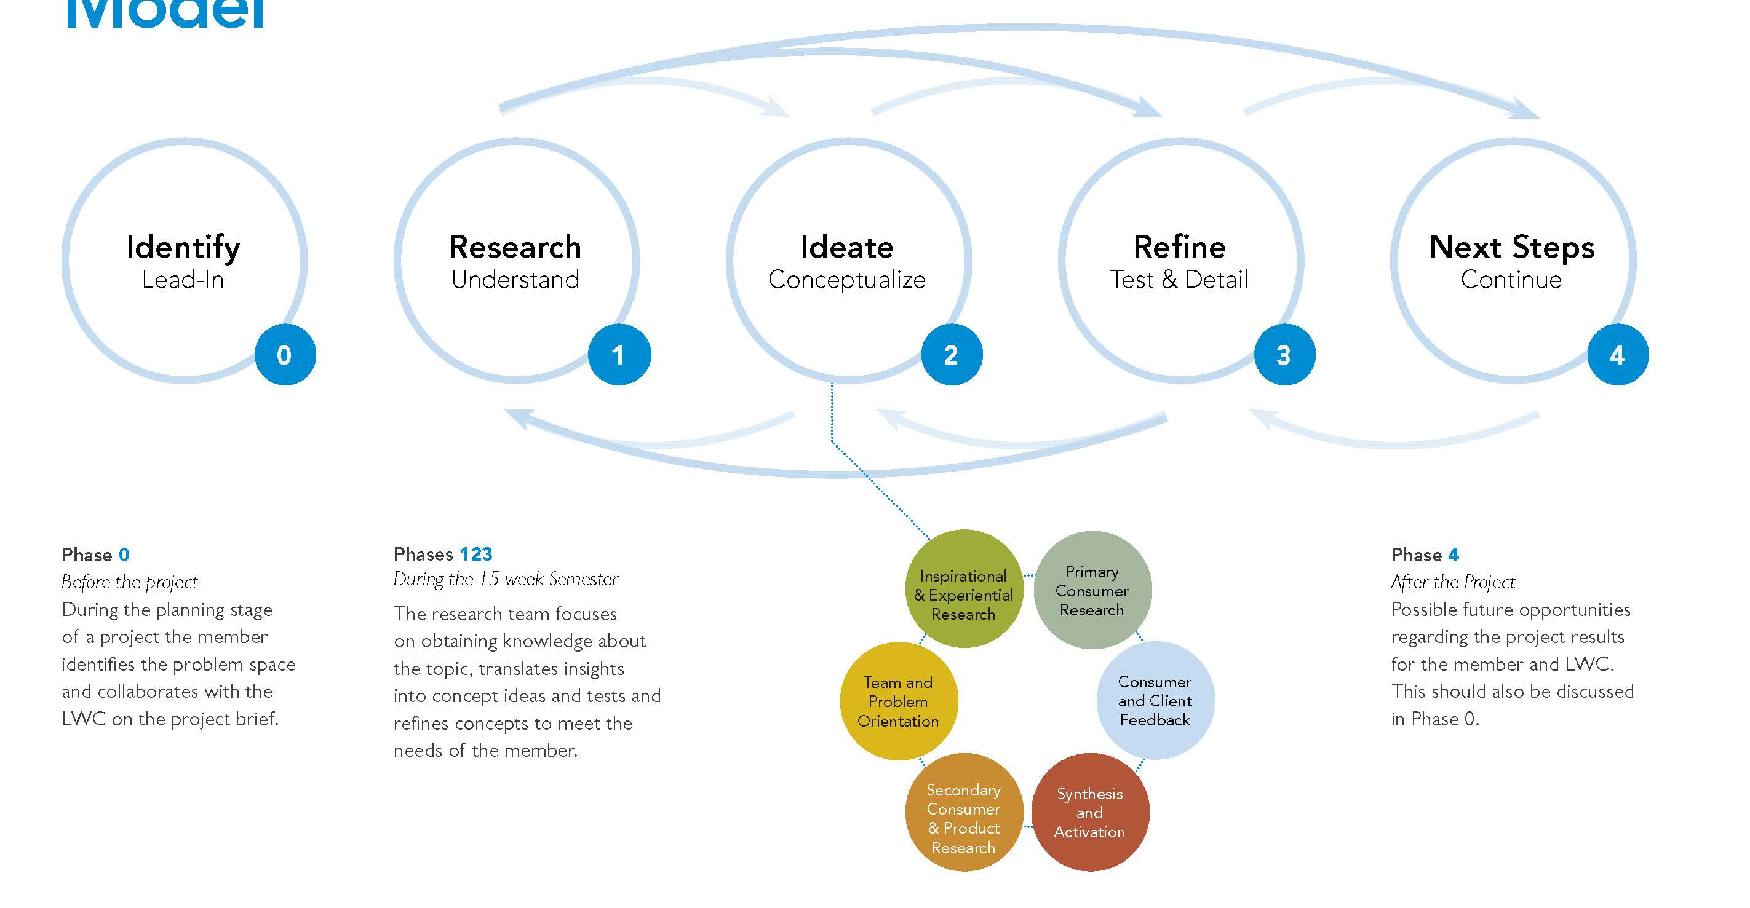
Process Model
Idea to concept in 16 weeks.
© Live Well Collaborative
Notes:
Building upon the success of the MENLO sessions, a University of Cincinnati DAAP (College of Design, Architecture, Art, and Planning) Masters of Design team took a deep dive in understanding the imaging process at UC Health Radiology. This deep dive acted as a framework for the Summer 2018 project conducted between UC Health Radiology, GE Healthcare, and the Live Well Collaborative. This supported UC Health’s dedication to improving lives through Empathy, Expertise, and Innovation in Radiology and the Vision of UC Health Radiology to be a nationally recognized center of imaging excellence known for best in class Patient Experience, a Nationwide Referral Base, and Innovative Research & Teaching. This project is a collective effort between UC Health Radiology, The Live Well Collaborative, and GE Healthcare, to help UC Health Radiology achieve their objectives.

Slide 8
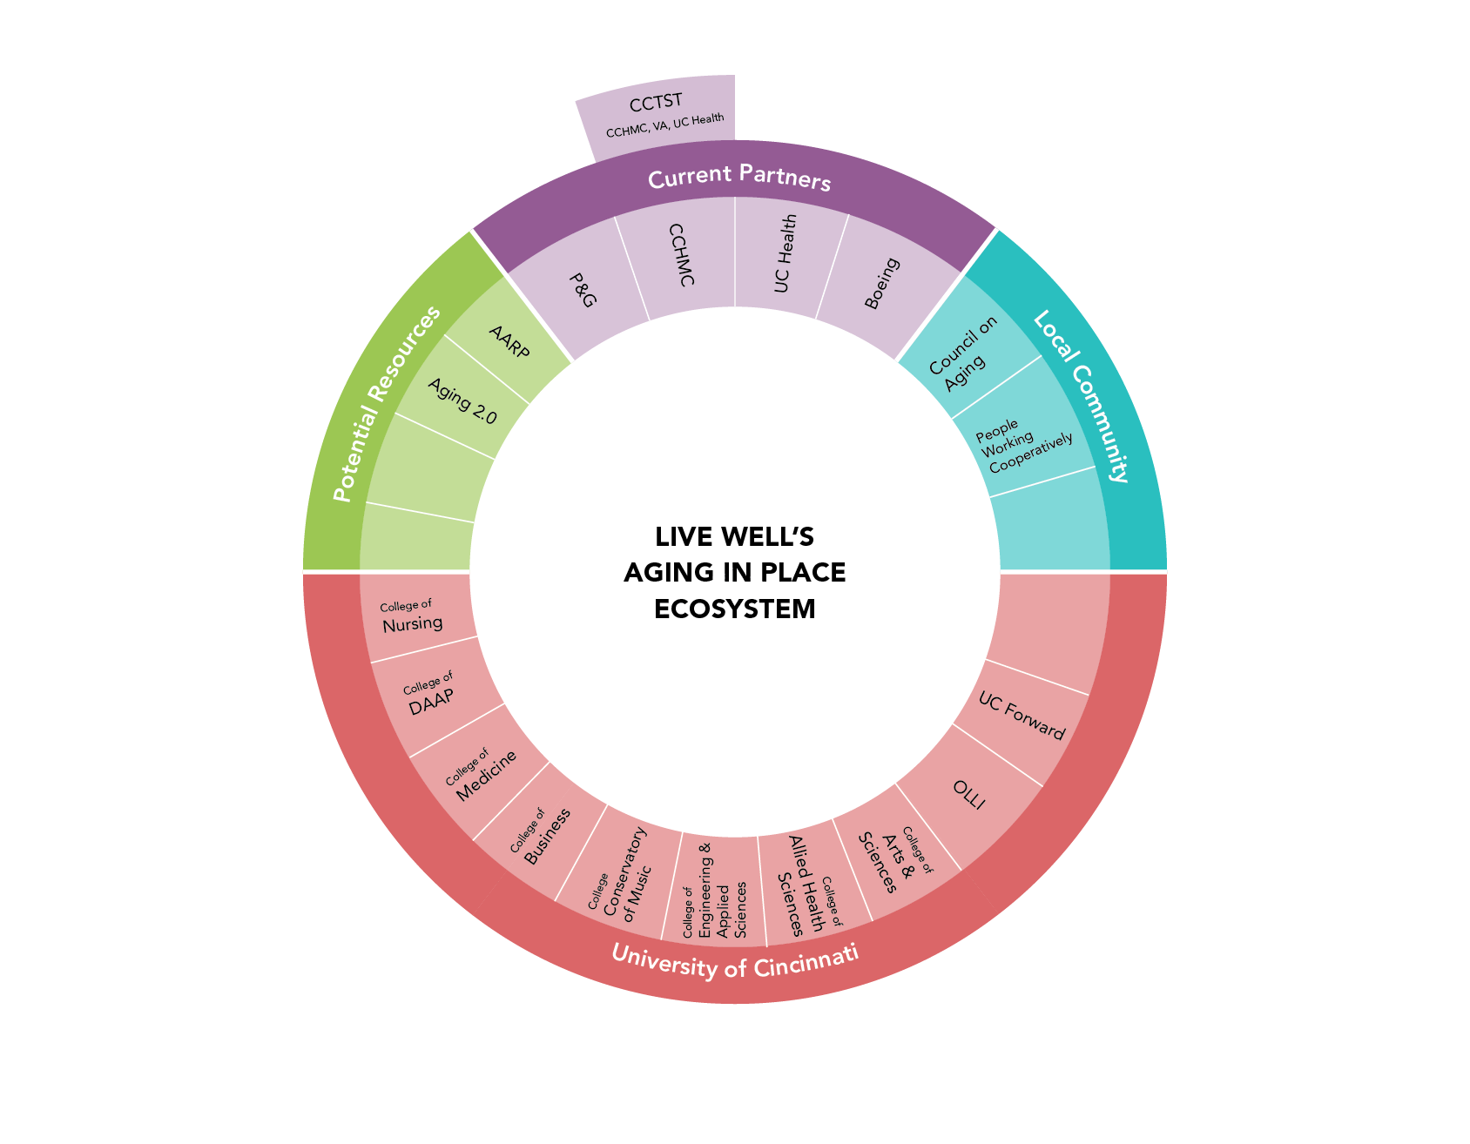
Our Network:
© Live Well Collaborative

Slide 9
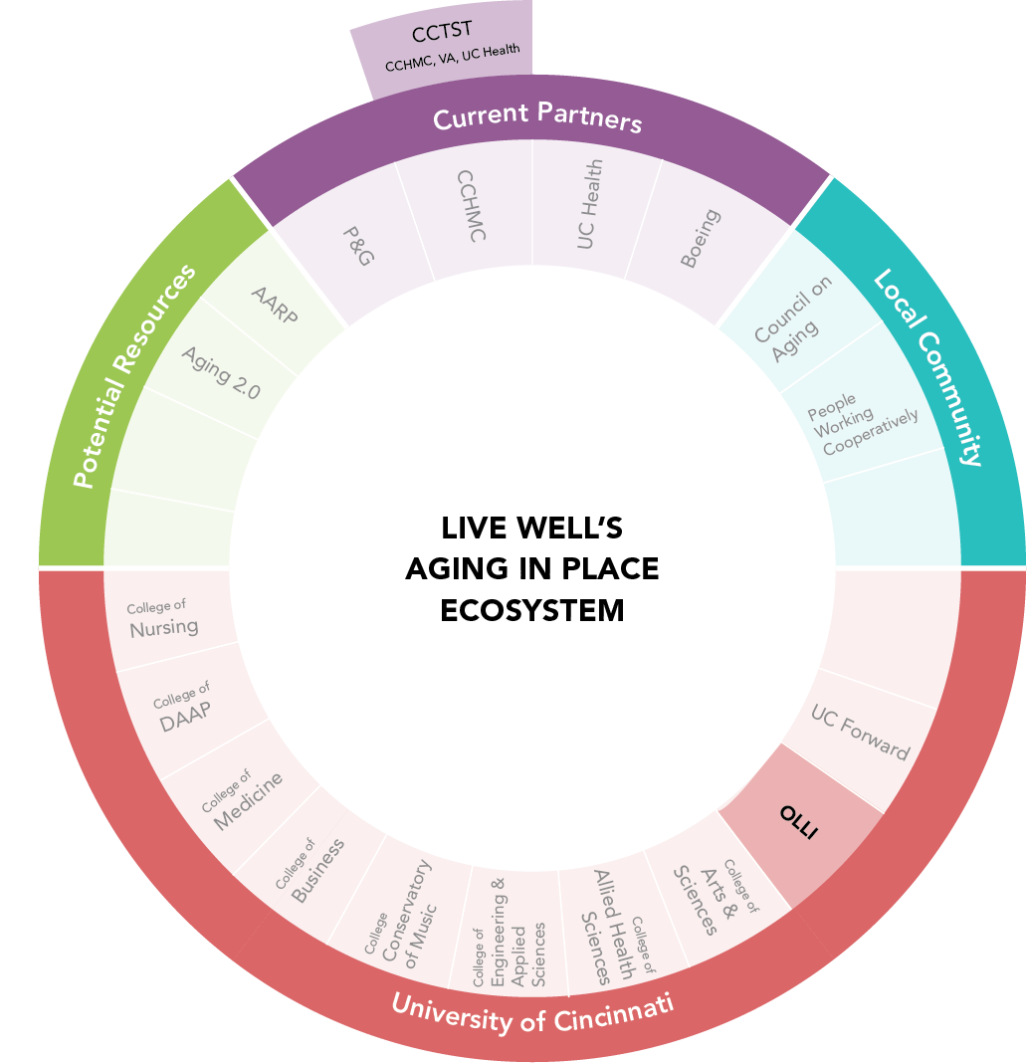
Key Partnership - OLLI
© Live Well Collaborative
Notes:
Building upon the success of the MENLO sessions, a University of Cincinnati DAAP (College of Design, Architecture, Art, and Planning) Masters of Design team took a deep dive in understanding the imaging process at UC Health Radiology. This deep dive acted as a framework for the Summer 2018 project conducted between UC Health Radiology, GE Healthcare, and the Live Well Collaborative. This supported UC Health’s dedication to improving lives through Empathy, Expertise, and Innovation in Radiology and the Vision of UC Health Radiology to be a nationally recognized center of imaging excellence known for best in class Patient Experience, a Nationwide Referral Base, and Innovative Research & Teaching. This project is a collective effort between UC Health Radiology, The Live Well Collaborative, and GE Healthcare, to help UC Health Radiology achieve their objectives.

Slide 10
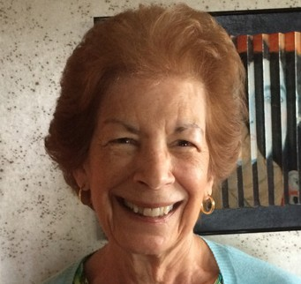
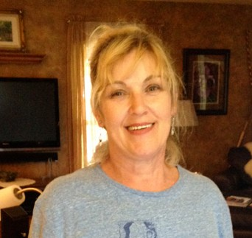
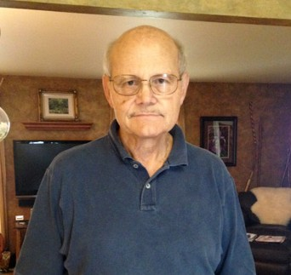
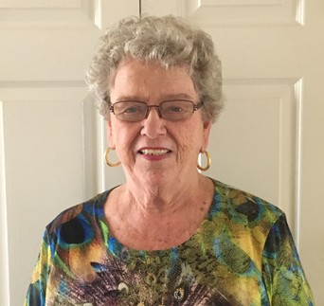
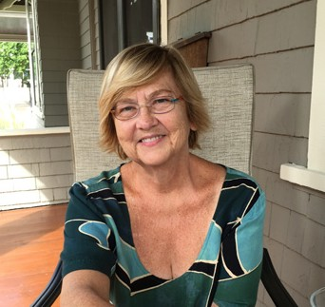
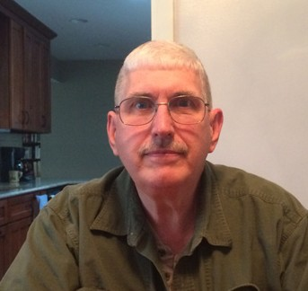
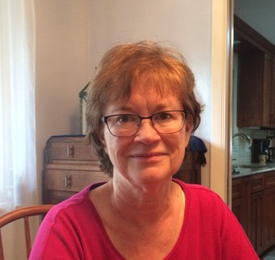
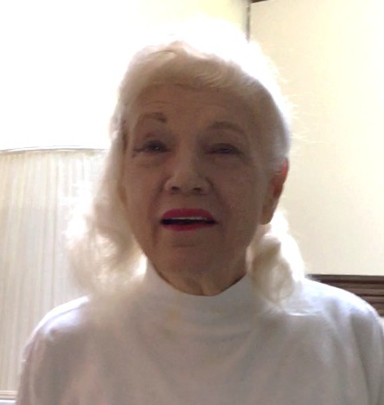
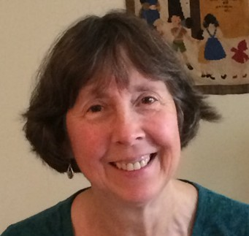
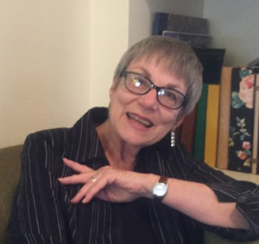
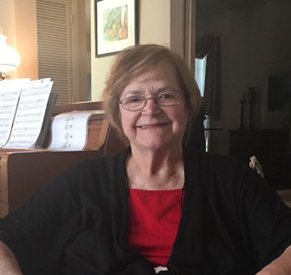
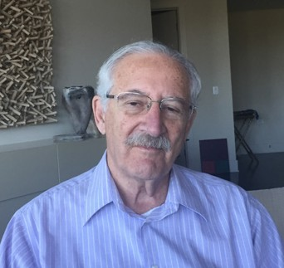
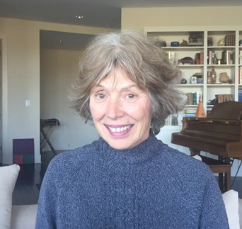
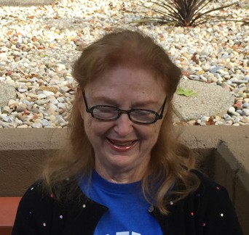
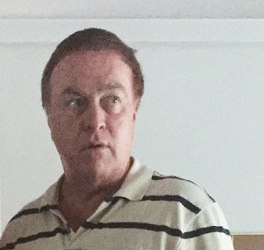
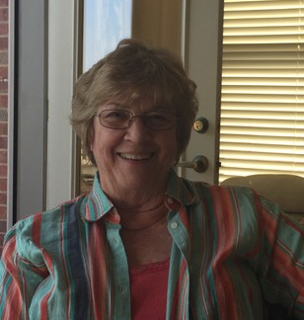
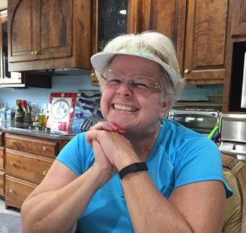
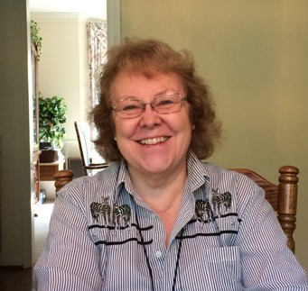
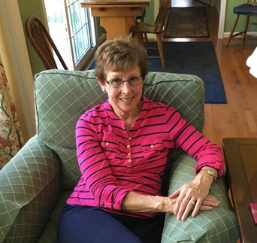
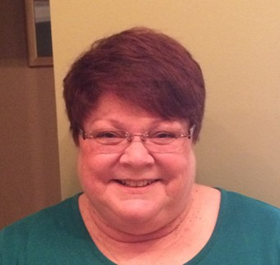
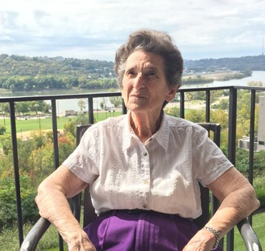
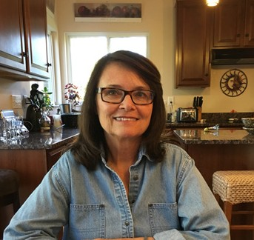
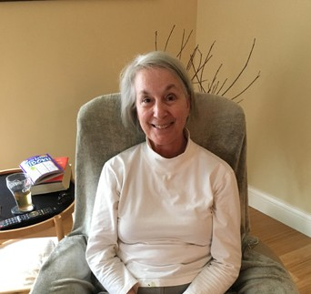
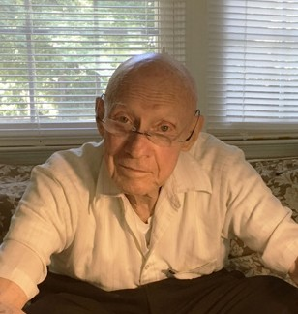
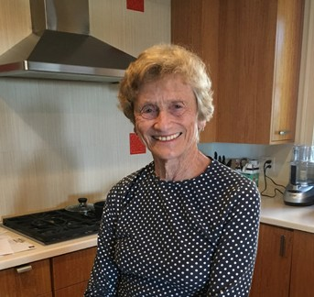
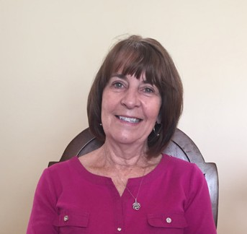
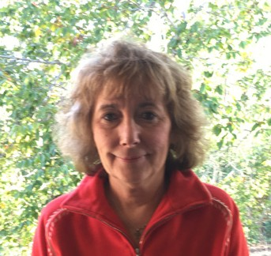
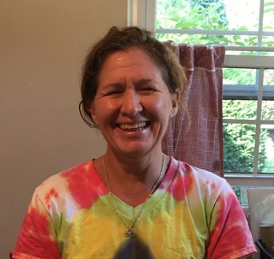
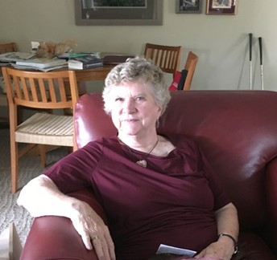
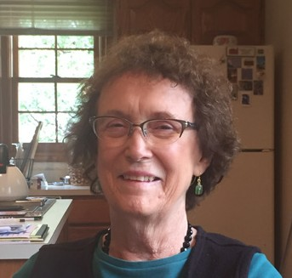
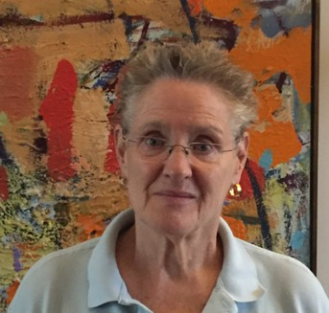
Swiffer Ergonomic Redesign
Thirty consumers were identified from OLLI, the Osher Lifelong Learning Institute, at UC. Participants were located over the Greater Cincinnati area.
© Live Well Collaborative

Slide 11
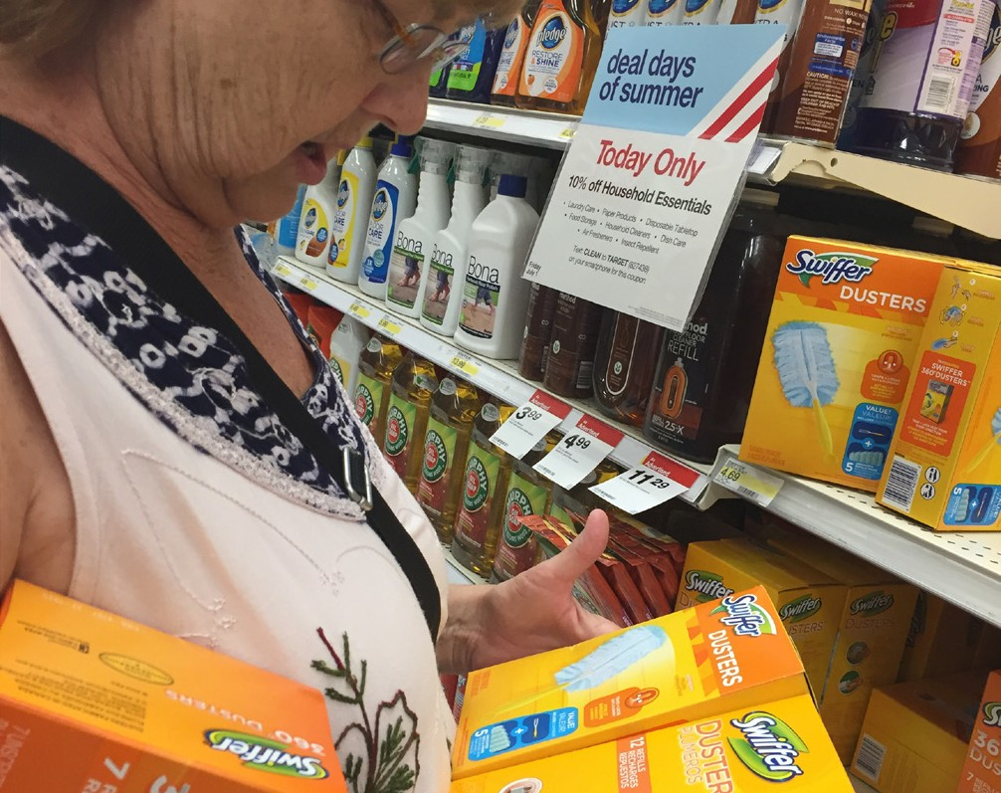
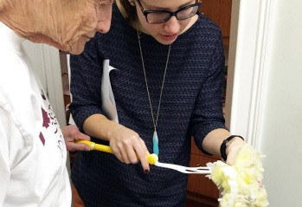
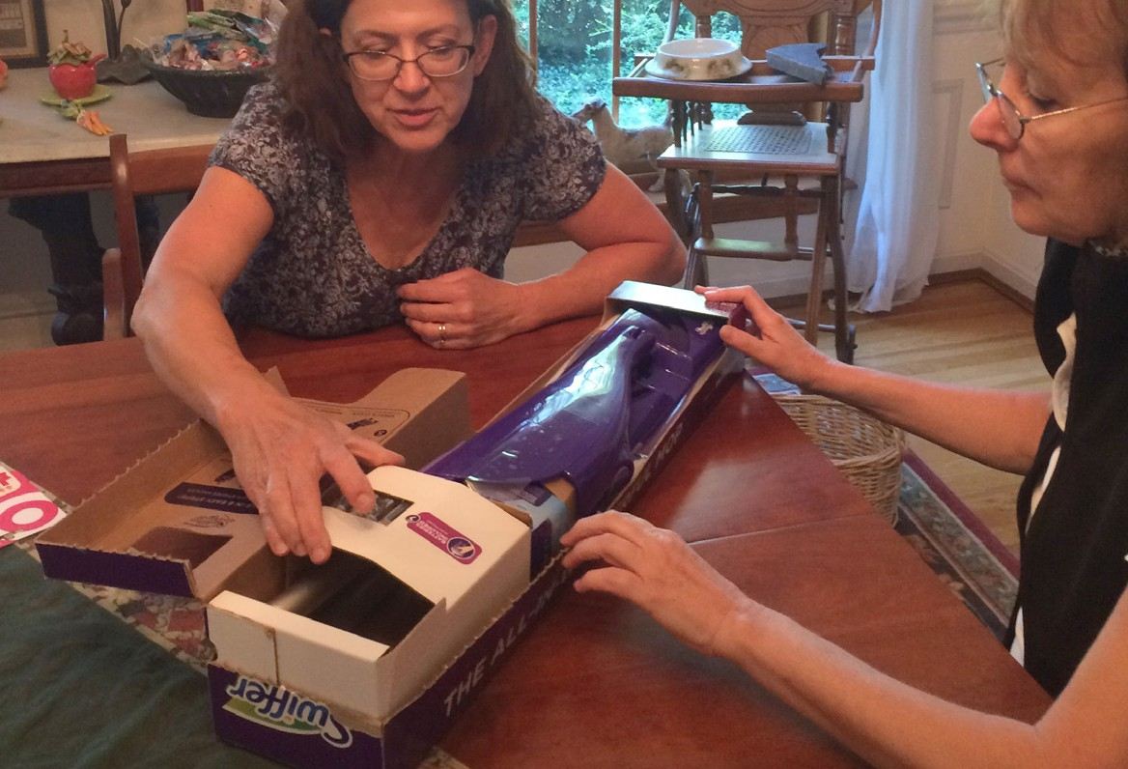
User Centered Interactions:
Store Shelf Interaction
The LWC team conducted a
shop-along with consumers to understand their experiences shopping store shelves.
In-Home Use
The LWC team interacted with consumers as they assembled and use the products for the first time to identify key points of delight and pain with products.
Unpacking
The LWC team analyzed how consumers opened and unpacked the products to determine the optimal packaging experience for the product.
© Live Well Collaborative

Slide 12
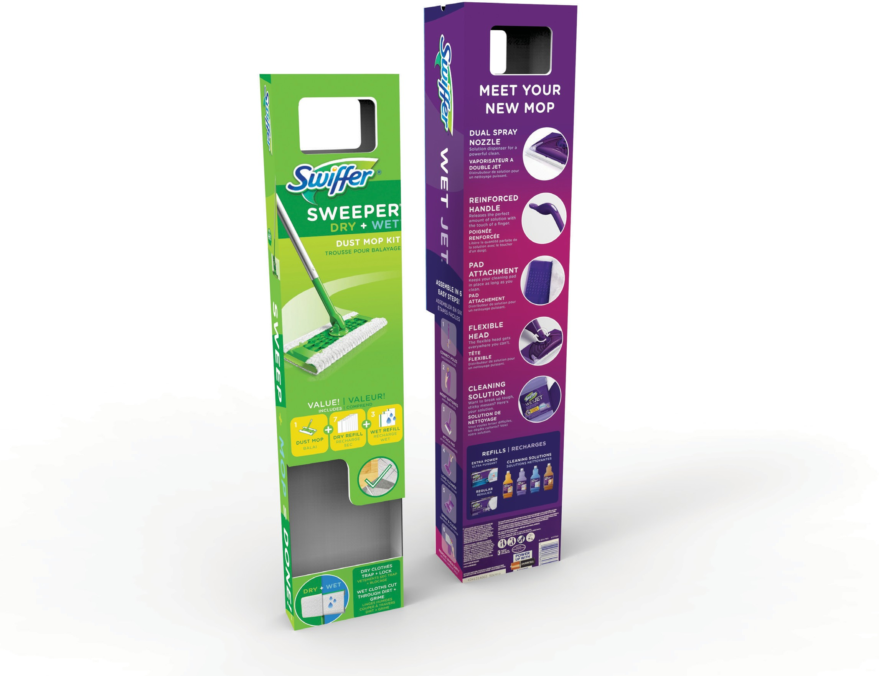
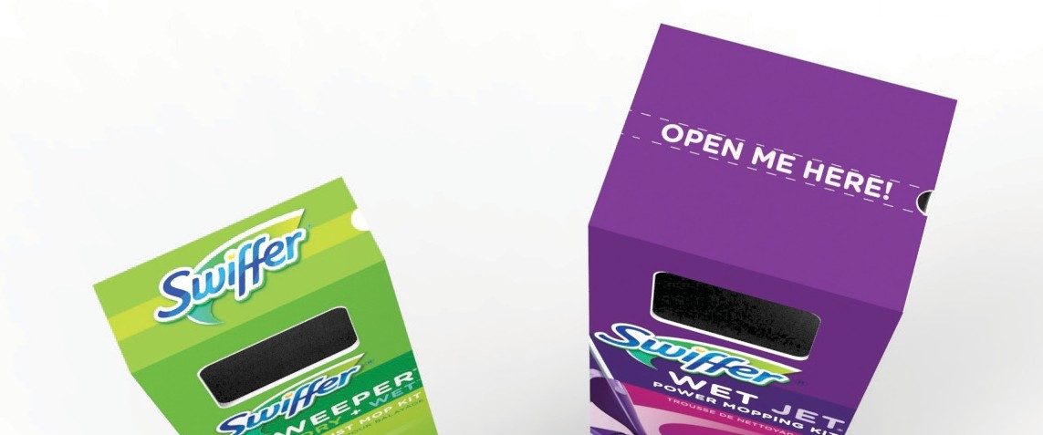
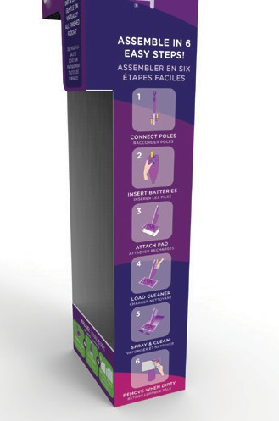

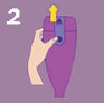


Translatable Outcomes:
Sweeper & WetJet Strategies
11 pt, smallest font 80 pt, largest font
10.5 pt, smallest font 80 pt, largest font
Educate — Clearly states what the product is.
Educate — Clearly states what the product is.
Where to open / rip tab — Different colors and text draw the consumer’s eye.
Educate — Back of box is dedicated to explaining the different aspects of the product and how they help achieve a better clean.
Directions — Prominently displayed on one side of the box.
1
CONNECT POLES
RACCORDER POLE S
2
INSERT B ATTERIES
INSERER LES PILE S
Educate — Clearly states what the product package contains.
Full Scale
Educate — Information showing what surfaces the product cleans.
3/4 Scale
© Live Well Collaborative

Slide 13
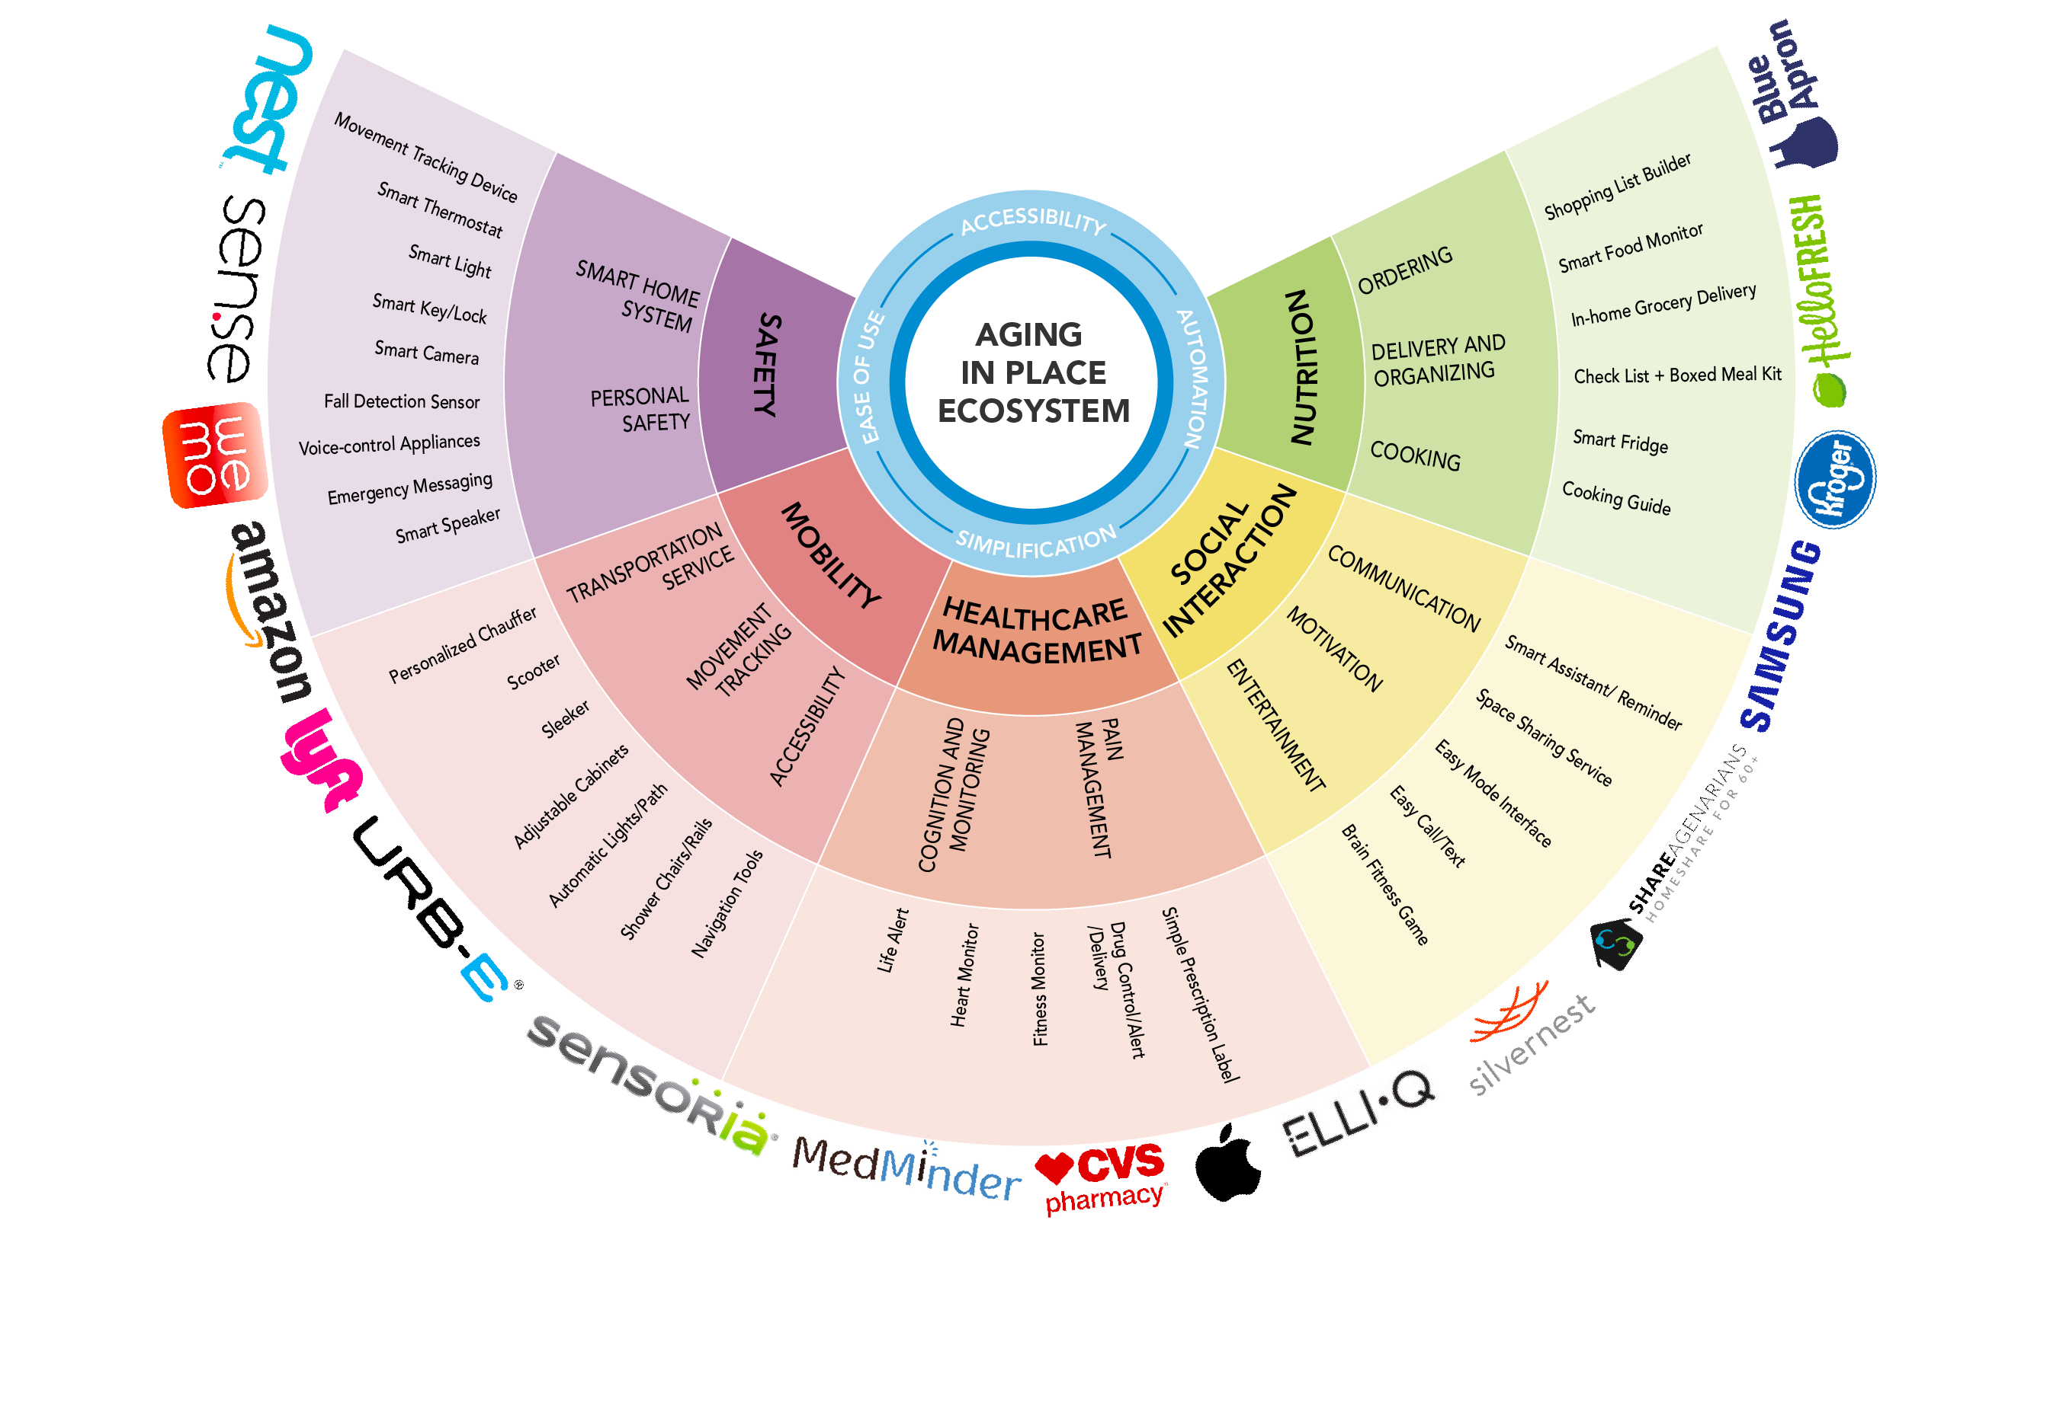
Aging in Place Ecosystem:
© Live Well Collaborative

Slide 14
Partnership Abilities:
CO-DESIGN APPROACH
Live Well teams utilize a co-design approach working with companies to create cutting edge solutions.
INNOVATION WORKSHOPS
Live Well conducts workshops with companies and organizations to teach them how to use an innovative process model to solve complex problems.
HUMAN-CENTERED EMPATHIC DESIGN
Human-centered empathic design working with all stakeholders, both core and connected. Consumer and patient centric with an understanding of meeting the needs of all stakeholders.
© Live Well Collaborative

Slide 15
Useful Partnerships:
GRANT OPPORTUNITIES
Live Well is looking for partnerships to co-write grants for future innovative work.
INTEGRATION OF INNOVATION
Live Well wants to partner with organizations that can integrate innovative solutions developed during semester long projects.
© Live Well Collaborative

Slide 16
Questions and Comments?
For more information, visit: livewellcollaborative.org
or contact us directly:
Linda Dunseath
Executive Director
ldunseath@livewellcollaborative.org
Craig Vogel
President
vogelcg@ucmail.uc.edu
Blake Lane
PhD Research Fellow
blakelane@livewellcollaborative.org
© Live Well Collaborative

