Slide 1
Stop the STIGMA, Start the CONVERSATION

Slide 2
MISSION
We are a non-profit organization established in 2010 with the mission to promote optimal mental health for Greater Cincinnati youth through stigma reduction and customized, evidence-based education so that we live live in a world without suicide.
youth (13-18) live with a mental health condition
STOP the STIGMA and START the CONVERSATION

Slide 3
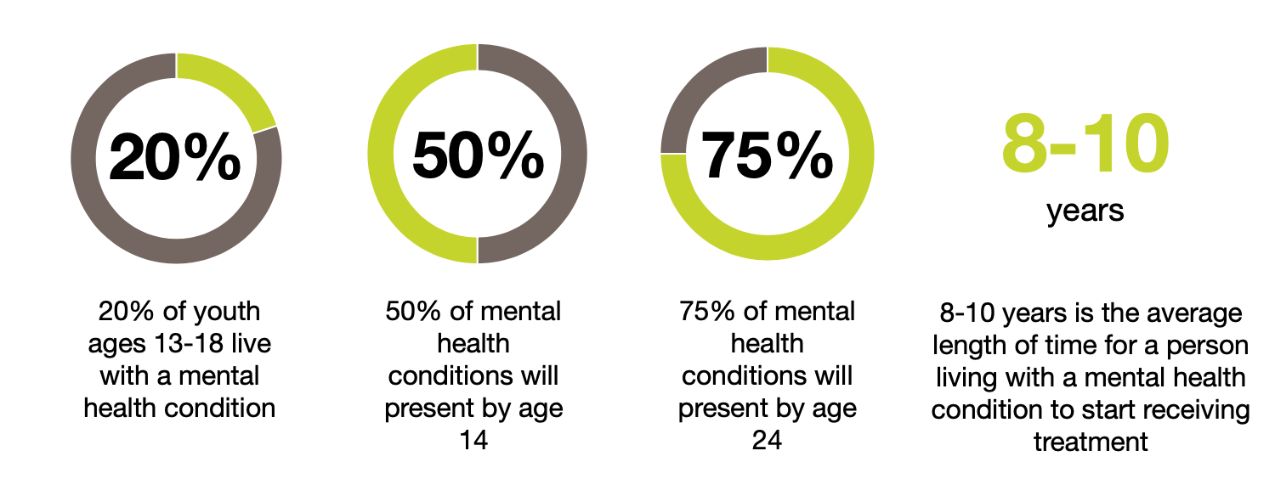
WHY EDUCATE ON MENTAL HEALTH
2nd
Suicide is the second leading cause of death for youth 13-24.
STOP the STIGMA and START the CONVERSATION
Climate Survey
Programming Recommendation and Long-Term Plan
Program Implementation
Program Assessment

Slide 4
MENTAL HEALTH FACTS
Nationally, mental illness is on the rise among our youth
1 in 5 children ages 13 to 18 have or will have a diagnosable mental illness
50% of all lifetime cases of mental illness begin by age 14 and 75% by age 24
Average delay between onset of symptoms and treatment is 8 to 10 years
37% of children with a mental health condition age 14+ drop out of school
the highest dropout rate of any disability group
70% of youth in juvenile justice systems have a mental illness
Youth suicide is at a 30-year high and has jumped from the 3rd to the 2nd leading cause of death for youth ages 10 to 19
90% of those who died by suicide had an underlying mental illness
Psychiatrists attribute increase in mental health issues and suicide to: 1) perfectionism and 2) trauma
Cincinnati has seen significant increase in mental health cases at Children’s Hospital
Psychiatry impatient bed days has increased by 38% since 2013
There were 21 suicides among ages 12-24 in 2016
Cincinnati middle schools, high schools and colleges do not have adequate mental health and suicide prevention education or awareness programs
STOP the STIGMA and START the CONVERSATION

Slide 5
HOW WE WORK WITH SCHOOLS
Preliminary Needs Assessment
Since each school has a unique culture, there is not a one-size-fits all solution for mental health& wellness needs.
Utilizing our expertise, we streamline and simplify selecting the most appropriate evidence-based mental health education programming to target each school’s needs. We select from our program guide of over 16 evidence-based programs
Climate Survey
Programming Recommendation and Long-Term Plan
Program Implementation
Program Assessment
STOP the STIGMA and START the CONVERSATION
Climate Survey
Programming Recommendation and Long-Term Plan
Program Implementation
Program Assessment

Slide 6
WHY EVIDENCE-BASED
What does it mean?
Evidence-based means that validated research has been done on the efficacy and safety of the program for the specific demographic and target population the program aims to reach. The data has been peer reviewed and published by an accredited.
Why is this important?
When providing widespread youth interventions and programming it is critical to choose evidence-based programs to protect youth. We must be assured that the program will have the positive results we wish to see.
How do I ensure my school is using evidence-based programs?
It is important to ask to see the published findings on the program to ensure the program is evidence-based.
STOP the STIGMA and START the CONVERSATION

Slide 7
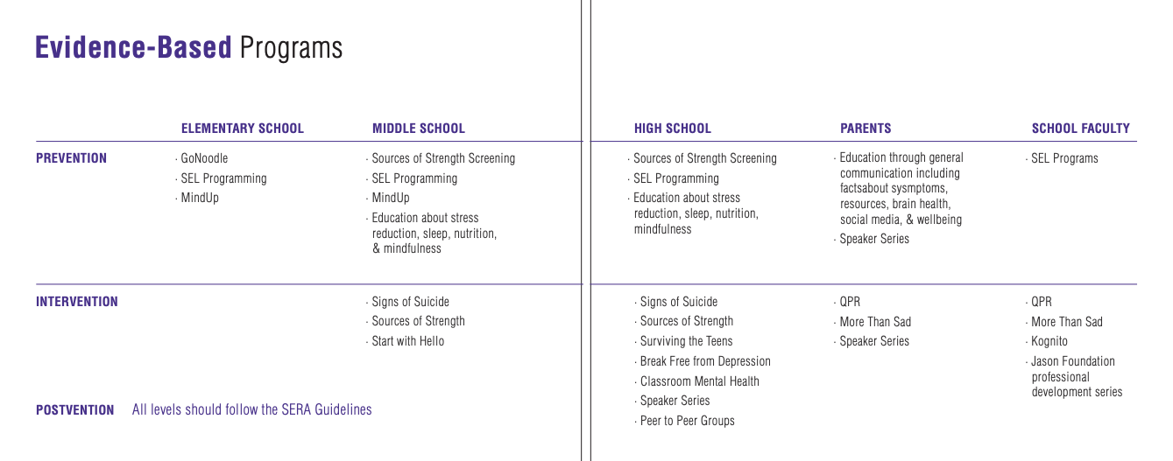
PROGRAM GUIDE
To learn more go to, 1N5.org/resources-for-faculty
STOP the STIGMA and START the CONVERSATION

Slide 8
QUESTION. PERSUADE. REFER.
What is QPR Training?
As someone who may be in the best possible position to prevent suicide---parent, teacher, coach, mentor--you will find that QPR is designed to help you save a life.
Question - a person about suicide
Persuade --someone to get help
Refer -- someone to appropriate resource
QPR is NOT a form of counseling or treatment.
QPR is intended to offer hope through positive action.
By learning QPR, you will come to recognize the warning signs, clues, and suicidal communication so people in trouble and gain skills to act vigorously to prevent a possible tragedy.
Independent researchers and federal agencies have suggested that the QPR intervention could be useful in far broader applications --recognizing a person who needs professional help but is not suicidal.
As CPR is the for the HEART, QPR is the for the MIND!
STOP the STIGMA and START the CONVERSATION

Slide 9
QUESTION. PERSUADE. REFER.
Who should be trained in QPR?
QPR is considered gatekeeper training.
A gatekeeper is anyone in a position to recognized a crisis or warning signs that someone may be contemplating suicide. This could be you--a parent, teacher, school counselor, coach, mentor, pastor/priest/rabbi, school nurse, youth leader, volunteer,, and/or community member.
How long does it take?
QPR training takes an hour and a half to two hours.
Why should we train people in QPR?
Suicide is not the second leading cause of death for youth 10-24 according to the CDC
90% of those that die by suicide have an underlying mental health condition.
50% of mental health conditions present by age 14
To learn more, go to https://qprinstitute.com/about-qpr
As CPR is the for the HEART, QPR is the for the MIND!
STOP the STIGMA and START the CONVERSATION

Slide 10
PEER-TO-PEER PROGRAMS
Overview:
Any student is able to participate in the BC2M club
One or two school advisors assist with running the club
BC2M program manager (Erin Horn) supports each club and will physically visit each school at least 2-3 times a year with phone/email support between visits.
Access to the BC2M portal which hosts:
Event and activity ideas each club can customize to their schools needs.
Educational presentation and discussion questions to use at club meetings
Advisor Guidebook
Weekly newsletters with program updates and information
Overview:
Students are select to be peer leaders
Students are trained during a full-day of training with a certified national trainer
Advisors and select teachers are trained in a full-day of training with a certified national training
Access to the Sources of Strength website and social media to help brainstorm ideas for school-wide events and activities.
Advisors have access to the Advisor Resource Guide and checklist, campaign materials, videos and more.
Access to the headquarters program manager
STOP the STIGMA and START the CONVERSATION

Slide 11
PEER-TO-PEER PROGRAMS
Program Support:
Local BC2M program manager supports each club and will physically visit each school at least 2-3 times a year with phone/email support between visits.
Access to the BC2M portal which hosts:
Event and activity ideas each club can customize to their schools needs.
Educational presentation and discussion questions to use at club meetings
PSA’s for student use
Advisor Guidebook
Weekly newsletters with program updates and information
To learn more go to: https://bringchange2mind.org/
Program Support:
Access to the Sources of Strength website and social media to help brainstorm ideas for school-wide events and activities. Information includes
Campaign ideas
Video library of how to create campaigns
Video PSA’s for students to use
Advisors have access to the Advisor Resource Guide and checklist, campaign materials, videos and more.
Access to the headquarters program manager
To learn more go to: https://sourcesofstrength.org/
STOP the STIGMA and START the CONVERSATION

Slide 12
PEER-TO-PEER PROGRAMS
Cost:
Free
BC2M provides a $500 grant to help fund activities related to the BC2M mission.
Club swag is provided (free of charge) to help unify the BC2M members and highlight the presence of the club on campus.
One–year, free subscription to Headspace meditation app for all club members (valued at $145).
Cost:
First year: $5,000 per school for full-day advisor training and full-day peer leader training.
Second year: pending as we work to train a 1N5 employee to be a National Trainer
STOP the STIGMA and START the CONVERSATION

Slide 13
PEER-TO-PEER PROGRAMS
What’s the evidence say?
Student involvement in BC2M High School Program clubs was associated with:
greater mental health knowledge
enhanced attitudes
decreased social distance
increased positive actions to reduce stigma.
Link to report
What’s the evidence say?
Increase in peer leaders’ connectedness to adults
Increase in peer leaders’ school engagement
Peer leaders in larger schools were four times more likely to refer a suicidal friend to an adult
Among general student population, the program increased positive perceptions of adult support for suicidal youth and the acceptability of seeking help
Positive perception of adult support increased most in students with a history of suicidal thoughts
Link to overview and report
STOP the STIGMA and START the CONVERSATION

Slide 14
WARRIOR RUN: HIGH SCHOOL CHALLENGE
How the High School Challenge Works:
Schools create a team for the High School Challenge on the http://cincywarriorrun.org/ website
Schools compete for one $1500 student scholarship, a Skyline Chili party, and a traveling trophy
100% of the funds raised for each school are returned to that school to be used for new mental health education programming.
1N5 works with the school administration to develop programming based on each school’s unique needs.
1N5 provides additional grant money to each school.
Score breakdown:
# of students running (as a % of student population)
# of students volunteering (as a % of student population)
Overall dollars raised.
STOP the STIGMA and START the CONVERSATION

Slide 15
COMMUNITY INITIATIVES
Brain Health Network
In conjunction with MindPeace*, we have a coalition of 14 area school leaders that discuss current mental health needs of their students. Discuss programs that are working as well as share successes and barriers to improve the region’s mental health programming.
Youth Mental Health Innovation Challenge
Bring 100 area youth together to brainstorm solutions to address the youth mental health crisis.
Competition to award $9,000 in funding to implement ideas.
Working with Cincinnati leaders to facilitate the day.
To learn more go to, https://1n5.org/innovationchallenge
Partnership with Cincinnati Children’s Hospital
Partner with Children’s Hospital provide the Adapting for Life -Surviving the Teens program to Cincinnati Schools.
Provided resources to help expand the program from being in 24 schools to 75 schools.
To learn more about the free program, contact Stacey Hoffmann
*MindPeace is a non-profit organization that works with area social service agencies to put mental health counselors into schools: private insurance or Medicaid pays for the counseling services.
STOP the STIGMA and START the CONVERSATION

Slide 16
Help STOP the STIGMA and
START the CONVERSATION.
Together, we can make a lasting impact on our community.
Nancy Eigel-Miller
Nancy_miller@1N5.org
513-607-7434
STOP the STIGMA and START the CONVERSATION

