Slide 1

Healthy by Design
ARIAL
Use Arial as the Font.
Use The Health Collaborative Colors Above
Virtual Meeting on the Social Determinants of Health
April 4, 2019

Slide 2
VISION & Mission
Greater Cincinnati is healthy by design and everyone is connected to quality, affordable healthcare
To lead data-driven improvement that results in healthier people, better care, and lower costs
Notes:
Intro

Slide 3

Who We Are
Neutral forum for all stakeholders
concerned with health and healthcare
Those improving community health
Those receiving healthcare
Those providing healthcare
Those paying
for healthcare

Slide 4



Collective
Impact
Program
Management
Professional
Services
We provide insight into regional health issues, help catalyze community will around solutions, and measure progress on shared community aims
We expertly manage
large-scale improvement initiatives that involve multiple stakeholders working together toward a defined common goal
We provide data and value-added solutions that help our stake-holders succeed, and with our partners, accelerate innovation to make health and healthcare a competitive advantage for the region

Slide 5
Collective Impact

Slide 6

Health as a value we share

Slide 7



A Community Health Challenge
Exceptional healthcare, but less than exceptional health outcomes
Building an equitable and prosperous region for all citizens is a priority across Greater Cincinnati. Partners are coming together to implement solutions from education and poverty, to workforce development and other fundamental components, to make Cincinnati a place where all citizens want to live, work, learn and play.
Greater Cincinnati is in a critical situation when it comes to our community’s health. Healthcare alone can’t fix it.
We are fortunate to have exceptional healthcare resources, but our health outcomes continue to tell a story of inequity and rank amongst the unhealthiest in the nation.
Healthcare providers in Cincinnati rank in the top quartile in the US. Despite our excellent healthcare:
Ohio and Kentucky continue to rank among the unhealthiest states. Greater Cincinnati ranks in the bottom quartile for key measures of well-being.
Gallup ranked Greater Cincinnati 152 out of 189 communities across the US based on health-related factors, including physical health, financial security, and community safety.
Hamilton County still ranks among the worst 10% in the country for infant mortality.

Slide 8
The Missing Health Link
80% of health is determined by factors outside of the healthcare we receive. The conditions where we live, grow and age are often more impactful than the medical care we receive when it comes to staying healthy and improving health outcomes.
These factors include housing, transportation, utilities, hunger, and interpersonal violence. As a community we are realizing the vital need to address health-related social factors in order to improve our overall health outcomes.
What Determines Our Health?
Healthcare
20%
Genetics & Social Determinants of Health
80%
Designing Healthcare
Treating the whole patient means designing a healthcare system that is more accessible, coordinated, continuous, and comprehensive - a system where value is based on the quality of care provided and rewards providers for both efficiency and effectiveness.

Slide 9
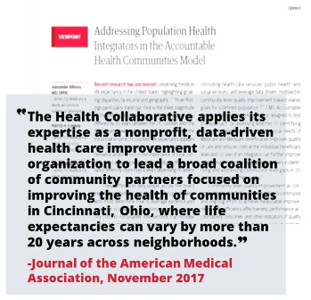
GEN-H: A Regional Health Agenda
Driving Collective Impact for Community Health
GEN-H launched in 2014 under the leadership of The Health Collaborative and United Way of Greater Cincinnati, as a community-wide response to the critical and growing health challenges facing Greater Cincinnati.
Guided by community-wide feedback and informed by healthcare data, GEN-H ultimately identified three key building blocks:
addressing unmet health-related social needs
designing value-based care
empowering place-based health and wellness initiatives
Through this work, health stakeholders in our region came together and committed to developing a regional Health Improvement plan using the Collective Impact model to drive progress.

Slide 10
Driving Action Through GEN-H
GEN-H is a long-term, systems-change initiative. In 2018, The Health Collaborative developed a plan to leverage the learnings gained from GEN-H to date to drive action + impact over the next 3 years.
GEN-H VISION & GOALS
Cincinnati will be a healthier, more vibrant community when we address the unmet health-related social needs of our community. Cincinnati will be a region healthy by design; a place where the health outcomes of our people reflect the exceptional healthcare of our region now, and for generations to come.
GOAL 1:
Design
Healthcare
to provide care that is more accessible, coordinated, continuous, and comprehensive
GOAL 2:
Connect
Social Services
to eliminate social determinants that often prevent individuals from getting the care they need
GOAL 3:
Empower
Neighborhoods
to prioritize their health and wellness initiatives based on the needs of their community

Slide 11


Accountable Health Communities model
5-year demonstration project: May 2017 - April 2022
The Accountable Health Communities (AHC) Model will assess whether systematically identifying the health-related social needs of community-dwelling Medicare and Medicaid beneficiaries (CDB’s), including those who are dually eligible, and addressing their identified needs, impacts those CDBs’ total healthcare cost and their inpatient and outpatient healthcare utilization.

Slide 12

Participating Partners
Clinical Delivery Partners
Health Systems
FQHC, Primary Care & Behavioral Health
Cincinnati Children’s Hospital Medical Center
The Christ Hospital Health Network
TriHealth
UC Health
Centerpoint Health
City of Cincinnati Health Department
Crossroad Health Center
Primary Health Solutions
Talbert House
Warren County Combined
Health District

Slide 13

Participating Partners
Community Partners
CareSource
Council on Aging of Southwest Ohio
Cincinnati-Hamilton County Community Action Agency
Health Care Access Now
Molina Healthcare of Ohio
United Way of Greater Cincinnati
United Way of Greater Dayton
Ohio Department of Medicaid

Slide 14

The Model
Participating clinical sites and community partners will implement the four components of the model via Healthify:
Universal Screening to identify certain unmet health-related social needs (food insecurity, housing, transportation, utilities, and interpersonal violence)
Referral to increase awareness of community services
Navigation services to assist high-risk w/accessing community services
Encouraging alignment between clinical and community services to ensure services are available and responsive

Slide 15

AHC Model Workflow Diagram
Beneficiary enters clinical delivery site
Risk Stratification
High Risk (>2 ED visits within 12 months)
Lower Risk (<2 ED visits within 12 months)
Screening
(+) Screen: Any health-related social need present
Screening for Health-related Social Needs
Personal Interview
Receives Alignment Intervention & Usual Care
Receives Awareness Intervention & Usual Care
Bridge Organization Responsibilities :
Data Sharing
Gap Analysis
Quality Improvement Plan
Tailored Community Referral Summary + Community Service Navigation + Usual Care
Tailored Community Referral Summary + Usual Care
(-) Screen: No health-related social need
PARTNER ALIGNMENT (QI)
Usual Care

Slide 16


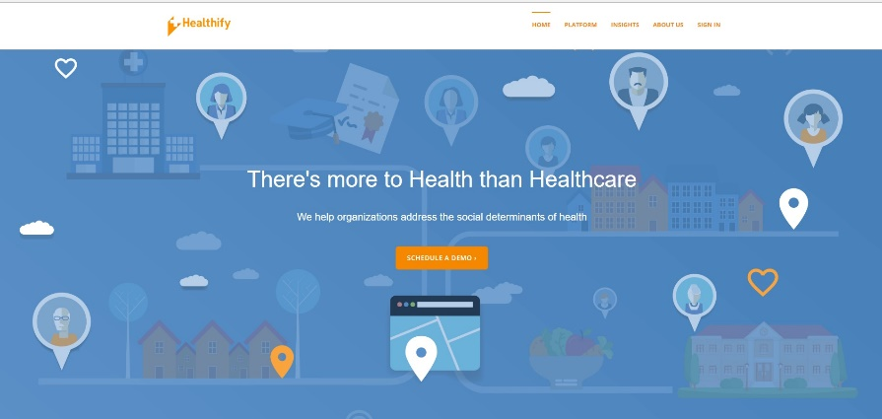

Gen-H Connect Screening Tool
Survey given to patients to identify health-related social needs.
Developed by National Academy of Medicine
Identify eligibility
Risk stratification
Administered via Healthify; software solution for connecting clinical and social services

Slide 17

Results to date
1,506 screenings to date (October 2018-February 2019)
Approximately 25% of those screened are high risk
Food is the most frequently identified need

Slide 18
Barriers/Challenges to Screening
Screening eligibility limited to Medicare & Medicaid beneficiaries
Lack of integration with EHR; use of multiple systems to document
Length of time it takes to complete screening
Lack of staff resources

Slide 19
Barriers/Challenges to screening
Eligibility limited to Medicare &/or Medicaid beneficiaries
Lack of integration with EHR
Length of time to complete screening

Slide 20


Slide 21
Kiana R. Trabue
ktrabue@healthcollab.org

