Slide 1
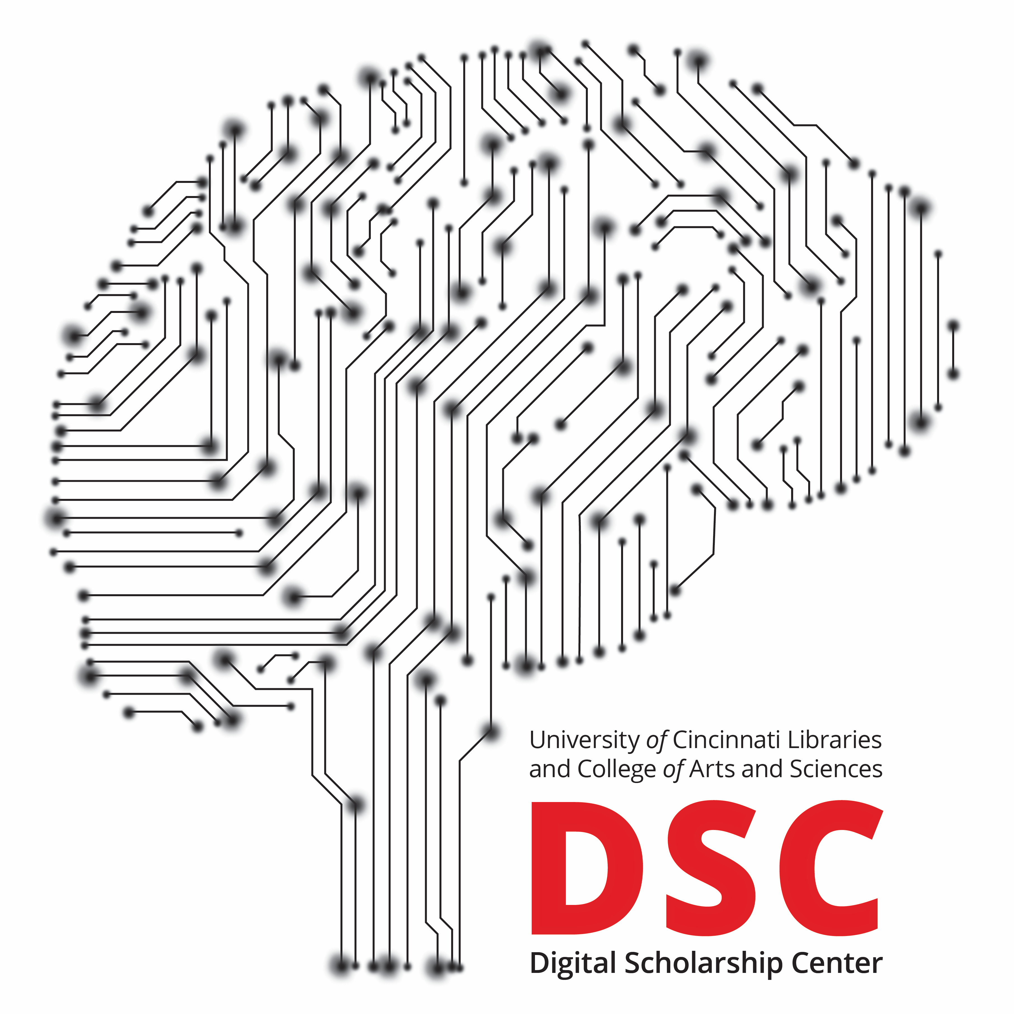
The Digital Scholarship Center: Text Mining across Disciplines
James Lee, PhD
Associate Vice Provost for Digital Scholarship
Associate Dean of Research, University Libraries
Director, Digital Scholarship Center

Slide 2
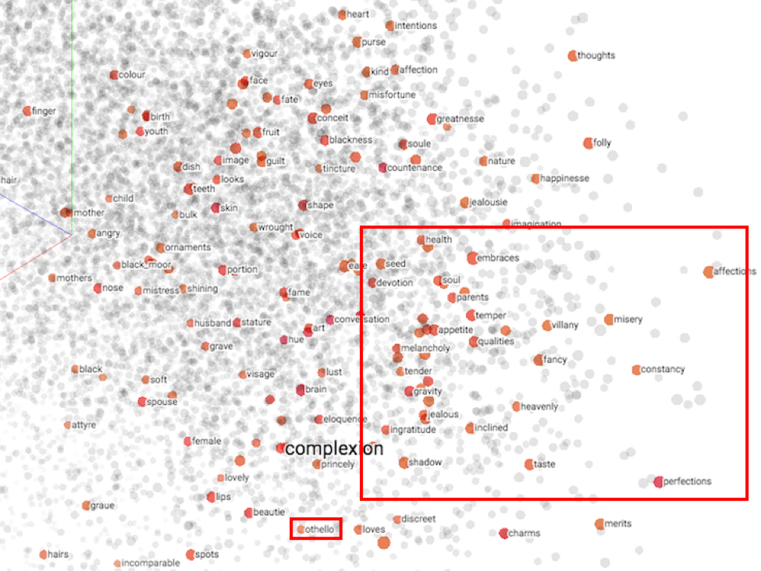
My Background:
Machine Learning and Historical Archives

Slide 3
Transdisciplinary Teams in Digital Scholarship
What are Digital Scholarship Centers / Studios?
The DSC has assembled research groups that genuinely span multiple disciplines, with people trained to think very differently about every step in the research process.
Teams are composed of true partners across entire research lifecycle:
Formulation of research questions
Pitching grant proposals
Dataset cleanup and manipulation
Data analysis and visualization
Argument formation
Publication of findings
Machine Learning and Data Visualization as discipline-agnostic methods: a “borrowing of techniques”.

Slide 4
Andrew W. Mellon Foundation: Digital Integrator
$900,000 over 30 months from the Andrew W. Mellon Foundation.
Specific goal: Advance our “catalyst” model of Digital Scholarship.
The long view: Mellon supports culture change.
Goals:
Model new transdisciplinary strategies and practices for translating between disciplines that rarely interact – connect domain experts with technical innovations in machine learning.
We provide resources and infrastructure to nurture research questions and collaborations that slip between the cracks of funding agencies.
Transdisciplinary computational tools / Human interpretable research products.

Slide 5
Model: Catalyst vs. Concierge
Six Digital Centers/Studios supported by Mellon initiative.
Leaders defining a new type of “digital integrator” collapsing silos.
Peers: UIUC, UConn, Brown, Emory, UC’s DSC, Duke.
Spectrum from “concierge” to “catalyst.”
Digital integrators as hubs in the academic research ecosystem.
Phase 2:
Digital Futures Building
$3.1 Million in grant funding
Mellon Renewal

Slide 6
Not Just a Feel-Good Story
Multiple publications in a range of fields – content area, methodology, popular press.
Grants from multiple bodies – agencies, foundations, industry.
Example: “Iowa Digital Bridges” – Mellon and Gates Foundations, NIH, NSF, NEH, NEA.
A new perspective on teaching and doctoral training.

Slide 7
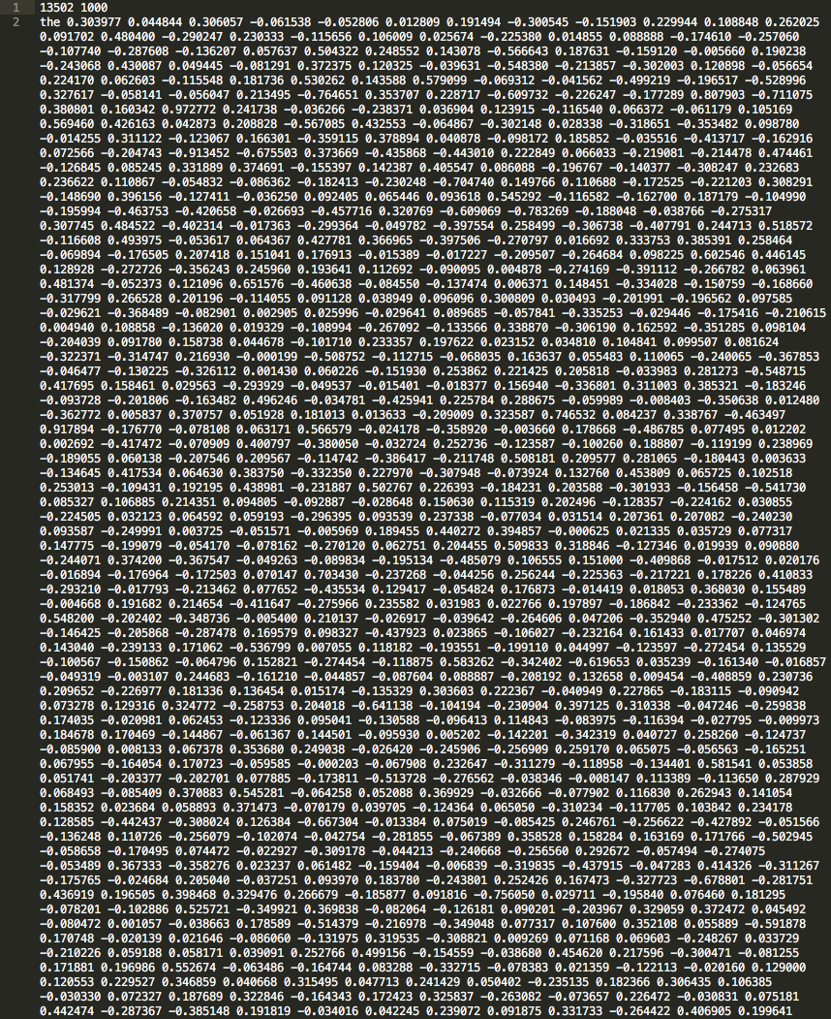
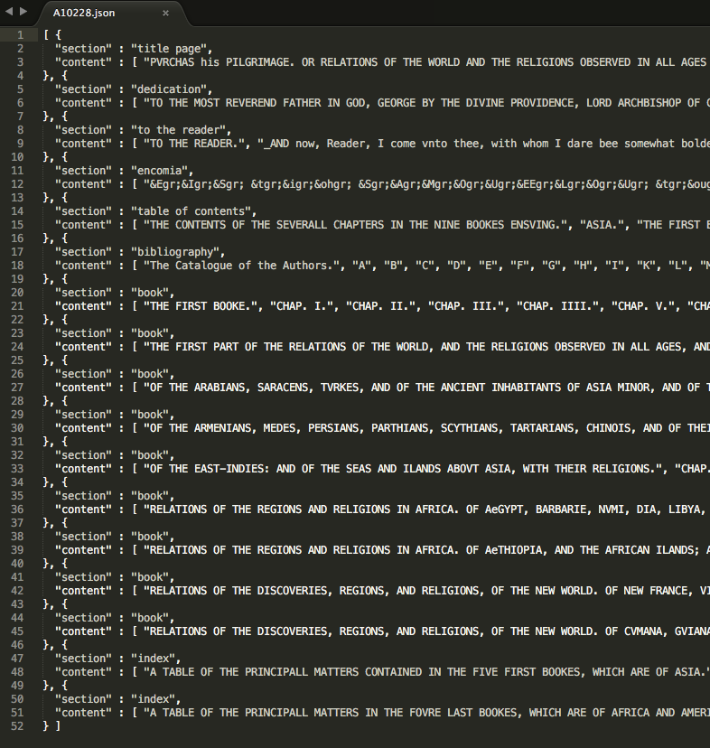
Building Bridges: Data Structures
The Shakespearean and the Astrophysicist.

Slide 8
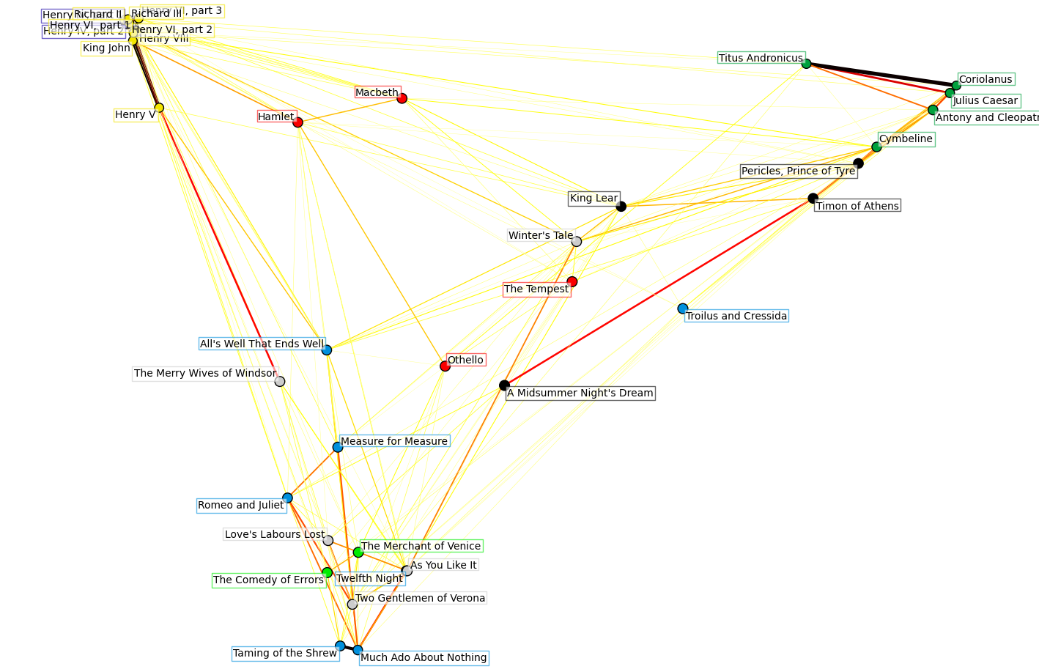
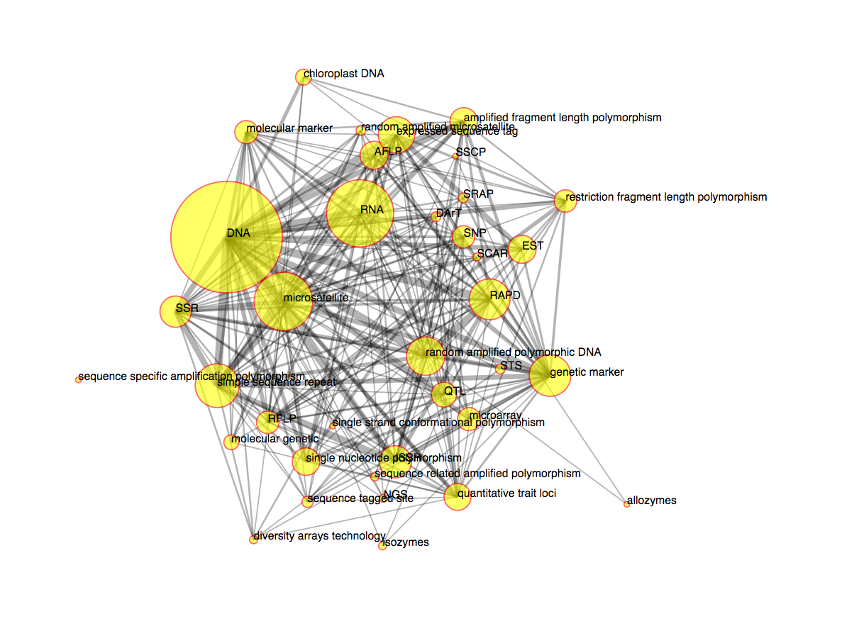
Building Bridges: Data Structures

Slide 9
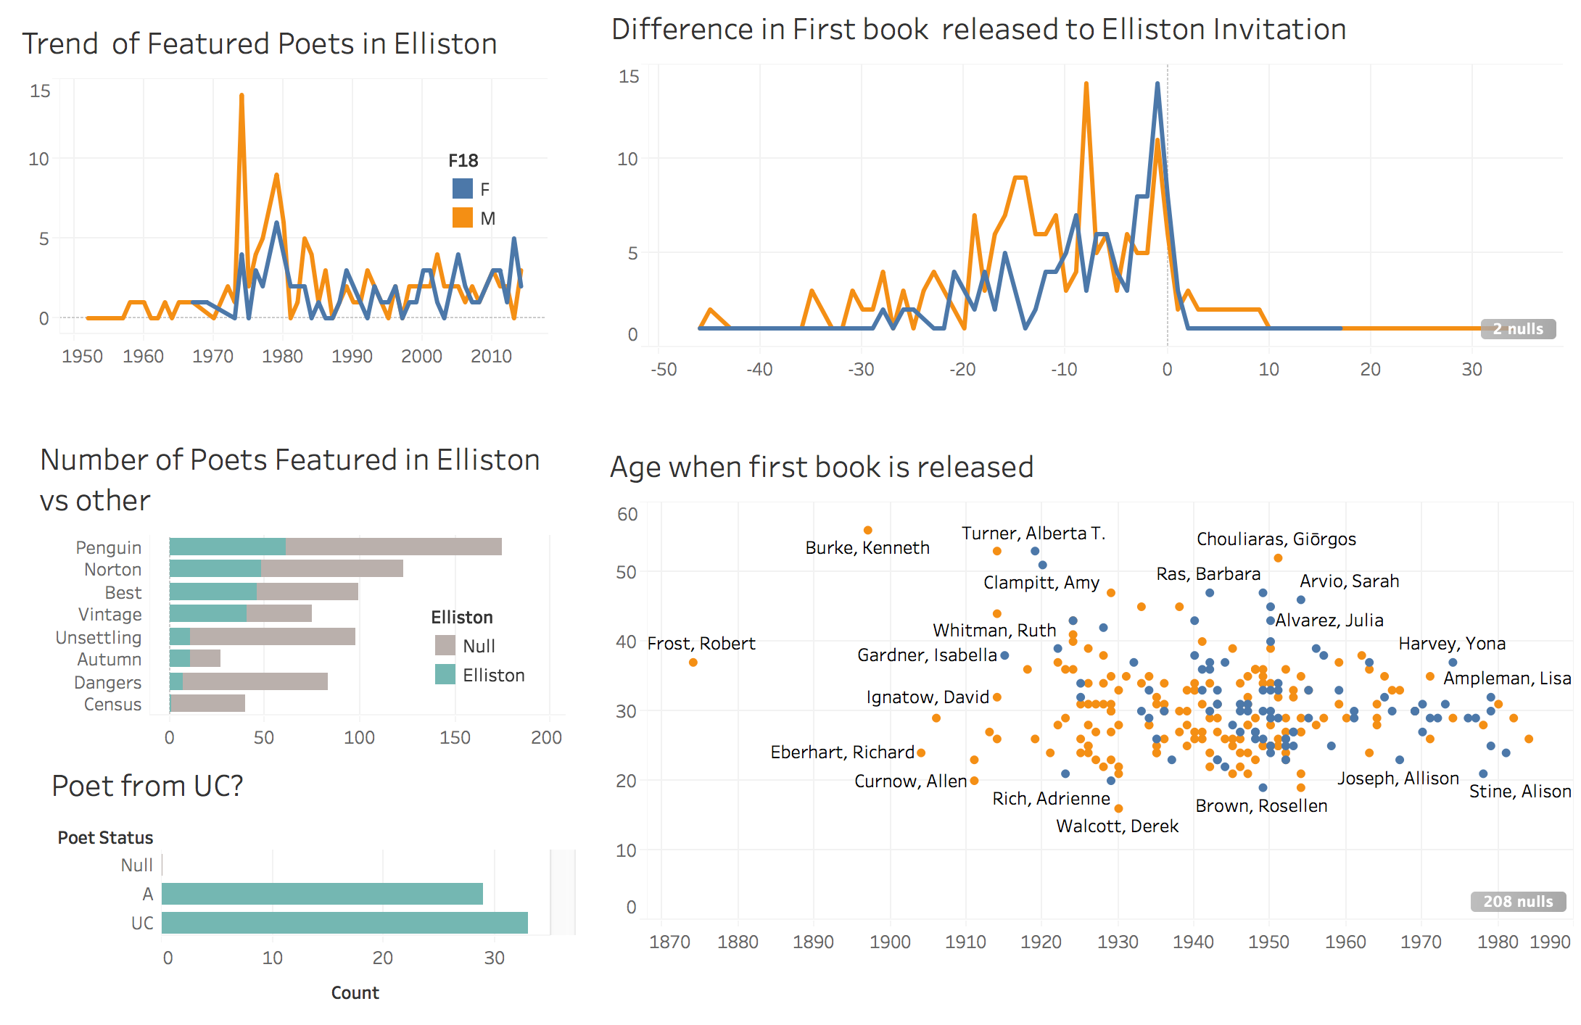
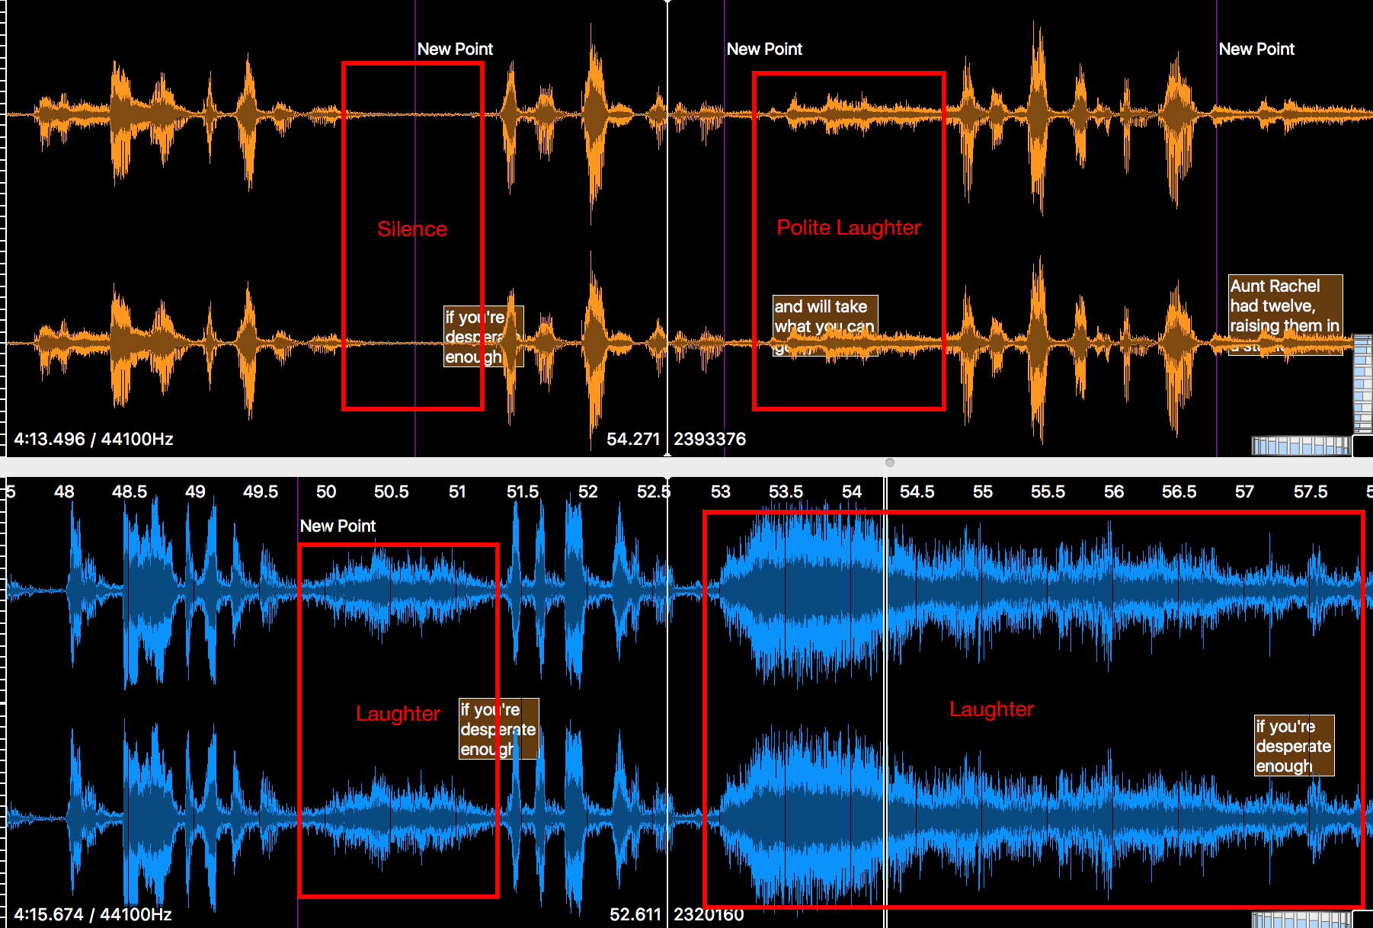
Building Bridges: Data Visualization
Different visual frameworks for analysis and interpretability

Slide 10
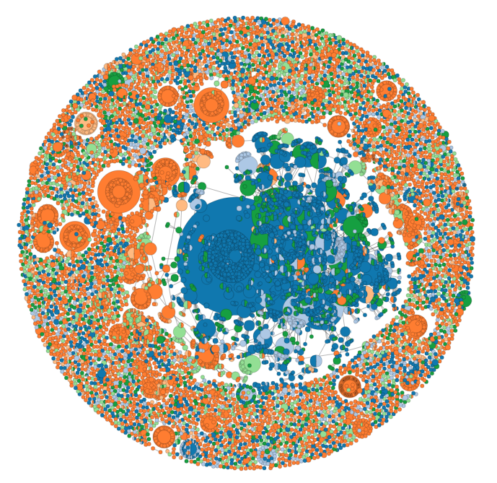
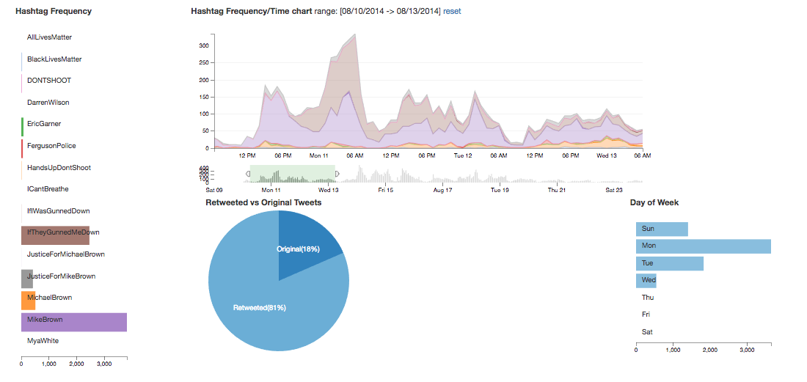
Shared Motivations, Different Languages
Social Networks: Social network analysis and visualization.
Team: DSC, A&S, Law, DAAP, CCHMC, CEAS, CECH.

Slide 11
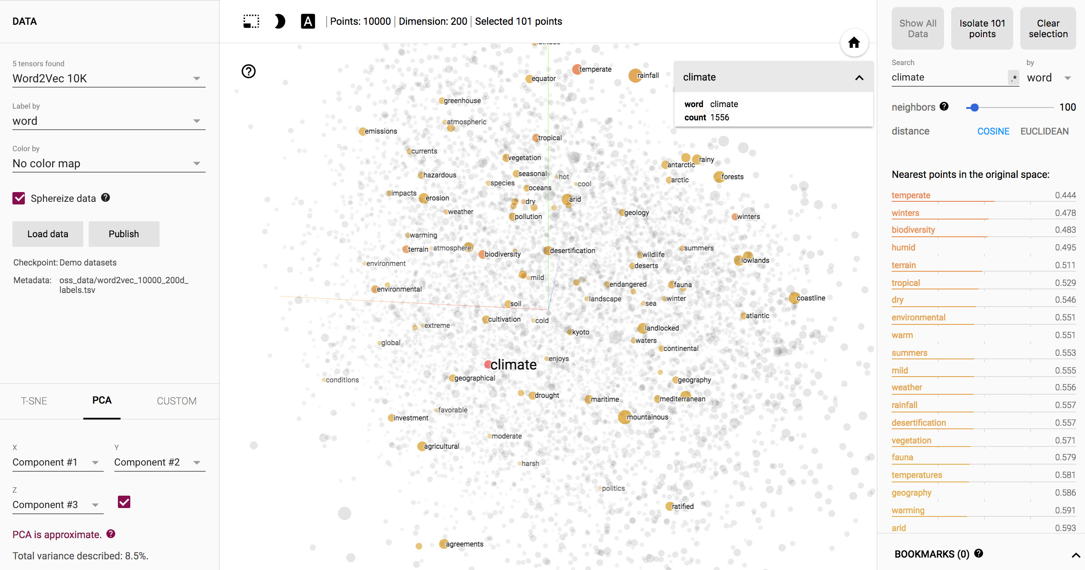
Shared Motivations, Different Languages
Using machine learning to extract salient features, cluster, and classify free text in EHR and literature.
Team: A&S Biological Sciences, UC CoM, CCHMC Hospital Medicine, among others.

Slide 12
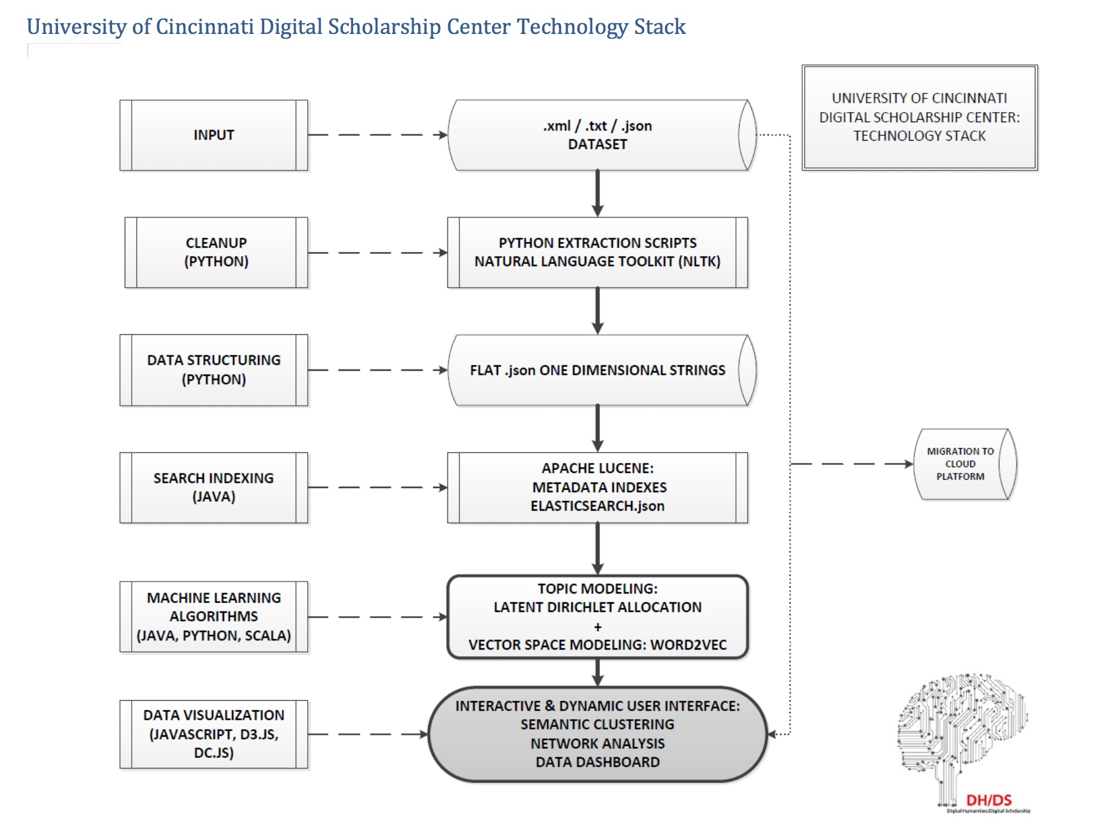
Cloud Platform for Collaboration

Slide 13
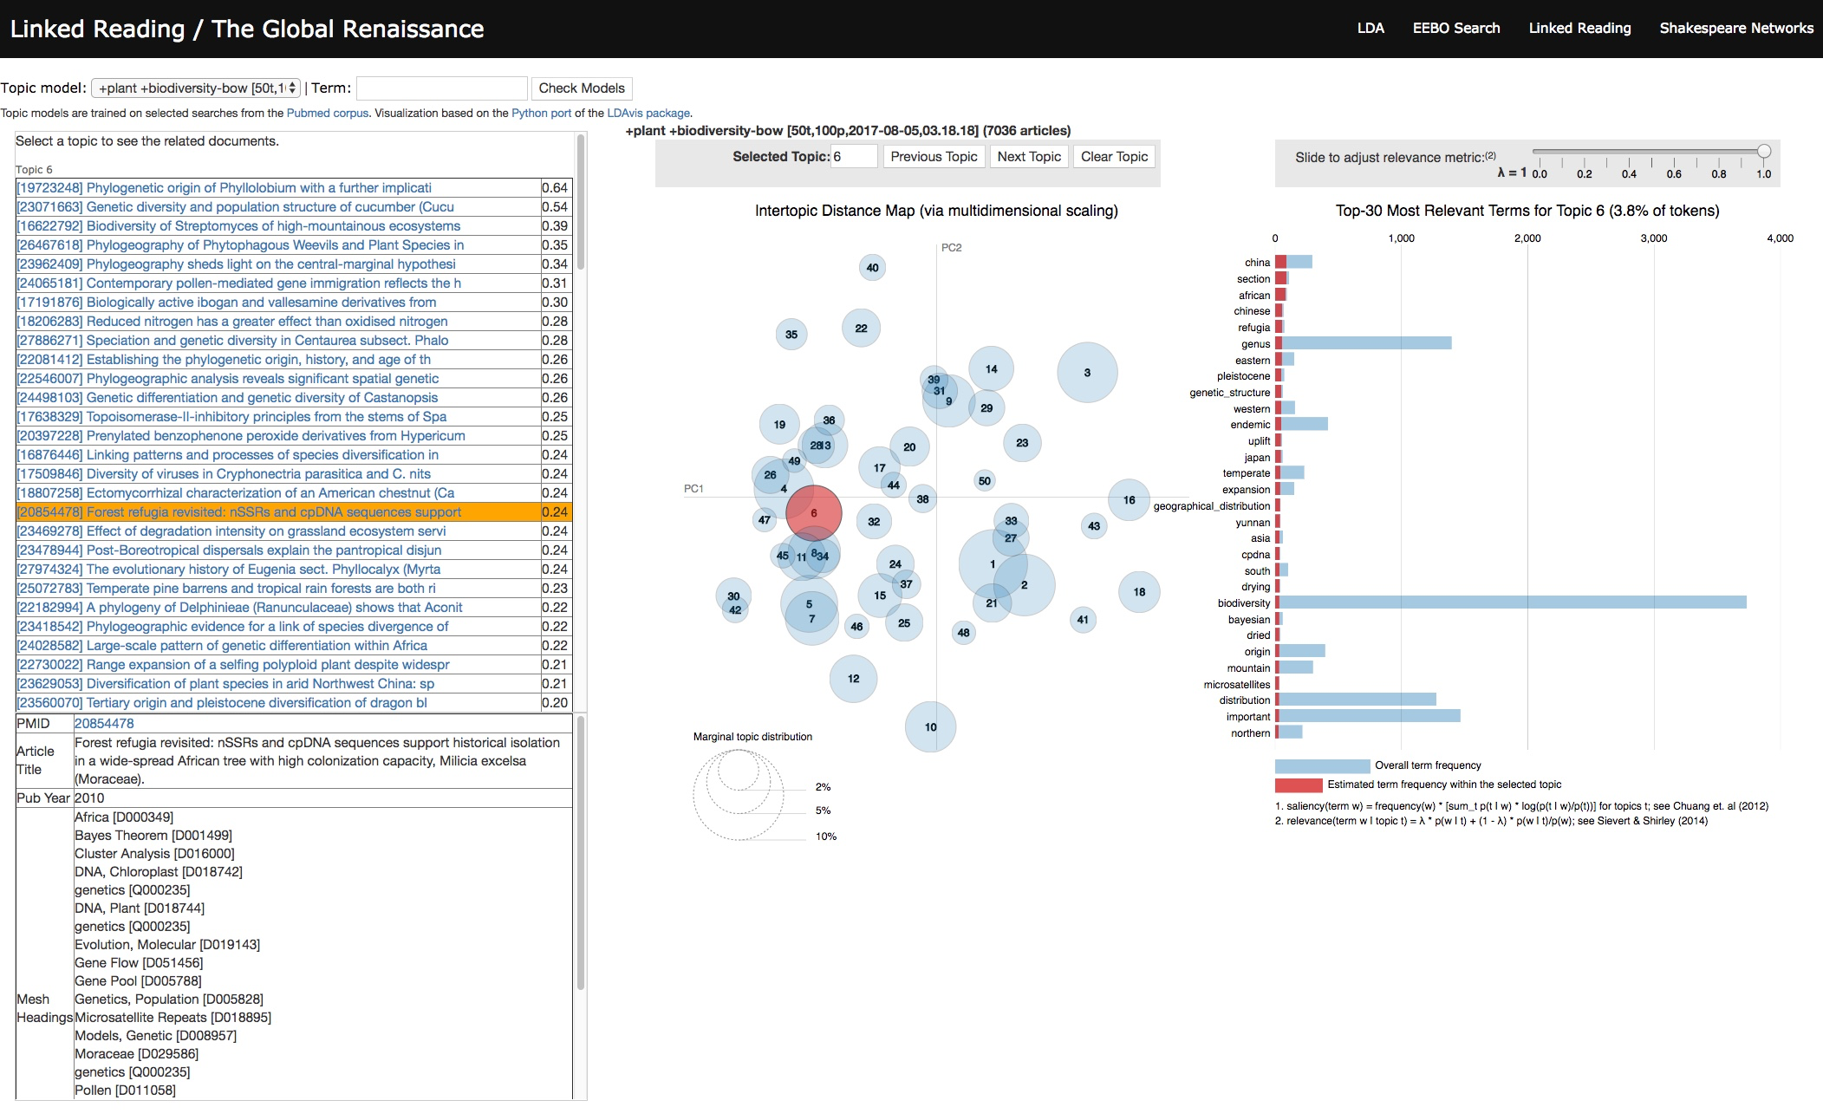

Slide 14
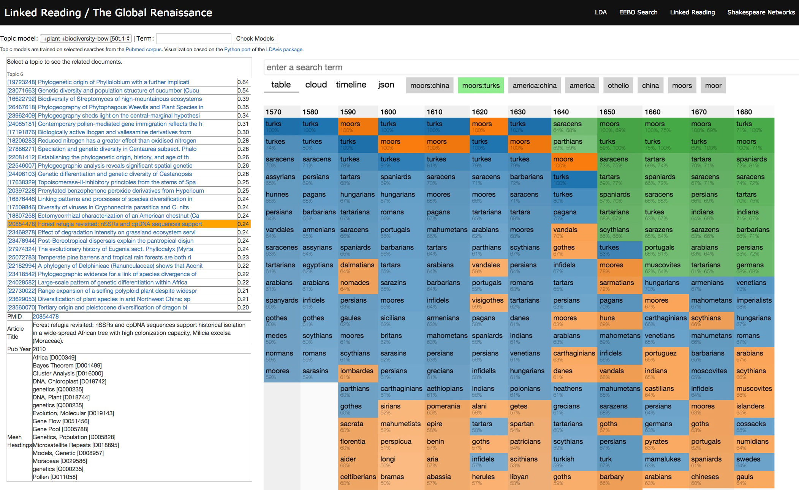

Slide 15
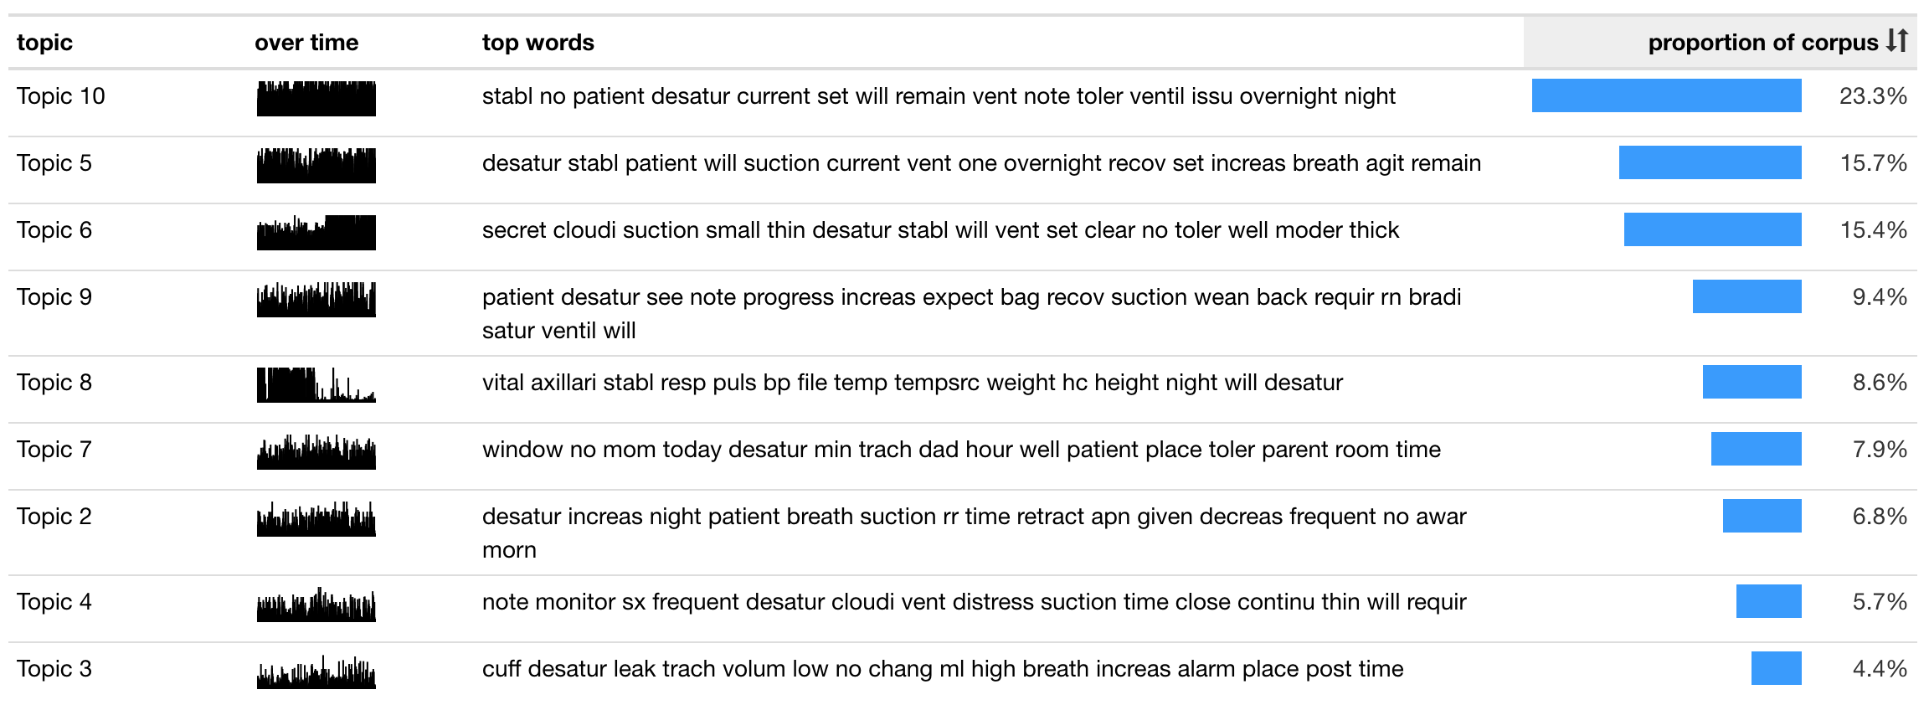

Slide 16
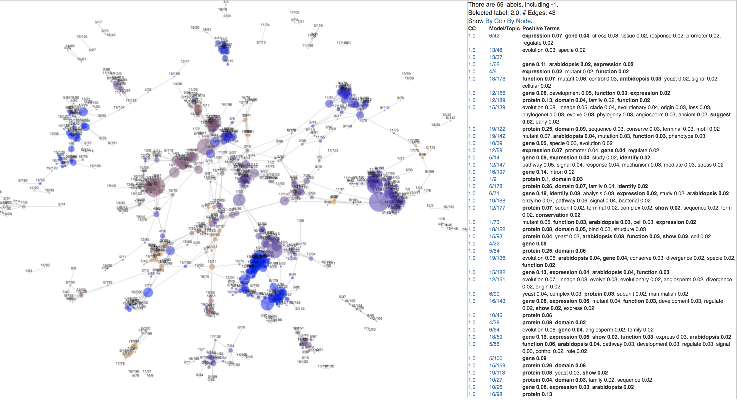
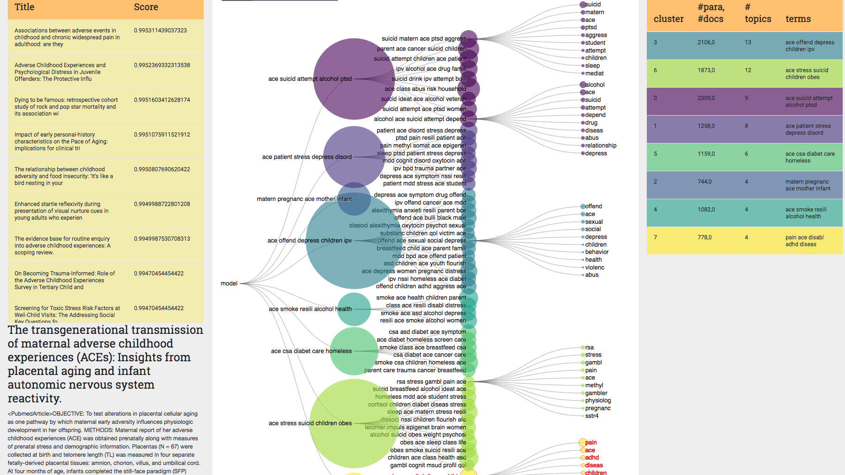

Slide 17
