Slide 1
Virtual Meeting on Aging Aging Research Collaborators from the College of Nursing and Maple Knoll Communities
Tamilyn Bakas, PhD, RN, FAHA, FAAN Professor and Jane E. Procter Endowed Chair, University of Cincinnati College of Nursing
Rebecca Lee, PhD, RN, PHCNS-BC, CTN-A Associate Professor, University of Cincinnati College of Nursing
Jim Hoeh Maple Knoll Community Marketing Manager

Slide 2
UC College of Nursing
Mission Develop nurse leaders who are empowered to generate, explore and apply nursing knowledge for evolving health care environments.
Vision Through the creative leveraging of technology and inclusive excellence, we will lead the transformation of health care in partnership informed by the people we serve.
Values ICARE: Integrity, Collaboration, Accountability, Respect and Excellence

Slide 3
What is Maple Knoll Communities?

Slide 4
Maple Knoll Communities, Inc.
Mission Statement
Maple Knoll Communities, Inc. is recognized as a growing provider of outstanding senior communities and services that allow those we serve to thrive in a stimulating and dignified environment. This will be accomplished through creativity and responsible fiscal stewardship.

Slide 5
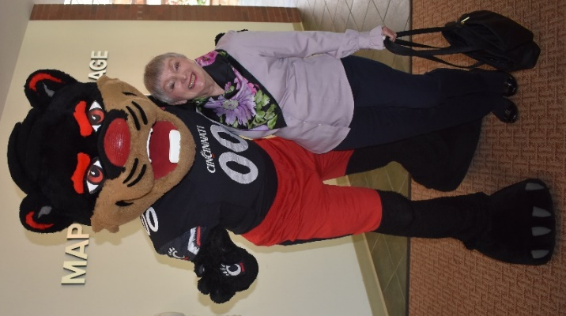
Formal Affiliation
Formal Affiliation signed on April 2015 and renewed May 2018
Affiliation Vision Statement: We will shape the future of healthcare and promote the best lifestyle possible for older adults.
Affiliation Mission Statement: Create a nationally
recognized interdisciplinary learning partnership for
students, faculty, practitioners, employees, and
researchers that strives to enhance the quality of care
and services for older adults. We will further the
missions of the University of Cincinnati and Maple
Knoll Communities by fostering a sustainable program
of innovation, research, and practice.

Slide 6
The T-CHAT Project: Using Telehealth to Optimize Healthy Independent Living in Older Adults
Tamilyn Bakas, PhD, RN, FAHA, FAAN
Professor and Jane E. Procter Endowed Chair
T-CHAT Co-PI
Debi Sampsel, DNP, MSN, RN
Director of Telehealth and Innovation Smart House
T-CHAT PI

Slide 7
Telehealth Community Holistic Assistance Team (T-CHAT)
A program where healthcare providers combine the use of a telehealth remote presence robot with health coaching to improve healthy independent living in older adults.
Our Nurse Practitioner students are using the t-robot to deliver 3 weekly T-CHAT sessions to older adults.
Older adults are coached on how to manage their chronic conditions and to improve their overall health.

Slide 8
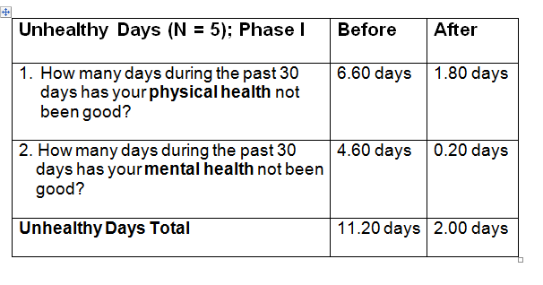
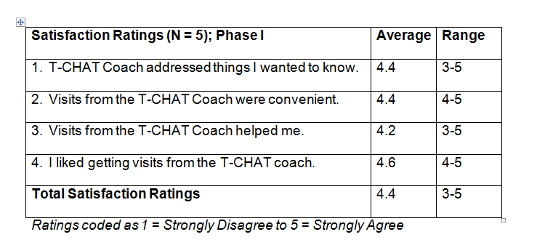
Results
Bakas, T., Sampsel, D., Israel, J., Chamnikar, A., Bodnarik, B., Clark, J.G., Ulrich, M.G., Vanderelst, D. (2018). Using telehealth to optimize healthy independent living for older adults: A feasibility study. Geriatric Nursing, 39(5), 566-573.
Bakas, T., Sampsel, D., Israel, J., Chamnikar, A., Ellard, A., Clark, J.G., Ulrich, M.G., & Vanderelst, D. (2018). Satisfaction and technology evaluation of a telehealth robotic program to optimize healthy independent living for older adults. Journal of Nursing Scholarship, 50(6), 666-675.

Slide 9
Our T-CHAT Team

Slide 10
Maple Knoll Village
and
Telehealth Remote Presence Robot Research Project
The University of Cincinnati and
Meadows Affordable Housing Collaboration
T-CHAT Health Promotion
Dr. Debi Sampsel, DNP, RN
Dr. Tamilyn Bakas, PhD, RN, FAHA, FAAN &
College of Nursing

Slide 11
Shared Goal to Positively Impact the Health of Older Adults living at poverty levels
UC – Meadows Common Goals to improve the health of older adults
CEAS
CON
Meadows
All other UC Colleges
COM
Key:
UC = University of Cincinnati
CON =College of Nursing
CEAS = College of Engineering and Applied Science
COM = College of Medicine
Housing = Meadows

Slide 12
Maple Knoll Village
Interprofessional Remote Presence Telehealth Research Project
Testing and developing technology aimed at creating environments that promote self-care and independence
Promoting aging in place innovations and discoveries
Serving as a bridge from classroom to real world through experiential learning: students, faculty, and volunteers in health care, engineering and other related areas work together to complete service learning
Developing a national service model that leverage use of new technologies for health monitoring, environmental scans and injury prevention

Slide 13
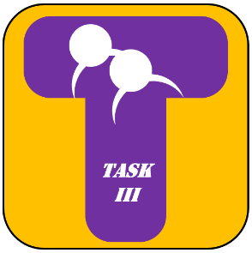
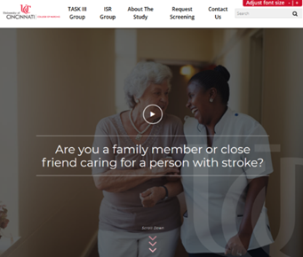
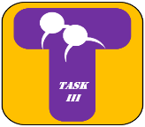
Caregiver Self-Management Needs Through Skill-Building (R21NR016992) ClinicalTrials.gov: https://clinicaltrials.gov/ct2/show/NCT03635151?term=Tamilyn+Bakas&rank=1 ; TASK III Website: https://www.task3web.com/ PI: Tamilyn Bakas, PhD, RN, FAHA, FAAN Co-Is: Bonnie Brehm, Kari Dunning, Brett Kissella, Michael McCarthy, Elaine Miller, Matt Rota, Heidi Sucharew (From Colleges of Nursing, Medicine, Allied Health Sciences, Cincinnati Children’s)
Determine feasibility of the Telephone Assessment and Skill-Building Kit (TASK III) in 74 family caregivers of stroke survivors randomized to TASK III or to an Information, Support, and Referral (ISR) group:
TASK III caregivers get a choice each week as to use the TASK III Resource Guide hard copy mailed to them, TASK III Website, TASK III eBook, or TASK III USB Drive.
ISR caregivers get an American Stroke Association brochure, and are guided to resources on the American Stroke Association website.
Both groups receive 8 weekly calls from a registered nurse, with a booster call at 12 weeks. Caregivers choose whether to use the telephone or videoconferencing for their calls.
Visit our
TASK III Website:
https://www.task3web.com/
Notes:
This study is designed to test feasibility of the Telephone Assessment and Skill-Building Kit (TASK III), a nurse-led intervention designed to address the needs and concerns of family caregivers of stroke survivors.
TASK III consists of 8 weekly calls from a nurse with a booster session a month later. Caregivers randomized to TASK III receive a TASK III Resource Guide with 40 tip sheets addressing their needs and concerns, as well as skill-building strategies such as stress management, problem solving, and goal setting to improve their health. The TASK III Resource Guide may be accessed by a hard copy binder, on a USB drive, in an eBook format, or through our task3web.com website. The nurse assesses caregiver needs and concerns, and refers them to the TASK III Resource Guide tip sheets.
TASK III is being compared to an Information, Support, and Referral (ISR) group who also receives 8 weekly calls from a nurse with a booster session a month later. Caregivers randomized to the ISR group receive a brochure about family caregiving from the American Stroke Association, access to the American Stroke Association website, and active listening from the nurse.

Slide 15
Elaine Miller, PhD, RN, FAAN
Preparing healthcare workers to safely and effectively evacuate older adults in disaster situations.
Project title: Effect of virtual reality simulation on improving
the performance of healthcare workers when evacuating older
adults. Building upon on prior AHRQ study involving educating
healthcare workers using VRS to improve evacuation outcomes of
neonates performed at CCHMC.
Project considering : Testing the efficacy of disaster evaluation
app for healthcare workers caring for older adults.

Slide 16
Susan Reutman, PhD, MPH, RN
Demonstration Project: Motivating physical activity to promote healthy aging of the workforce: Small Move-A-Thon proof of concept.
Submitted Proposals: Pilot Move-A-Thon methods development (American Association Sports Psychology), workforce (NIH R21/33), and community (ONA & Ohio Parks and Recreation).

Slide 17
Discussion
Jean Anthony, PhD, RN – Depression, Suicide, Disparities
Myrna Little, M. Ed - Community Health Nursing
Additional Nurse Researchers: CON Website:
https://nursing.uc.edu/research/researchers.html
How can we be a partner to others?
Who are partners that would be useful to us?
Further discussion

