Slide 1
NCI Designation Overview
Steve Price, MBA – Associate Director for Administration, CCC
Executive Director for Cancer Research Administration,
UC Academic Health Center
Tammy Mentzel, MPH – Assistant Director for Programs and Projects, CCC

Slide 2
Bob the Builder…..and Wendy too!
Can we build it?
Yes we can!

Slide 3
Learning Objectives
Overview of NCI Designation
Misconceptions regarding NCI Designation
Opportunities to help move UC towards NCI-designation of its cancer research enterprise

Slide 4
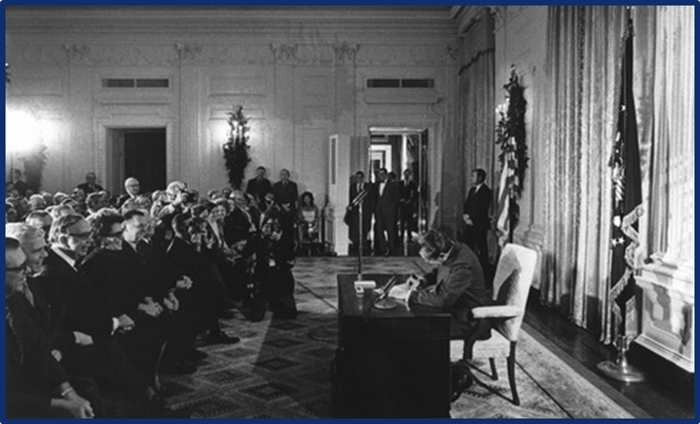
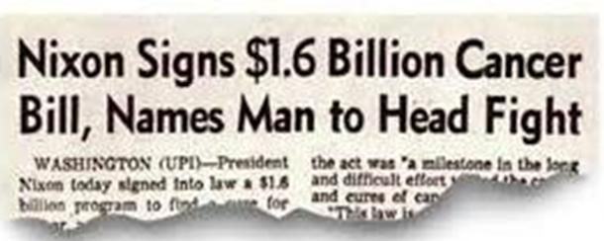
HISTORY OF NCI-DESIGNATED CANCER CENTERS
President Nixon signed the landmark National Cancer Act in 1971 formally establishing the NCI-designation cancer centers program and funding the first 15 Centers

Slide 5
WHAT IS NCI-DESIGNATION?
NCI designation is an accreditation given to elite US medical institutions demonstrating they are leaders in addressing the nation’s cancer burden through research.
NCI-designated cancer centers receive research infrastructure funding (grant) ranging from $1.4M-$6M/year plus institutional overhead costs.
A/K/A Cancer Center Support Grant (CCSG P30) – Peer-Reviewed by teams of 21 MDs, Scientists, Administrators, etc. from other NCI centers

Slide 6
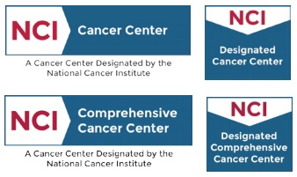
NCI RECOGNIZES THREE TYPES OF CANCER CENTERS
Basic, Clinical, and Comprehensive

Slide 7
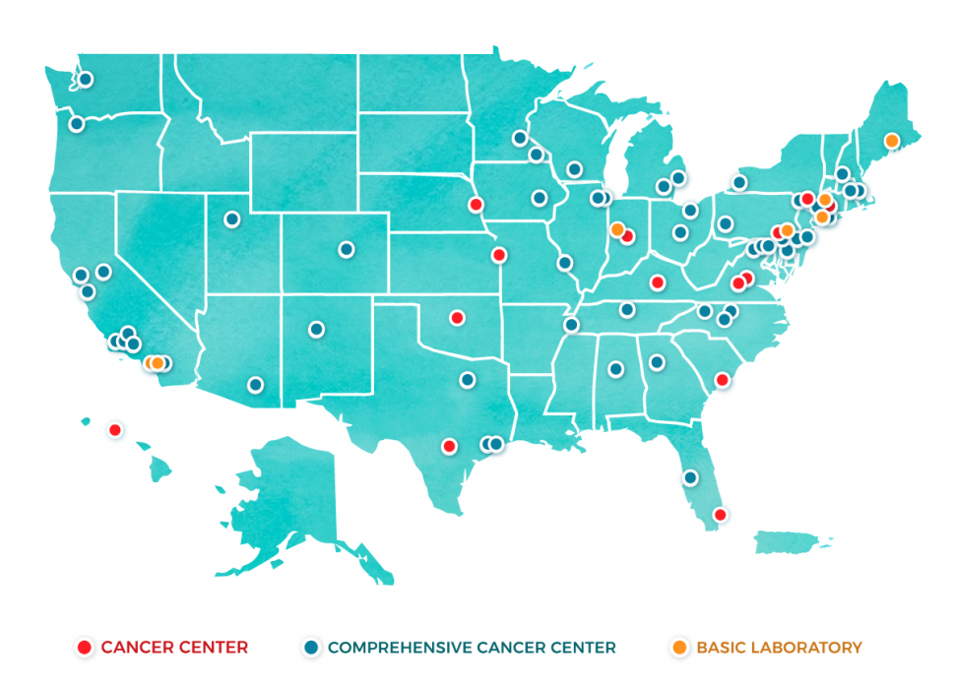
71 NCI Designated 7 Basic, 13 Clinical, 51 Comprehensive

Slide 8
Features of an NCI cancer Center

Slide 9
Essential Scientific Programs (Minimums)
Basic Science Program | Clinical Research Program | Cancer Prevention, Control and Population Sciences
At least 7 R01 equivalent projects | At least 7 R01 equivalent projects | At least 7 R01 equivalent projects
5 different PIs / Investigators | 5 different PIs / Investigators | 5 different PIs / Investigators
Quality of science measured through publications in high impact journals | Quality of science measured through publications in high impact journals | Quality of science measured through publications in high impact journals

Slide 10
SIX ESSENTIAL CHARACTERISTICS OF NCI-DESIGNATED CENTERS
Physical Space – dedicated, cancer-focused; shared resources & admin.
Organizational Capabilities
Transdisciplinary Collaboration and Coordination
Cancer Focus
Institutional Commitment
Center Director

Slide 11
Building Blocks of Success
Institutional Commitment
Translational, Transdisciplinary and Collaborative Research
Novel Shared Resources
Leadership and Organization
Membership Engagement
Catchment-Relevant Science
Programmatic
Research Productivity
Clinical Trials Activity and Impact
Planning and Evaluation

Slide 12
Tangible Benefits of NCI Designation
Facilitates recruitment of outstanding, world class physicians, scientists, clinicians, and students
Fuels partnerships with pharma/biotech companies
10% (at least) growth in patient volume in first year and greatly enhances clinical marketing/branding ability (all but 3 hospitals listed on top Cancer Hospitals in US New & World Report are NCI-designated)

Slide 13
Tangible Benefits of NCI Designation
Research infrastructure costs are supported through the CCSG which generally are not supported via other NCI grant mechanisms
Additional grants available only to NCI-designated Cancer Centers (NCI, DOD, V Foundation, Pew)
NCI-designated centers report 4-fold increases in philanthropic support during first 5-10 yrs. and continue to attract the largest philanthropic donations

Slide 14
Benefit of NCI designation… for the patient
Advancements in care
Lower mortality
Close to home
Access to cutting-edge clinical trials
Expand cancer prevention
Clinical trials relevant to our catchment area
URBAN IMPACT
INNOVATION AGENDA

Slide 15
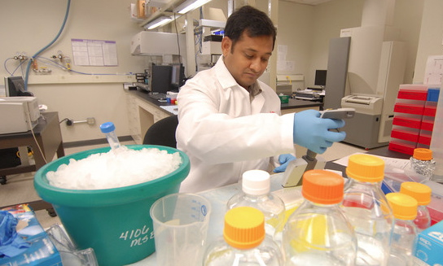
Benefits of NCI designation for the…. community
Catchment focused research and community engagement
Requires addressing health disparities in geographical catchment area
Jobs
Biotechnology
Improved research infrastructure
Attract world class researchers & clinicians
More research funding
Increased tax revenues
URBAN IMPACT
INNOVATION AGENDA

Slide 16
CCC Governing Board Composition
Neville Pinto, PhD (Permanent GB Chair) –
President, University of Cincinnati
Rick Lofgren, MD – President & CEO, UC Health
Andrew Filak, MD – Interim Dean & Sr. VP of Health Affairs, University of Cincinnati COM
Michael Fisher – President & CEO, Cincinnati Children’s Hospital
Peggy Hofstetter, MD – UCCOM Chair of Pediatrics

Slide 17
FRIENDS & RESOURCES - HURON

Slide 18
CCC ADMINISTRATIVE CORE
Goal: Build a strong cancer center research administrative and coordinating infrastructure that will effectively foster member engagement and support research leaders and the strategies and goals of the CCC Governing Board, utilizing best research administrative practices such as the NCI CCSG P30 requirements/guidelines.
By-Product: A fully NCI CCSG-compliant and effective administrative core which will receive an Excellent/Outstanding/Exceptional review score by site reviews.
It’s all about promoting the Quality of the Science as measured through Publications and Peer-Reviewed, Cancer-Relevant Funding.

Slide 19
Status Update
Focus – Buildout of an NCI-compliant Administrative Core
Phase I Hiring:
Sherrell Hines – 09/18 Assistant
Tammy Mentzel – 02/19 Asst. Director for Programs & Projects (from CO Nursing)
Kelly McDonald – 05/19 Accountant/Financial Mgr. (from COM Office of Fin & Ops)
Sharon Sauter – 06/19 CCSG Senior Project Manager (from CCHMC)
Christina Schwierling – 08/19 Data Base Administrator (in COM IT)
Center Director and NCI-compliant faculty leadership structure -- TBD
Key focus on data/analytics for dashboards and data tables and building staff infrastructure
Pathway to NCI-Designation (consortium oriented? vs UC faculty oriented?)

Slide 20
ADMIN CORE AREAS OF RESPONSIBILITY
Catchment
Communications
Data Analytics
Financial and Administrative Operations
Major initiatives
Membership (faculty members)
NCI Liaison to Office of Cancer Centers
Oversight of all CCSG Activities

Slide 21
ADMIN CORE AREAS OF RESPONSIBILITY
Philanthropy
Pilot Funds
Planning and Evaluation
Recruitment (investigators, MD scientists, etc.)
Reporting (all NCI required reports and monitoring of impact)
Shared Resources
Space and Facilities (research focused)
Strategic Planning
Training and Education

Slide 22
Dean & VP of Health Affairs UCCOM
External Advisory Board
Cancer Center
Director
Internal Advisory Board
Associate Director
for Administration
“Research EDBA”
Associate Director
Basic
Science
Associate Director
Clinical
Research
Associate Director
Cancer Prevention,
Control, & Population Science
Associate Director
Shared Resources
Assistant Director
for Programs
Genome Sequencing & Expression
Biostatistics
Sr. Project
Manager
Bioinformatics
Associate Director
Community
Engagement
Associate Director
Cancer Research Career Enhancement
Biorepository
Database Administrator
Transgenic & Genome Editing
Accountant
Assistant
Viral Vector
Communications
Public Relations
Proteomics
Members (158) – Full Scientific Members (TBD)
Proton
Events
Imaging
CPDM (CTO) PRMS
Draft – Much to be discussed / determined over time
Metabolomics
Notes:
Explain who we are

Slide 23
Target NCI Base Funding Levels (Direct Costs)
Basic Science Program | Clinical Research Program | Cancer Prevention, Control and Population Sciences
$2.2 - $3.0 mill NCI | $2.2 - $3.0 mill NCI | $2.2 - $3.0 mill NCI
At least 7 R01 equivalent projects (cancer relevant) | At least 7 R01 equivalent projects (cancer relevant) | At least 7 R01 equivalent projects (cancer relevant)
5 different PIs / Investigators | 5 different PIs / Investigators | 5 different PIs / Investigators
09/2019 $2.6 mil UC PIs NIHR $3.5 mil CCHMC | 09/2019 $0.0 mil UC PIs NIHR $0.6 mil CCHMC | 09/2019 $0.0 mil UC PIs NIHR $0.0 mil CCHMC

Slide 24
UC Grants & Contracts – DT 2
1) NCI Peer-Reviewed (Need $10 million) | $2,656,472 (10/2019)
2) NIH Peer-Reviewed | $3,323,939
3) Other Peer Reviewed | $782,000
SUBTOTAL PEER-REVIEWED | $6,762.411 (estimate)
4) Industry Non-Peer-Reviewed | TBD
5) Other Non-Peer-Reviewed | TBD
SUBTOTAL NON-PEER-REVIEWED | TBD
GRAND TOTAL | TBD

Slide 25
Misconceptions regarding NCI Designation
This can be done in 1-2 years??
Pursuing an “application”
NCI designation is an assessment of the quality of patient care??

Slide 26
Relationship between Patient Care and Research
Cancer Clinical Enterprise
Physicians in all Major Cancer Specialty Areas
Inpatient & Outpatient Operations
Hospital Affiliations and Network Partners
NCI-Designated Research Center Faculty Cancer Researchers
Research Programs
Shared Resources
University-based Leadership/Staff
Clinical Trials
NCI-designation is not earned from quality, volume, and breadth of cancer patient care

Slide 27
Opportunities to Contribute to NCI Designation Efforts
Community Outreach and Engagement
Cancer Prevention, Control and Population Sciences
Initiatives that meet the needs of our Catchment Area
URBAN IMPACT INNOVATION AGENDA

Slide 28
Opportunities to Contribute to NCI Designation Efforts
Partnering of UC basic scientists, engineers, physicist, etc. with clinicians/providers from the Academic Health Center (AHC) for translational research projects
Training and education of the next generation of cancer researchers, clinicians and healthcare practitioners. Advise us of resources
Developing shared resources (cores) with cancer focus. Leverage capabilities of existing groups/cores

Slide 29
Opportunities to Contribute to NCI Designation Efforts
Communicate opportunities to the CCC Administrative core team. Help us make connections. Share news and updates.
Support faculty retention and recruitment
Develop administrative systems and reporting that aid tracking cancer related activities across multiple colleges and departments.

Slide 30
Bob the Builder…..and Wendy too!
Can we build it?
Yes we can!

