Slide 1
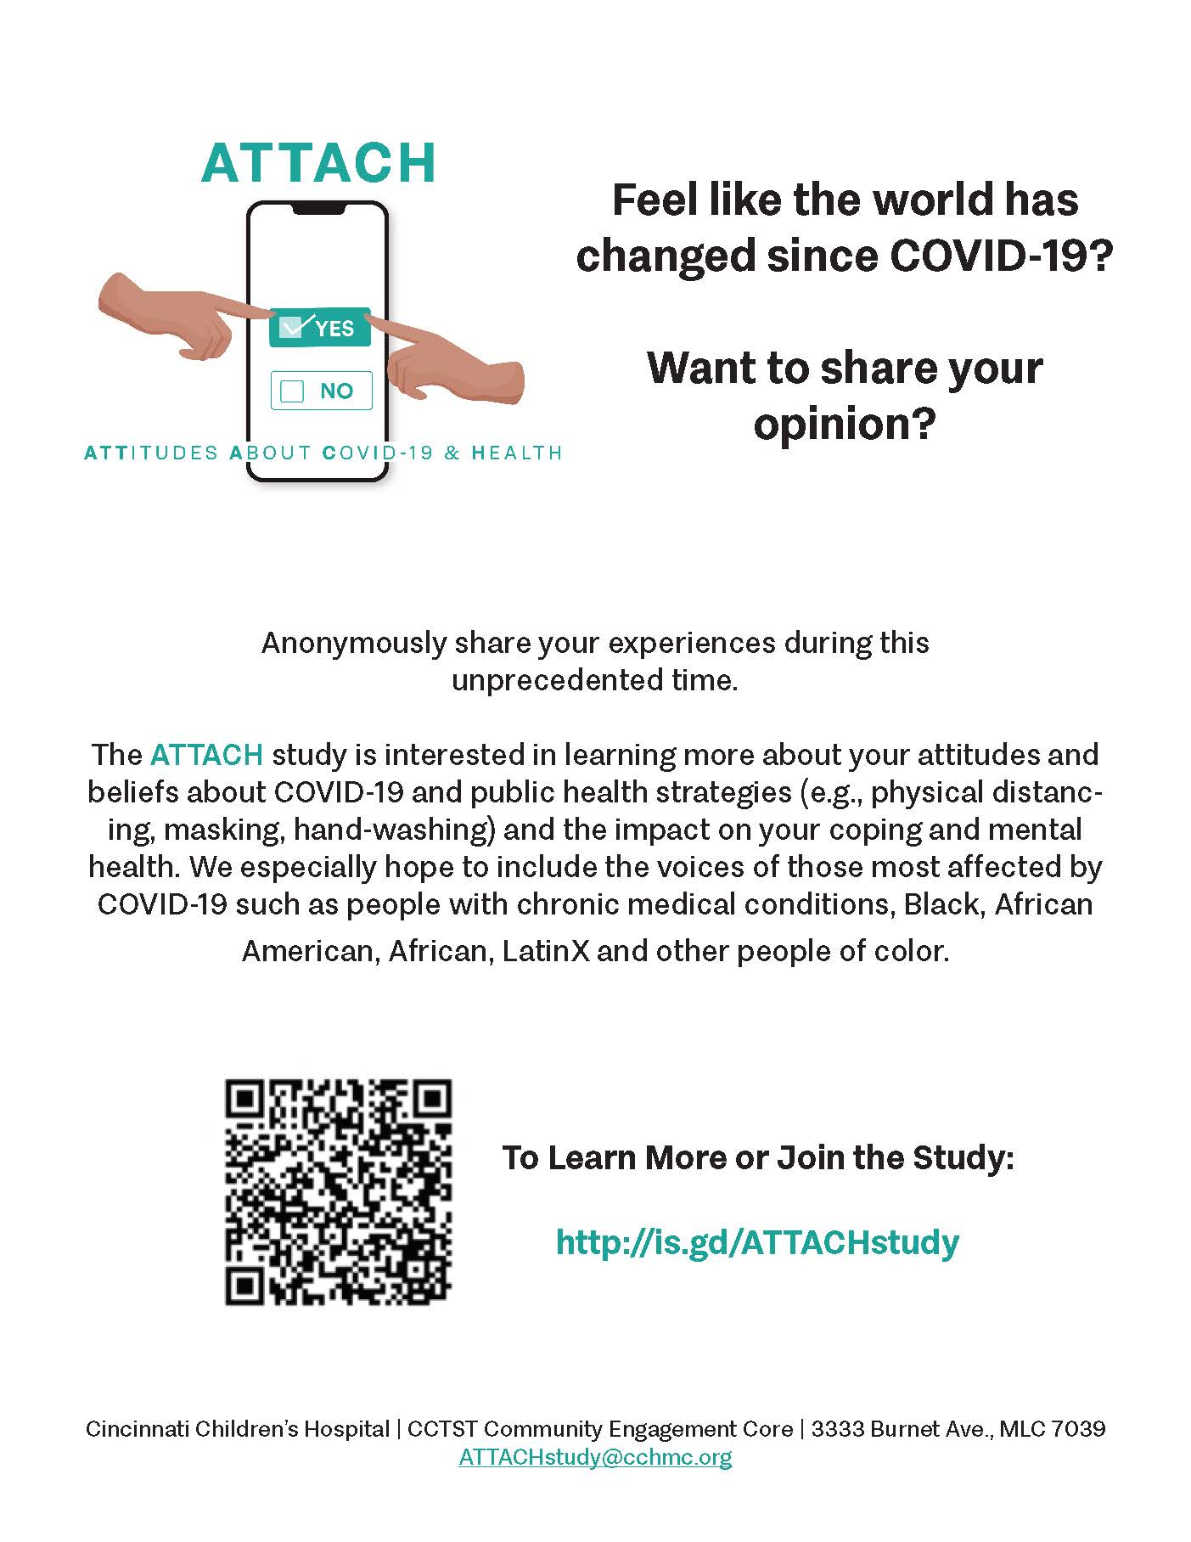
ATTACH Study
As you know the Black/African-American and LatinX voice with respect to COVID has not been as visible to county public health decision makers. We hope to change that with this study.
Our goal is to have people of color complete daily polls about their attitudes and beliefs that can bring this perspective to the table and identify any unmet needs.
We also hope to identify any mental health issues (difficulty coping, isolation) so we can advocate for more resources if possible.
Anyone who participates will be entered into a drawing for a $10 gift card if they give us their email. They don’t have to. They can remain anonymous. N=104

Slide 3
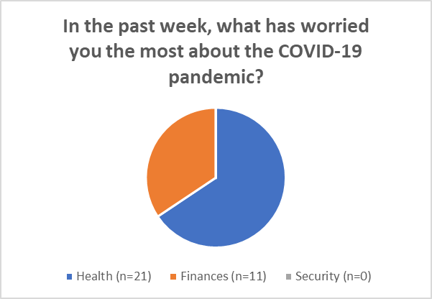
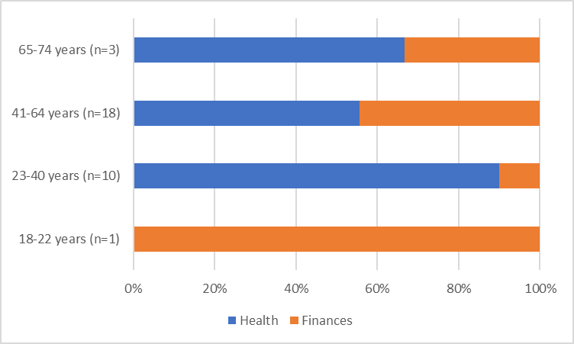
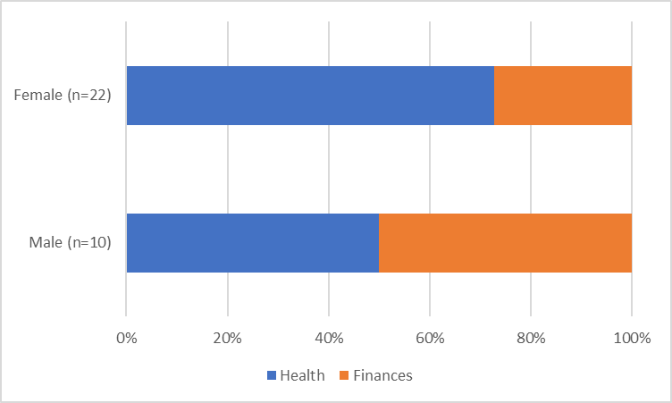
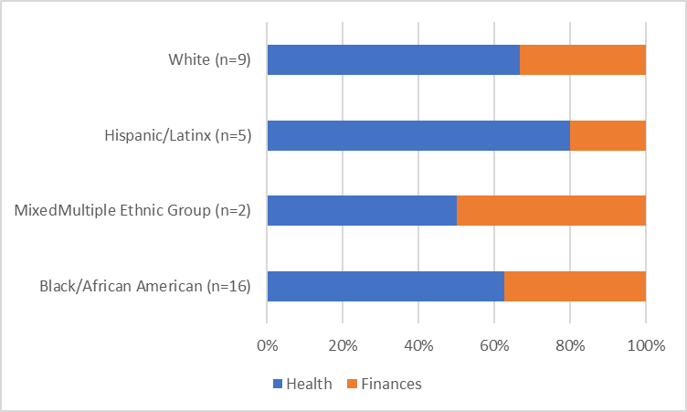

Slide 4
Surveys Completed
Anxiety (n=61)
Social Isolation/Loneliness (n=60)
PHQ-9 (n=60)
Resilience (n=60)
COVID-19 Perceptions (n=61)
COVID-19 Exposure* (n=8)

Slide 5
Plans for Phase 2
Stakeholder meetings
Review poll data
Resources
Targeted message
Continue recruitment
Review mental health data

Slide 6
ATTACH Study Stakeholder Video
COVID-19 Research and People of Color

