Slide 1
Five Dysfunctions of a Team: Symptoms, Assessment & Intervention
February 28, 2020
Megan Johnstone, PhD
Jack Kues, PhD
Rebecca Lee, PhD, RN
Notes:
First take a moment to introduce each other and say why we are the presenters. Be sure to go over what is in the packets and say there is no break but that people can go to the bathrooms (and where they are) anytime they want.

Slide 2
Recording
This workshop is being recorded in WebEx. The camera is focused on the podium and only your voice might be heard on the recording.
We will also take a few pictures during activities for promotional materials; please sign a release form or let us know if you have concerns.

Slide 3
Welcome! Who’s Here?
Notes:
Here are the scores from the assessment you took. For all scales, scores of 8-9 mean the dysfunctional is probably not an issue for your team. As score of six or seven, means the dysfunction COULD be an issue for your team. A score of 3-5 means the dysfunction needs to be addressed. Looking at the scores I see here, it looks like the teams you are on could all do with a some Team TLC. The goal of today’s sessions is to provide you with information to help you take on this task.

Slide 4
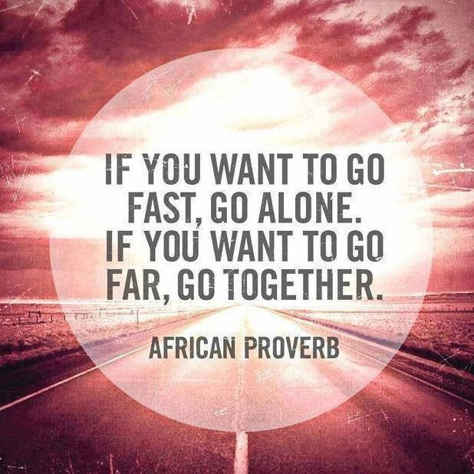
Introduction
Notes:
What makes a great team? How do you tell if a team you’re on is dysfunctional? Friendly does not always equal functional. Conflict does not always indicate dysfunction.
Consider a more "colorful" person/quote.

Slide 5
Pre-work: Your Experience in Teams
Notes:
What makes a great team? How do you tell if a team you’re on is dysfunctional? Friendly does not always equal functional. Conflict does not always indicate dysfunction.
Consider a more "colorful" person/quote.

Slide 6
Objectives
Understand the functions of a team
Apply tools to assess the functional levels of a team
Assess the need for, and value of, interventions to address team dysfunctions
Describe various types of interventions based on level of dysfunction

Slide 7
Functional Areas of Teams
Task Functions
Initiating
Information seeking
Information giving
Opinion seeking
Clarifying
Elaborating
Coordinating
Developing procedures
Summarizing
Maintenance (Team) Functions
Encouraging
Expressing feelings
Having fun
Compromising
Facilitating communication
Interpreting
Listening
Following
Declaring success
Notes:
Groups that are not high functioning teams are still perfectly able to complete tasks.

Slide 8
The Hierarchy of Challenges
Focusing on Results
Building Trust
Mastering Conflict
Achieving Commitment
Embracing
Accountability
Notes:
To be successful, teams have to master a number of challenges. Really, what I should say is “In order to BECOME a team a group of individuals must master a number of challenges. Many groups that we work with never actually get to the point where they are a functioning team. It could be an issue of TIME….each of these challenges take time……OR (next slide)

Slide 9
Results From Team Assessment Inventory
Notes:
Here are the scores from the assessment you took. For all scales, scores of 8-9 mean the dysfunctional is probably not an issue for your team. As score of six or seven, means the dysfunction COULD be an issue for your team. A score of 3-5 means the dysfunction needs to be addressed. Looking at the scores I see here, it looks like the teams you are on could all do with a some Team TLC. The goal of today’s sessions is to provide you with information to help you take on this task.

Slide 10
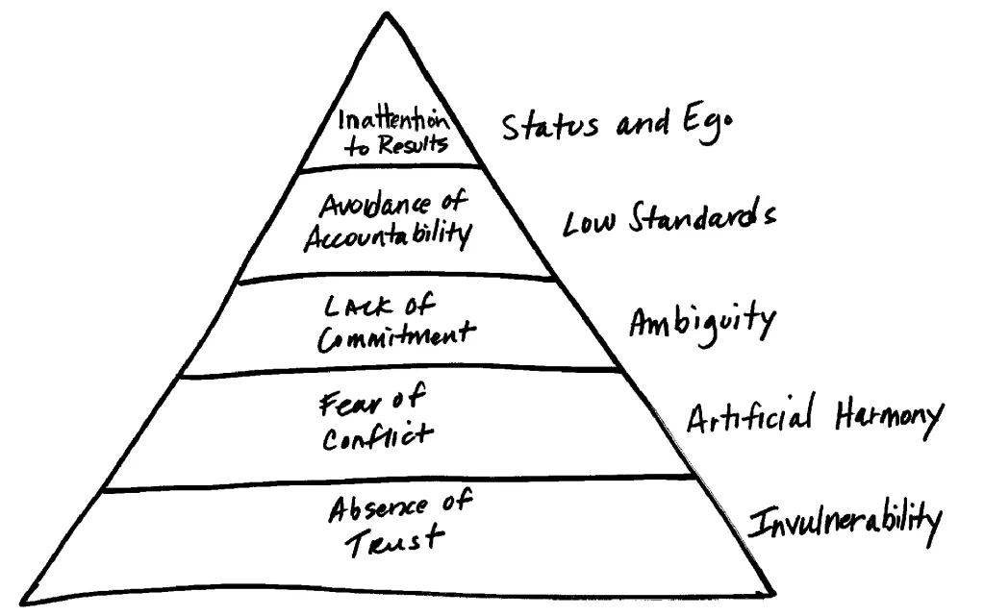
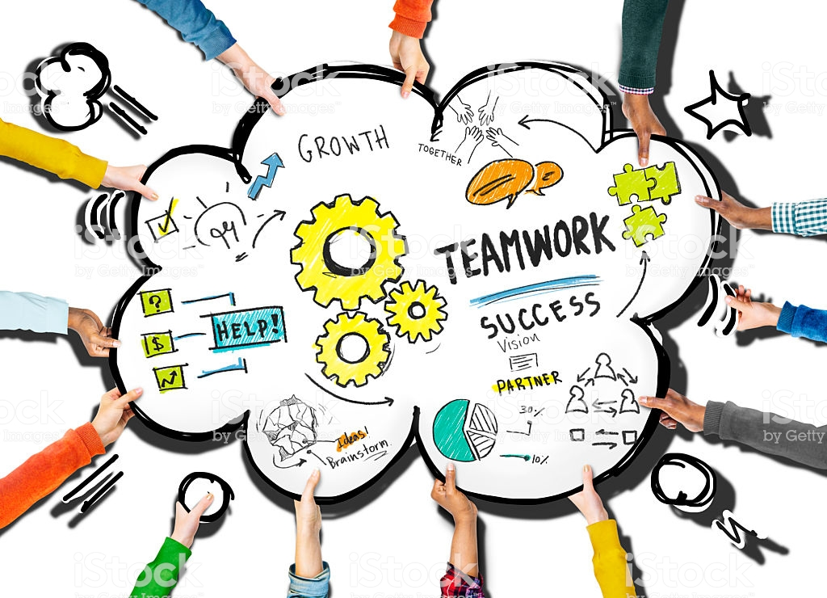
Understanding Assessment Intervention
The
Nature of Teams
Notes:
This is a model of how to address dysfunctions in a team.
You need to have a basic understanding of how teams function
You need to have the skills and tools to conduct an assessment of the team, its members, and its level of function
You need to develop and implement interventions that address the problems

Slide 11
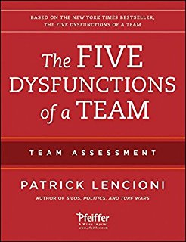
Focusing on Results
Building Trust
Mastering Conflict
Achieving Commitment
Embracing
Accountability
Notes:
…..it could be that the group gets stuck and becomes dysfunctional at one stage or another.
Pat Lencioni wrote this book in 2002. It’s one of the most popular books on teams. The book itself is written as a fable.
Unlike many of the gurus in this area, Lencioni is not an academician. He was born in 1965, grew up in Bakersfield, Ca., got a degree from Claremont McKenne College, and now lives with his wife and 4 sons in Alamo, California. This is the same school that graduated Robin Williams.
I’d like to go quickly through the 5 dysfunctions of a teams. We are going to spend quite a bit of time talking about each one of these. But first, let’s see if your own teams have any of these problems.
The use of a pyramid to describe these dysfunctions is important. Groups must address these issues from the bottom up. The purpose of todays introduction to Lencioni’s model is to give you some insight into groups……and teams to which you belong. Specifically we want to help you be able to assess and manage what is happening when you are working with others.

Slide 12
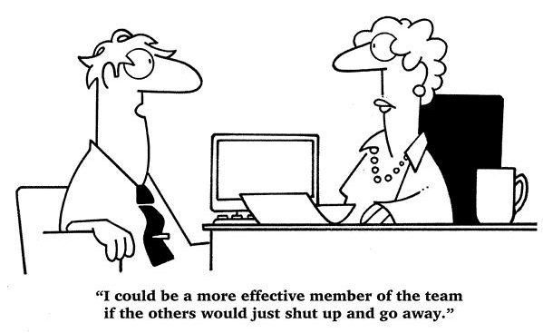
Tales from the Trenches: The Troubles We’ve Seen…
Notes:
Faculty begin with a couple of stories about problems they’ve experienced
Can you top this?
Invite attendees to tell their stories
Summarize the stories by pointing out how the problems are related to specific “dysfunctions” – could use a flip chart with categories listed, and then have someone from team recording problem depicted in story under the appropriate heading

Slide 13
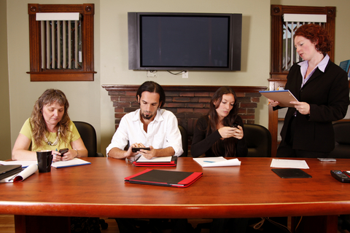
Some of My Favorite Dysfunctions
I’ll do it…..I’ll do it…..I’ll do it…..Sorry, I just can’t do it.
It won’t work!!!
Notes:
They want to do it….really, they do….. They, in fact, may be the BEST person to do it, but they’re too overcommitted…They’re embarrassed to tell you that they probably won’t be able to do it…..They hope that self-shaming with convince them to do it….and Finally….they have to admit to themselves and others that they just can’t do it.
No one is really THERE…..
The Judge……everyone is watching and waiting for the Judge to make a pronouncement about an idea or direction….

Slide 14
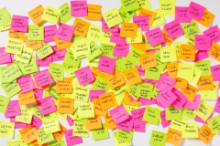
Tell us about your experiences with Team Dysfunction
Using the sticky notes at your table
Write down, in a few words:
Dysfunctions you have seen in teams
Problems you’ve experienced in teams
Stories you’ve heard about bad behavior in teams
Bad team outcomes
Other horror stories about teams
One thought, experience, story, per sticky

Slide 15
Tell us about your experiences with Team Dysfunction
Place your stickies on the wall next to the dysfunction that you believe it BEST represents
Inattention to Results
Avoidance of Accountability
Lack of Commitment
Fear of Conflict
Absence of Trust

Slide 16
Detailed instructions (not for display)
Stickies on table (different colors for different dysfunctions)
Dysfunctions on the board or on the wall (in pyramid shape with colors).
Participants write down their dysfunctions and attempt to place them on the pyramid(s?).
Read a couple of examples from each dysfunction.

Slide 17
Exercise follow-up discussion (Less than 10 Min)
Discuss distribution of stickies
Which dysfunctional areas had the most?
Which dysfunctional areas had the least?
Types of problems seen in each
Think of causes of problems at higher levels
Root cause analysis
Problems as they relate to functional areas of a team

Slide 18
Why Do a Team Assessment?
To strengthen a team that is having problems
To get a new team started right
To help a team grow
To prevent problems from arising
When team membership turns over
To bond teams in situations such as remote teams and startups
Before a major strategic shift or campaign toward a big goal
As part of ongoing team development to establish baseline then compare at intervals
Notes:
Also get rid of this one?

Slide 19
Assessment Tools
Name of Tool | Source | Domains | # of Items | Comments
Team Effectiveness Questionnaire | London Leadership Academy | Purpose and goals Roles Team processes Team relationships Intergroup relations Problem solving Passion and commitment Skills and learning | 56 | Takes a fair amount of time to fill out. Designed to help leaders assess their teams.
Team Effectiveness Survey | Bens, Ingrid (2005). Facilitating with Ease. | Does not appear to have separate domains | 17 | Short. Items can be analyzed individually.
The Five Dysfunctions of a Team – Team Assessment | Lencioni, Patrick (2012). | Trust Accountability Commitment Conflict Trust | 38 | This is a proprietary instrument linked to Lencioni’s training programs. Extensive interpretation scheme.
Notes:
Grid of tools available with primary goal of each, who they’re meant for, etc (Jack to create)
I think we’re getting rid of this slide – maybe include in handouts?

Slide 20
Be careful with “Quick Fixes” !

Slide 21
Symptoms and Diagnosis
Team Exhibits These Symptoms
Conceal weaknesses & mistakes, hesitate to ask for help
Jump to conclusions about intentions
Main Issue:
Shared Situational Awareness
Trust
Notes:
There’s nothing like experience to bring home a point. Angela to recreate.

Slide 22
Symptoms and Diagnosis
Team Exhibits These Symptoms
Back-channel politics and personal attacks thrive
Waste time and energy with posturing
Main Issue:
Communication
Conflict
Trust
Notes:
There’s nothing like experience to bring home a point. Angela to recreate.

Slide 23
Symptoms and Diagnosis
Team Exhibits These Symptoms
Revisit discussion and decisions
Ambiguity about direction and priorities
Main Issue:
Clear Command Instruction
Commitment
Conflict
Trust
Notes:
There’s nothing like experience to bring home a point. Angela to recreate.

Slide 24
Symptoms and Diagnosis
Team Exhibits These Symptoms
Misses deadlines and key deliverables
Mediocre performance
Main Issue:
Shared Experience
Accountability
Commitment
Conflict
Trust
Notes:
There’s nothing like experience to bring home a point. Angela to recreate.

Slide 25
Symptoms and Diagnosis
Team Exhibits These Symptoms
Stagnates or fails to grow.
Avoids Obstacles and individuals goal focus.
Main Issue:
Shared Values
Trust
Conflict
Commitment
Accountability
Results
Notes:
There’s nothing like experience to bring home a point. Angela to recreate.

Slide 26
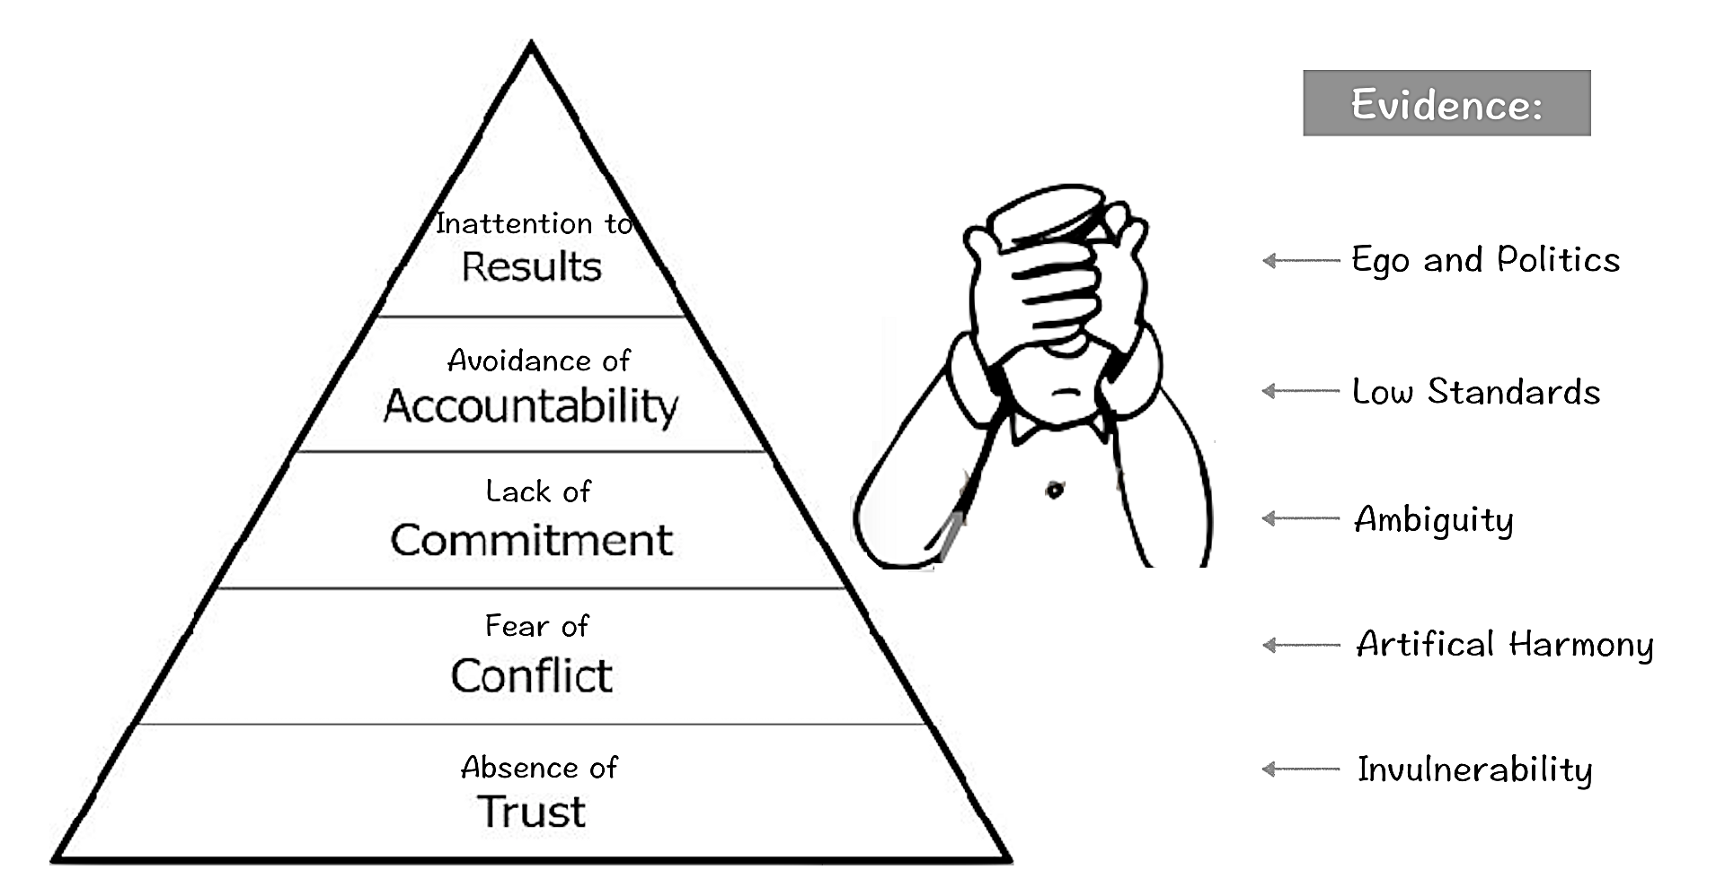
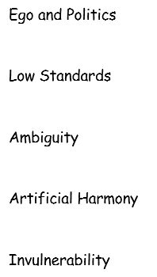
Team Dysfunction Causes and Results
Notes:
Result and Cause
Remove or recreate a bit?

Slide 27
Addressing Dysfunction from the Ground Up
Focusing on Results
Building Trust
Mastering Conflict
Achieving Commitment
Embracing
Accountability
Notes:
Jack's last slide
…..it could be that the group gets stuck and becomes dysfunctional at one stage or another.
Pat Lencioni wrote this book in 2002. It’s one of the most popular books on teams. The book itself is written as a fable.
Unlike many of the gurus in this area, Lencioni is not an academician. He was born in 1965, grew up in Bakersfield, Ca., got a degree from Claremont McKenne College, and now lives with his wife and 4 sons in Alamo, California. This is the same school that graduated Robin Williams.
I’d like to go quickly through the 5 dysfunctions of a teams. We are going to spend quite a bit of time talking about each one of these. But first, let’s see if your own teams have any of these problems.
The use of a pyramid to describe these dysfunctions is important. Groups must address these issues from the bottom up. The purpose of todays introduction to Lencioni’s model is to give you some insight into groups……and teams to which you belong. Specifically we want to help you be able to assess and manage what is happening when you are working with others.

Slide 28
Absence of Trust
Notes:
Becky starts here.
The base of the pyramid is all about trust. Do you trust the members of your team?

Slide 29
Absence of Trust
Team members afraid to ask for help
Mistakes are hidden
Skills and experience not shared
Jump to conclusions about the intentions and aptitudes of others
Notes:
Absence of Trust means being afraid to admit any weaknesses, faults or mistakes, not being honest with other people on your team about your capabilities or need for help. People who aren’t afraid to admit the truth about themselves are less likely to act invulnerable and engage in politically motivated behavior that wastes the team’s time and energy

Slide 30
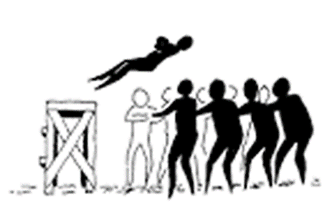
Teams who Trust
“Teamwork begins by building trust. And the only way to do that is to overcome our need for invulnerability." –Patrick Lencioni
Are honest about their abilities
Not afraid to say they were wrong about something
Feel comfortable asking for help
Not afraid to say, “I’m sorry”
Notes:
No quality or characteristic is more important than having a basis of trust in your team members. It is a willingness to be open and vulnerable within the group. Trust sits at the bottom of the pyramid because it is the basis for all the other functions of a great team. Those without trust can fail to recognize and tap into one another’s skills and experiences and that means that great ideas are not being generated and abilities are not being used. To establish real trust a person must be willing to take risks without guarantee of success starting with the leader.

Slide 31
Table Activity: Building Trust
Connect as humans:
Tell something about yourself that may surprise others
Discuss the responses of the table members, noting similarities and differences of experiences
Notes:
Absence of trust looks like a group of individuals rather than a team working together
People work in silos without the support of others on the team
We can build trust by learning to be vulnerable with each other about our capabilities and our need for help. How many of you have engaged in some type of ice breaker activity at the first meeting of a new group? Did you know why (besides entertainment)? In the first small group activity, you going to get to know the people at your table. You’ll have about 8-10 minutes to complete this activity, and then we’ll all discuss what you found. LARGE GROUP WILL RUN 2-5 MINUTES: What were some commonalities you found among group members? Differences? Anything that surprised you?
Develop different questions to model building trust, also offer different tools or techniques.

Slide 32
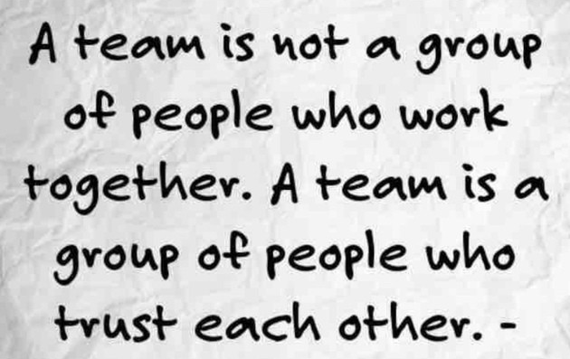
Trust Take-Home Ideas
It’s not about who you are, it’s about who you are together.
Why do we have the meeting after the meeting?

Slide 33
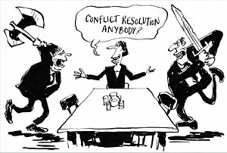
Fear of Conflict
Notes:
Raise your hand if you love conflict. Many people have an actual fear of conflict. They will go out of their way to avoid it and a team lacking in trust will be afraid to engage in healthy conflict. Lack of trust, fear of even healthy conflict, create environments where back-stabbing, out-of-meeting personal attacks thrive. For example, generating ideas to get your projects going at the beginning is critical. But what if you can’t tell someone, “I don’t think your idea is very good and here’s why…”? If there is not healthy conflict in a group, you ignore controversial topics that are critical to team success, Fail to tap into all the opinions and perspectives of team members and you have no buy in.

Slide 34
Fear of Conflict
The meeting-after-the-meeting to vent
Arguments make people uncomfortable
Fear of hurting someone’s feelings
Notes:
What are some symptoms that suggest underlying fear of conflict?

Slide 35
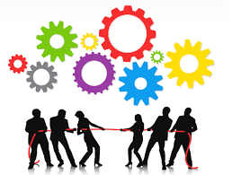
Teams that Master Conflict
Agree on how to handle conflict
Accept that some have skills others don’t have
Are not afraid to disagree, challenge and question one another
Don’t go behind each other’s back
Get ideas from all the members
Don’t play politics
Notes:
Have lively, interesting meetings, you can accept that this person on the team has a skill that you don’t have or another member has a better method of getting where you’re going than you do. You get ideas about the project from all the members. And you solve problems and discuss critical topics for success quickly, not behind someone’s back or have to figure out a workaround.

Slide 36
Table Activity: Mastering Conflict
Setting Conflict Management Norms:
Each person should write down their preferences for acceptable & unacceptable behaviors around discussions & debates (e.g., tone of voice, use of language, participation, etc.)
After sharing, develop a list of no more than 5 items that represent the team’s idea of productive discussion
At completion of the activity, we’ll share some of your rules of engagement
Notes:
Many teams ignore conflict and just continue to go in the wrong direction. Teams who don’t handle conflict in a healthy way do not reach their fullest potential. Teams can handle conflict in a healthy way by engaging in discussion with all team members. Teams can handle conflict by having a leader willing to say, “I think we’re going in the wrong direction. Or just I was wrong.”
One strategy for proactively addressing fear of conflict is to decide on a set of rules for how you will handle conflict on your team. FOR ACTIVITY 2, YOU’LL TAKE THE NEXT 8-10 MINUTES TO WORK AT YOUR TABLES TO DRAFT A DOCUMENT LISTING SOME GOOD RULES FOR CONFLICT MANAGEMENT ON TEAMS. ONCE YOU’RE DONE, WE’LL TAKE A FEW MINUTES AS A LARGE GROUP TO SHARE. Note: as teams evolve, this list should be revisited!
Use Megan’s framework as a foundation?

Slide 37
Conflict Take-Home Ideas
Challenge the idea, not the person.
If everyone is on the same page at the beginning, it’s probably not going to be a very interesting story.
Agreement is the destination, debate and discussion pave the road.
Assume positive intent.
Aim for “social, intellectual, and professional” integration of all members of the team.
Express appreciation every time you feel it; the more you express it, the more you feel it, and the more it comes back around.

Slide 38
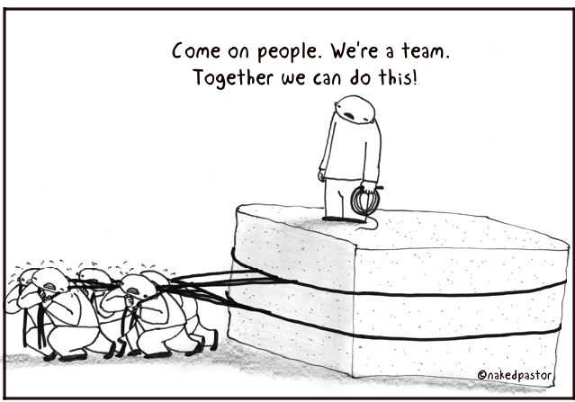
Lack of Commitment
Notes:
The lack of clarity or buy-in prevents team members from making decisions they will stick to. Yogi Berra once said, “If you don’t know where your’re going, you’ll end up someplace else!”
Lack of commitment- How many of you have experienced this problem on a team? From other team members? Be honest – yourself? If you have no trust and you’re working on a project that’s not very good or worse you think isn’t going to work because everyone was afraid to be honest and you end up with lack of commitment in the team project. Lack of commitment means people aren’t going to work to their full potential.

Slide 39
Lack of Commitment
Members are confused about purpose
Afraid to take wrong action
Second guess each other
Keep discussing the same issues
Notes:
What are some symptoms we might see that reflect a lack of commitment?

Slide 40
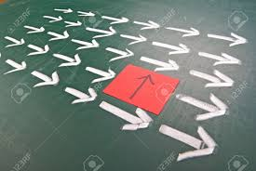
Teams that Achieve Commitment…
Know where they are going
Learn from their mistakes
Move forward
Get there first
Notes:
Teams that are committed have a direction, know their priorities, understand the objective and goal and where they are headed. They learn from mistakes and move forward but if they find a better opportunity they are willing to at least discuss a change in direction without feeling hesitant to bring it up or feel guilty over discussing behind someone’s back. With these characteristics they have genuine buy-in from all the members.

Slide 41
Strategies for Building Commitment
Establishment of a common goal
Intent is to provide the team with a common sense of purpose
Organizational clarification
Intent is to clarify team direction
Clarification of team principles
Intent is to create a set of norms for managing the life of the team:
e.g., meeting structure & schedule, preferred method(s) of communication, etc.
Notes:
There are many strategies that you can use, and perhaps have used, on your teams to Create Commitment. Team discussions should be held early and often around: establishing (and being reminded of) a common team goal; clarifying team direction; and

Slide 42
Table Activity: Achieving Commitment
What symptoms of lack of team commitment have you observed on your past or current teams? Create a list at your table.
Choose a strategy (treatment) from the list provided (or come up with your own), to address a symptom you listed.
Notes:
For your next table activity, you’ll have 8-10 minutes to discuss symptoms of lack of commitment you’ve seen in other team members, or experienced yourself. Match these with a strategy that would help address, either one from the list provided, or one you’ve had success with in the past! Then we’ll share as a large group (2-5 minutes)
Getting the job done. Doing what it takes. Not giving up. Seeing things through to the end.
Missing deadlines, false consensus during meetings – “the meeting after the meeting”, something else is always a priority
3. Give all team members a chance to he heard – this included emotional and task oriented information. Built trust and allow conflict. You want people to be able to buy-in, to commit, even if they don’t agree with a decision. Make sure everyone is on the same page about the ultimate purpose of the team. Be explicit about worse case scenarios. Leaders can help by pulling out all of the ideas a team can generate. Co-creation. Open conversation.
Add Megan’s four point strategy.

Slide 43
Commitment Take-Home Ideas
You have to know where you are going before you start your trip.
Make sure your team is traveling together.
It may not be a lack of commitment, it may be a lack of direction.

Slide 44
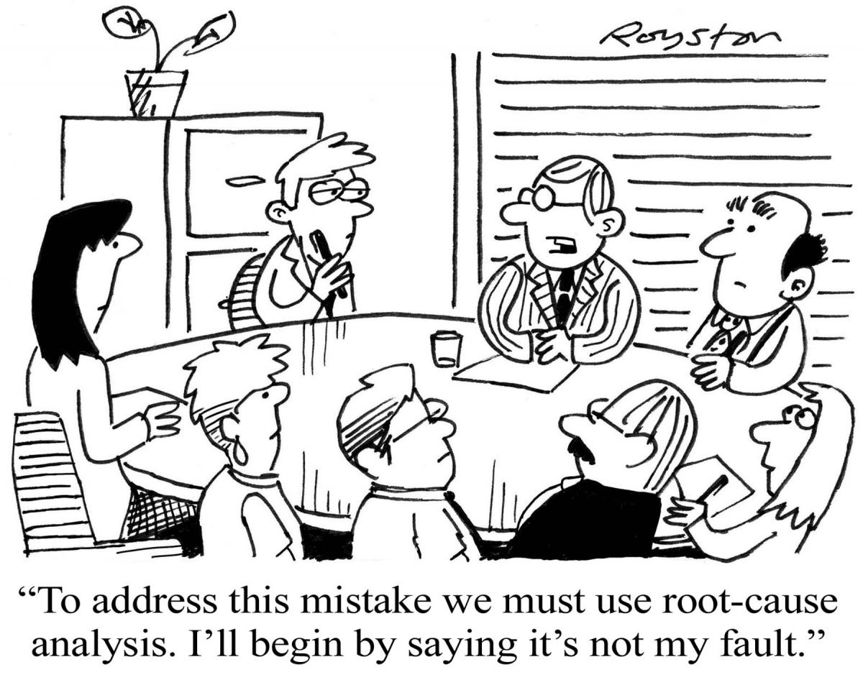
Avoidance of Accountability
Notes:
The need to avoid interpersonal discomfort prevents team members from holding one another accountable. Some team members have difficulty holding themselves accountable!

Slide 45
Avoidance of Accountability
Some members coast
Team achieves uninspired outcomes
The project drags out
One person does all the work
Notes:
What does avoidance of accountability look like? (go over symptom list), and ask for others. They have to be able to call peers out on performance or behaviors that may harm the team. The irony of holding back on this out of fear of discomfort is that eroding performance actually creates more resentment between people.
If you have no trust and there’s unhealthy conflict where people don’t feel they can say what they want to say it creates resentment among team members who have different standards of performance, it encourages mediocrity, members miss deadlines on key deliverables.

Slide 46
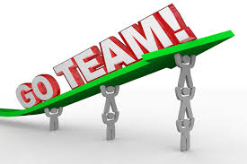
Teams that Embrace Accountability
Hold each other to standards for behavior and results
Give constructive feedback
Respect each other
Notes:
Once there is a clear sense of what is expected, teammates are enabled to hold one another accountable.

Slide 47
Table Activity: Embracing Accountability
Team Effectiveness Exercise
For each person in the group, respond to the following question about their team members:
What is the single most important behavioral characteristic demonstrated by this person that contributes to the team’s strength?
For higher functioning teams:
What is one behavior or characteristic demonstrated by a team member that can sometimes obstruct team progress?
Notes:
For your next table activity, you’ll spend about the next 8-10 minutes reviewing one strategy that can be used to promote accountability among team members: Team Effectiveness Exercise. LARGE GROUP: Share both positive and negative behaviors or characteristics you’ve encountered on previous teams that impacted team performance.
Responsibility to deliver on a commitment. It is initiative and follow through. Not taking blame.
2. Peer pressure, direct peer to peer feedback. Team leader.
3. Clear expectations and the right person doing the right job (capability), clear measurement, feed back, and consequences. Bad ways: Micromanagement, blame and shame, holding only part of the team accountable, severely punish mistakes.
Refine language to make directions clear. (Add slide about constructive/destructive behaviors to help them get started)

Slide 48
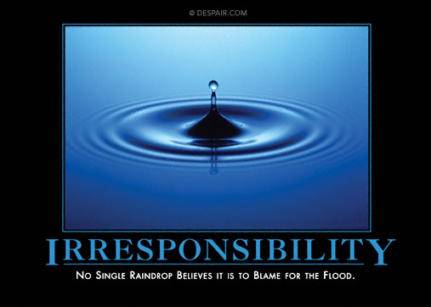
Accountability Take-Home Ideas
Model vulnerability to create a culture of accountability
Notes:
Becky to choose the ones she wants to present.

Slide 49
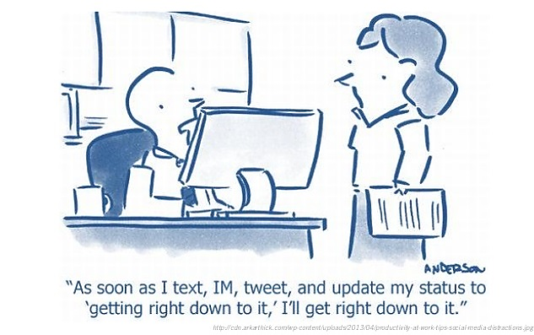
Inattention to Results
Notes:
Have you ever been a member of a team that doesn’t focus on results? Or maybe there were one or two individuals who lost their focus? Let’s face it, we are all BUSY PEOPLE with lots of competing demands! However, what’s the hallmark of a successful team? They achieve results!

Slide 50
Inattention to Results
Get nothing accomplished
Work on the wrong things
Lose star performers
Team members take care of themselves
Notes:
What are some of the symptoms of a team that’s not focusing on results? Poorly defined goals, no shared data to track progress. Also, ego, career development, competing priorities.
Without accountability, people will gravitate toward their own personal goals at the expense of the collective goals of the team.
The pursuit of individual goals and personal status erodes the focus on collective success.
It’s an avalanche, no trust, unhealthy conflict, a lack of commitment to the project so I don’t feel accountable and guess what? I don’t really care anymore about the results. the project stagnates/fails to grow, loses achievement-oriented employees. Encourages team members to focus on individual goals rather than the good of the team.

Slide 51
Teams that Focus on Collective Results….
Get things done!
Stay focused
Keep star performers
Take care of each other
Notes:
So what does a team that’s focused on results look like? When a team focuses on collective results and minimizes individualistic behavior, everyone is accountable, everyone enjoys the success and or feels the failure if things don’t work out with your project. But the idea behind collective results is there is a team goal that you are all working towards. And it needs to be objective. We will have invented a better walking wheelchair prototype. Things to watch out for: EGO-its in the heart of every member of the team remember in your own way you’re all smart and talented and innovative-that’s why you’re on the team. So you have to keep that team goal in front of you.

Slide 52
Large Group Discussion: Focusing on Results
Notes:
For our final activity, instead of working at your tables, let’s talk as a group about how to focus a team, and keep them focused on results. I’ve listed one potential intervention (go over). Now we’d like to hear from you about other strategies you’ve used on your previous or current team to keep everyone’s eye on the prize.
Trust building so members could share their needs. Goal definition. Score card that focuses on the collective progress of the team.
How can we reward behaviors that focus on team results?
*Note – we can pull score card development into the leadership workshop*

Slide 53
One potential intervention to focus on results:
Clarify a common goal for your team
Discuss & agree upon several objectives that must be accomplished in order to achieve the goal
Create a timeline for expected deliverables, including who is responsible
Set up a team dashboard to track progress toward your goal! Update the team regularly.

Slide 54
Attention to Results Take-Home Comments

Slide 55
Functional Teams
Building Trust
Mastering Conflict
Achieving Commitment
Embracing
Accountability
Focusing on Results
Notes:
If you turn the five dysfunctions around, you will find yourself with a highly functional team. (Read off all five). Recognize where these come from?

Slide 56
Final Thoughts
Effective Teams:
Turn common dysfunctions into strengths
Any thoughts about how you will be able to apply these skills to your teams?

Slide 57
Citations
Lencioni P. The Five Dysfunctions of a Team. San Francisco, CA: Jossey-Bass; 2002.
Lencioni P. Overcoming the Five Dysfunctions of a Team. San Francisco, CA: Jossey-Bass; 2005.
Scholtes PR, Joiner BL, Streibel BJ. The Team Handbook. 3rd ed. Edison, NJ: Oriel Stat A Matrix; 2010.

Slide 58
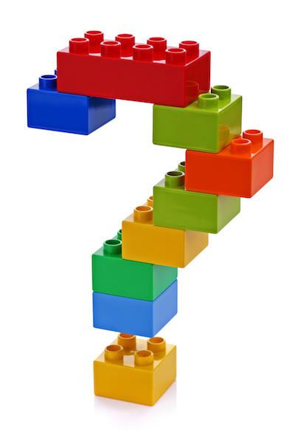
Questions

Slide 59
More Team Science Resources
CCTST CIS Website: cctst.org/programs/CIS
National Cancer Institute (NCI) Team Science Toolkit: ​
https://www.teamsciencetoolkit.cancer.gov/public/Home.aspx ​
Northwestern University Clinical & Translational Sciences Institute: ​
http://www.teamscience.net ​
Four learning modules about Team Science (simulations) ​
The Science of Team Science​
Team Science Research Process in Behavioral Science​
Team Science Research Process in Basic Medical Science​
Team Science Research Process in Clinical Medical Science ​

